Slide 1
OASIS BDXR Business Document Envelope
Martin Forsberg

Slide 2
BDXR Business Document Envelope
The OASIS Business Document Envelope specifies an XML vocabulary expressing in machine-processable syntax the semantics of enveloping a payload of content with information about that content.
Highly influenced by the work from CEN/WS BII Messaging Envelope requirements
Covers most of the SBDH-functionality that has been found useful/required in CEN/WS BII and PEPPOL

Slide 3
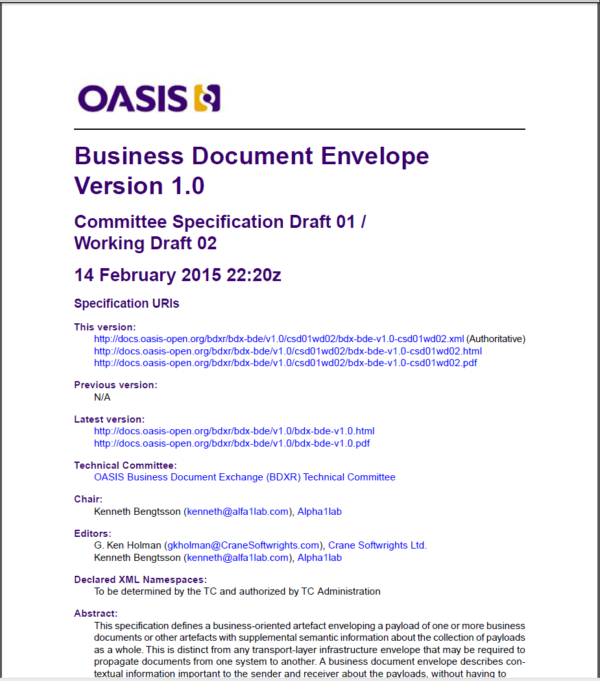
Current status
Committee specification draft
Open for further input

Slide 4
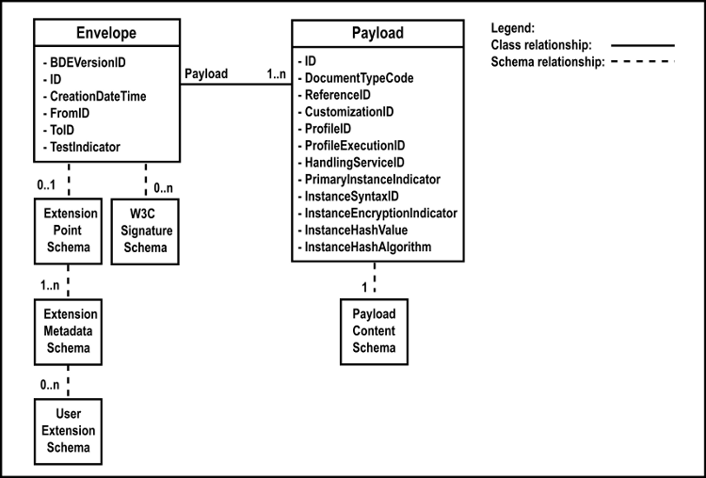
Business Document Envelope model
Model based on CCTS
Using the same approach as UBL

Slide 5
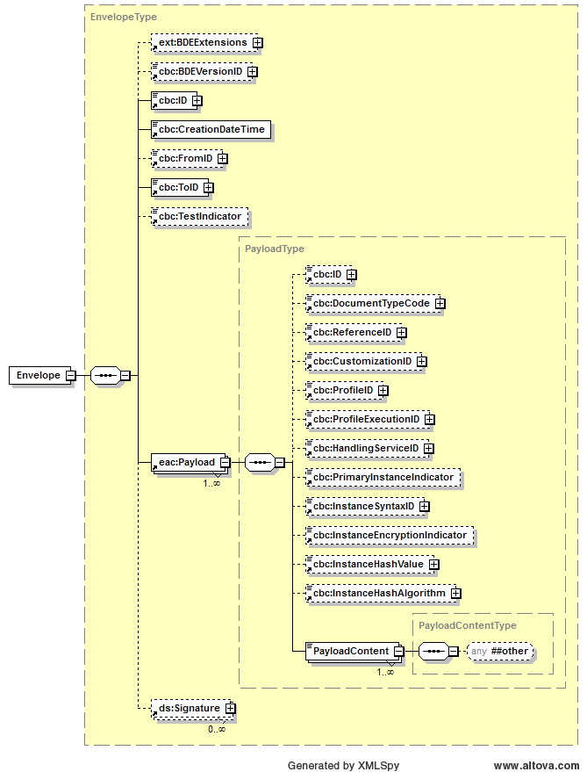
Draft schema
Created using UBL NDR
Using xsd:other for the payload

Slide 6
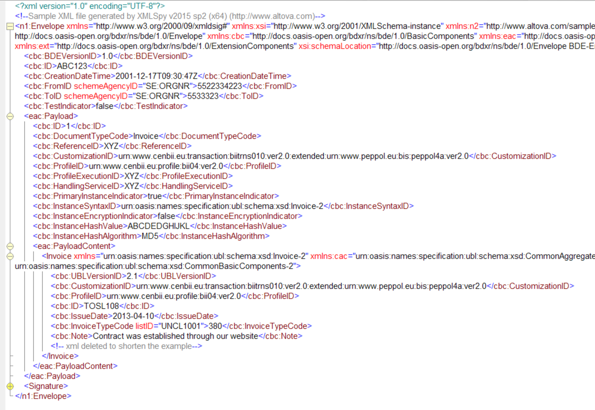
Sample instance

Slide 7
Use of signatures
Question raised by Ken Holman
We could choose the UBL approach of using the BDE extension point as a home for digital signatures. This makes our BDE document CCTS-pure, with every child of the document element being CCTS-modeled and non-CCTS signatures under the extension point. But it requires the signature tool to know about BDE in order to create the extension point scaffolding in which to place the signature.
Or we could continue with the approach I've drafted into CSD01WD02 where digital signatures are tacked on the end of the document breaking the "only CCTS rule" for children of the document element. But users may be able to use off-the-shelf signature tools that can tack on signatures to the end of the document element because that software would need know nothing about BDE.

