Slide 1
Cyber Threat Information Sharing
CYBER(16)006022
New developments
Tony Rutkowski, mailto:tony@yaanatech.com
08 Feb 2016
Copyright © Yaana Technologies LLC 2016

Slide 2
Major developments
EU NIS (Network Information Security) Directive (18 Dec 2015)
EU Commission and United States new framework for transatlantic data flows (2 Feb 2016)
Cybersecurity Information sharing act of 2015 (18 Dec 2015)
Department of Homeland Security (DHS) Enhanced Cybersecurity Services (ECS) program
US Executive Order 13691 - Promoting Private Sector Cybersecurity Information Sharing
OASIS Cyber Threat Intelligence Technical Committee
Center for Internet Security/ETSI Critical Security Controls for Effective Cyber Defence
Other initiatives
3GPP
IETF
2

Slide 3
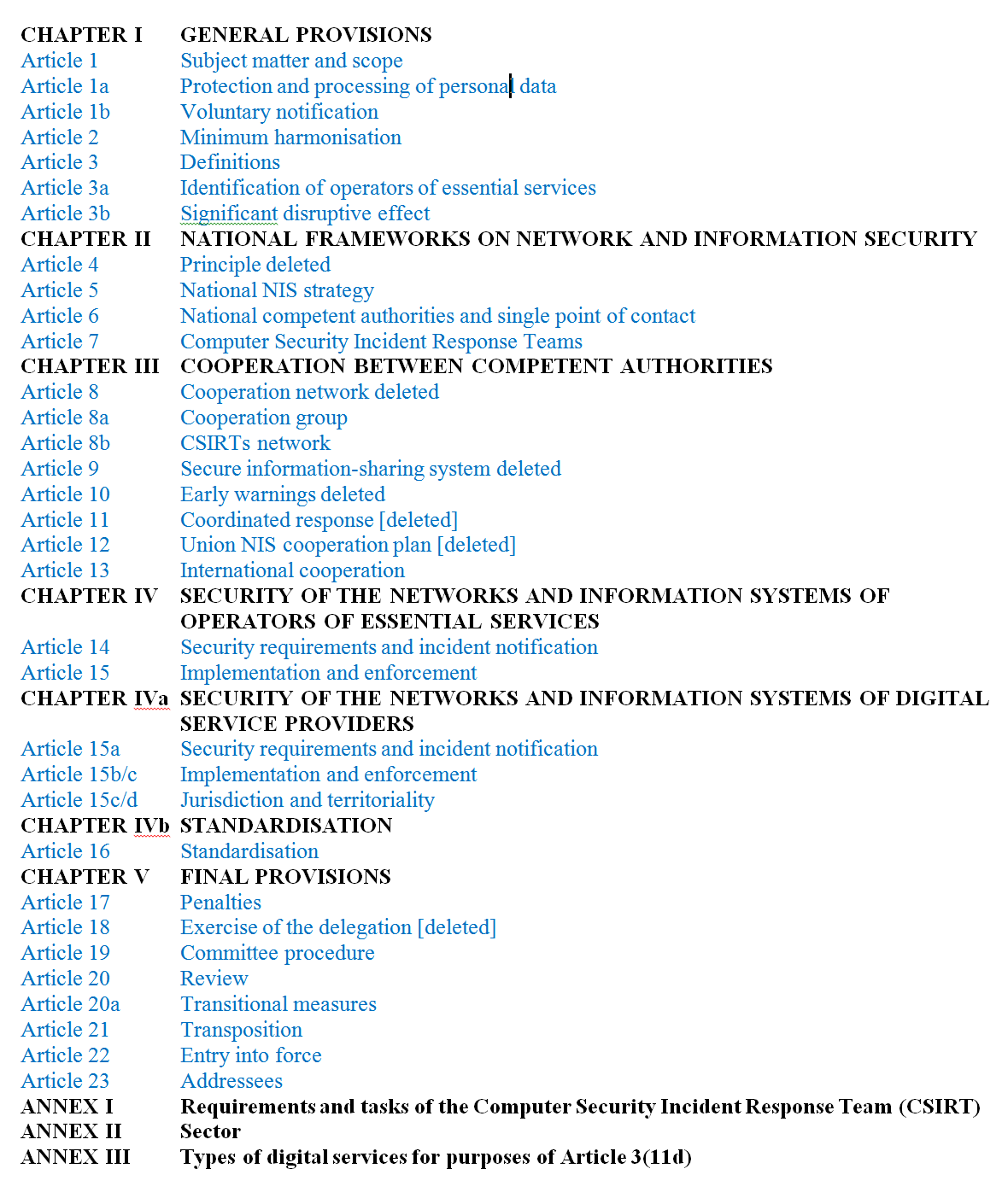
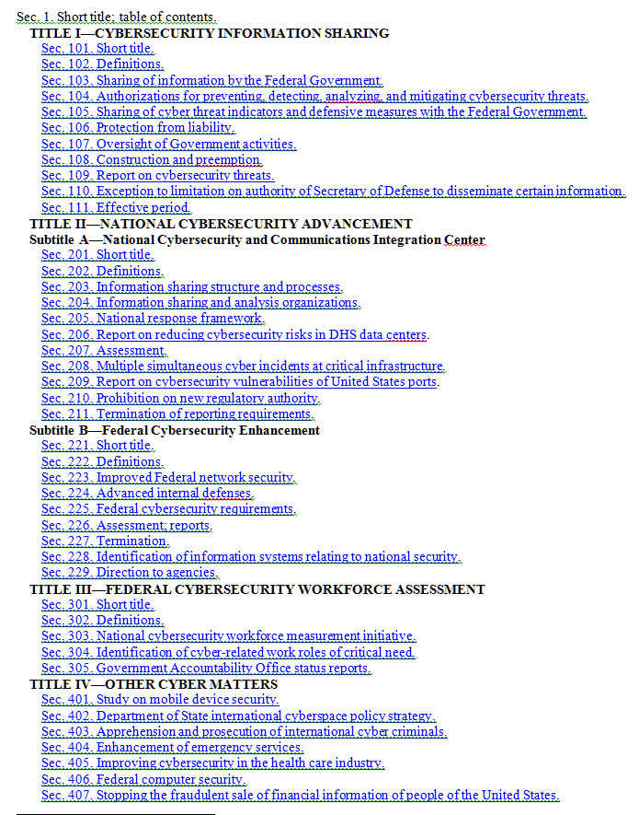
Legislative requirements
EU NIS Directive
U.S. Cybersecurity Act

Slide 4
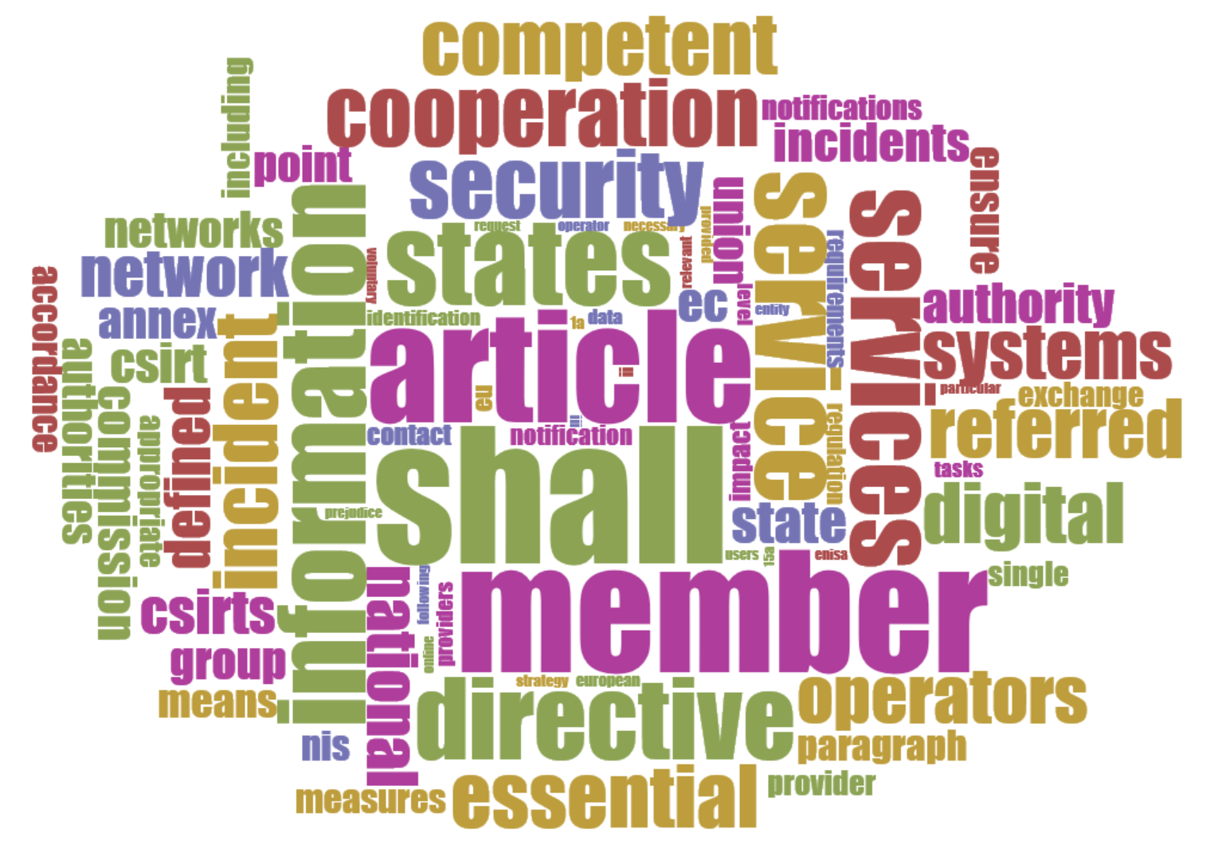
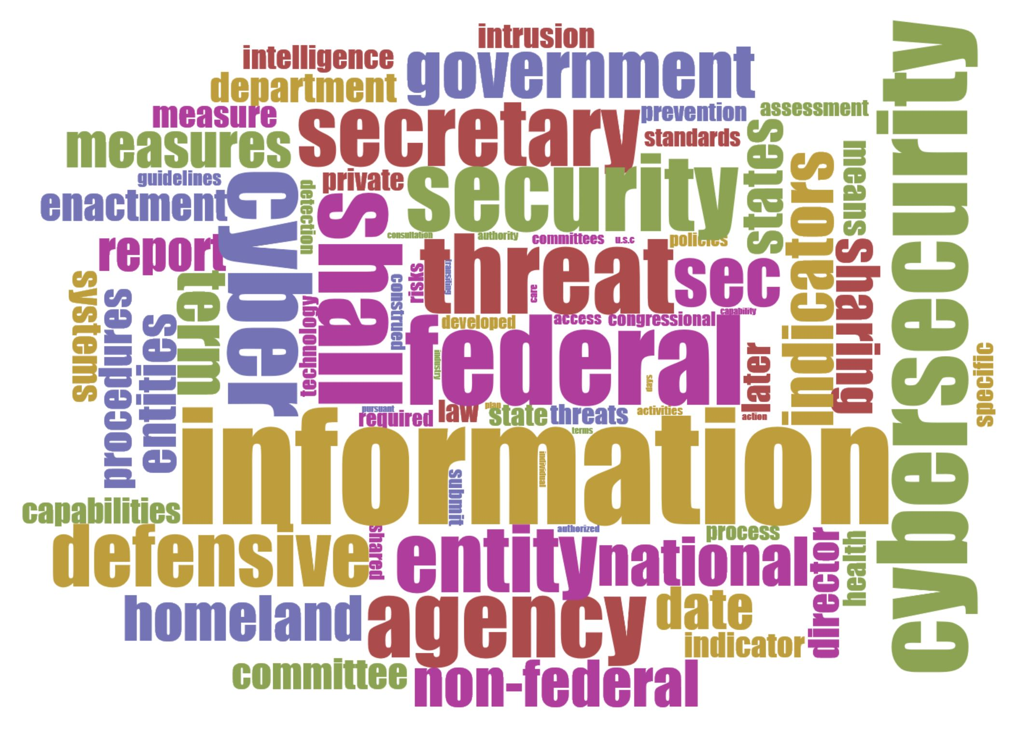
Comparable objectives
EU NIS Directive
U.S. Cybersecurity Act
Cirrus Word Cloud Display
4

Slide 5
EU NIS Directive Entity Ontology
European Union
Public or Private Entity
Operators of Essential Services pursuant to Art. 14 2 and 2ac + Annex II
Digital Service Providers Pursuant to Art. 15a 2 + Annex III
public Electronic communication networks or publicly available electronic communication service providers under EU DIRECTIVE 2002/21/EC
European Commission
European Network and Information Security Agency
Cooperation Group
Network and Information Security Committee
Member State
1. Energy
2. Transport
3. Banking
4. Financial market infrastructures
5. Health sector
6. Drinking water supply and distribution
7. Digital Infrastructure
Online marketplace
Online search engine
Cloud computing service
Competent Authority
Computer Security Incident Response Team
Trust service providers under
Representative for a Digital Service Provider
Third Party
Qualified Auditor
Public
Others not identified
Micro and Small Enterprises
= excluded from the Directive
5

Slide 6
Cybersecurity Act of 2015 Entity Ontology
Federal entity
non-Federal entity
Appropriate Federal entity
private entity
103(a) entities
[Sector-Specific] ISAC - Information Sharing and Analysis Center
sector coordinating councils
owners and operators of critical information systems
other appropriate non-Federal partners
DNI – Office of the Director of National Intelligence
DOD - Department of Defense
DOJ - Department of Justice
DHS - Department of Homeland Security
NSA – National Security Agency
NCCIC - National Cybersecurity and Communications Integration Center
voluntary information sharing relationship “
other determined by the Secretary
ISAO -Information Sharing and Analysis Organization
collaborates with State and local governments
Intelligence Community ¹
- Department of Treasury
DOE - Department of Energy
DOC - Department of commerce/NIST
State, tribal, or local government
DOS - Department of State
OMB – Office of Management and the Budget
HHT – Department of Health and Human Services
GAO – Government Accounting Office
International partners
Foreign power
Notes:
¹ See 50 U.S. Code § 3003(4)
* No definition
6

Slide 7
EU NIS Directive architecture & interfaces
Essential Services Providers
ESP-CA/CSIRT
CA/CSIRT-CA/CSIRT
^{Other Members}
Competent Authority or Computer Security Incident Response Team
CA/ CSIRT
Monitor & defend information system
Privacy processing*
defensive measures
cyber security risks
incidents
CA/ CSIRT
Required
Digital Service Providers [or Representative]
DSP-CA/CSIRT
Monitor & defend information system
Privacy processing*
CA/CSIRT-CA/CSIRT
^{Other Members}
CA/ CSIRT
public Electronic communication networks or publicly available electronic communication service or Trust providers
interfaces
PECN-CA/CSIRT
CA/ CSIRT
Monitor & defend information system
Privacy processing*
Voluntary
Other entities voluntary notification
CA/CSIRT-PUBLIC
Other-CA/CSIRT
Public
Monitor & defend information system
Privacy processing*
7

Slide 8
Cybersecurity Act architecture & interfaces
Federal entities
NCCIC (National Cybersecurity and Communications Integration Center
International Partners
IP-NCCIC
[NCCIC ]
Monitor & defend information system
+
information that is stored on, processed by, or transiting the information system
Mediation and Filtering
FE-NCCIC
cyber threat indicators
defensive measures
cybersecurity risks
incidents pursuant to §103(a)
[NCCIC ]
Non-Federal entities⁴
Monitor & defend information system
+
information that is stored on, processed by, or transiting the information system
Mediation and Filtering
NFE-NCCIC
[NCCIC ]
interfaces
8

Slide 9
EU NIS Directive information exchange expressions
Defensive measures information | Related to risks (static) to resist, at a given level of confidence, any action that compromise the availability, authenticity, integrity or confidentiality of stored or transmitted or processed data or the related services offered by or accessible via that network and information systems (Art. 3) to manage the risks posed to the security of networks and information systems …to ensure a level of security of networks and information systems appropriate to the risk presented to prevent and minimise the impact of incidents affecting the security of the networks and information systems (Arts. 14, 15) Related to incident handling (dynamic) All procedures supporting the detection, analysis, containment and response to an incident (Art. 3)
Cyber security risk Information | Any reasonably identifiable circumstance or event having a potential adverse effect on the security of networks and information systems (Arts. 3, 8)
Incident information | Any event having an actual adverse effect on the security of networks and information systems Nature of the notified incidents, such as the types of security breaches (Art. 8a 3c – recital) Information that could support the effective handling of the incident (Art. 14 2a) Enable the competent authority or the CSIRT to determine the cross-border effect impact of the incident (Art. 14 2.), including (a) the number of users affected by the disruption of the essential service; (b) the duration of the incident; (c) the geographical spread with regard to the area affected by the incident Other parameters for operators of essential service (Arts. 1, 2, 14)
9

Slide 10
U.S. Cybersecurity Act information exchange expressions
cyber threat indicator | information that is necessary to describe or identify (A) malicious reconnaissance, including anomalous patterns of communications that appear to be transmitted for the purpose of gathering technical information related to a cybersecurity threat or security vulnerability [malicious reconnaissance: a method for actively probing or passively monitoring an information system for the purpose of discerning security vulnerabilities of the information system, if such method is associated with a known or suspected cybersecurity threat.] (B) a method of defeating a security control or exploitation of a security vulnerability; (C) a security vulnerability, including anomalous activity that appears to indicate the existence of a security vulnerability; (D) a method of causing a user with legitimate access to an information system or information that is stored on, processed by, or transiting an information system to unwittingly enable the defeat of a security control or exploitation of a security vulnerability; (E) malicious cyber command and control [a method for unauthorized remote identification of, access to, or use of, an information system or information that is stored on, processed by, or transiting an information system.] (F) the actual or potential harm caused by an incident, including a description of the information exfiltrated as a result of a particular cybersecurity threat; (G) any other attribute of a cybersecurity threat, if disclosure of such attribute is not otherwise prohibited by law; or (H) any combination thereof. [Cybersecurity threat: an action,...on or through an information system that may result in an unauthorized effort to adversely impact the security, availability, confidentiality, or integrity of an information system or information that is stored on, processed by, or transiting an information system.]
defensive measure | an action, device, procedure, signature, technique, or other measure applied to an information system or information that is stored on, processed by, or transiting an information system that detects, prevents, or mitigates a known or suspected cybersecurity threat or security vulnerability. [Defensive measure does not include a measure that destroys, renders unusable, provides unauthorized access to, or substantially harms an information system or information stored on, processed by, or transiting such information system not owned by (i) the private entity operating the measure; or (ii) another entity or Federal entity that is authorized to provide consent and has provided consent to that private entity for operation of such measure.]
cybersecurity risk | threats to and vulnerabilities of information or information systems and any related consequences caused by or resulting from unauthorized access, use, disclosure, degradation, disruption, modification, or destruction of such information or information systems [Includes related consequences caused by an act of terrorism]
incident | an occurrence that actually or imminently jeopardizes, without lawful authority, the integrity, confidentiality, or availability of information on an information system, or actually or imminently jeopardizes, without lawful authority, an information system
10

Slide 11
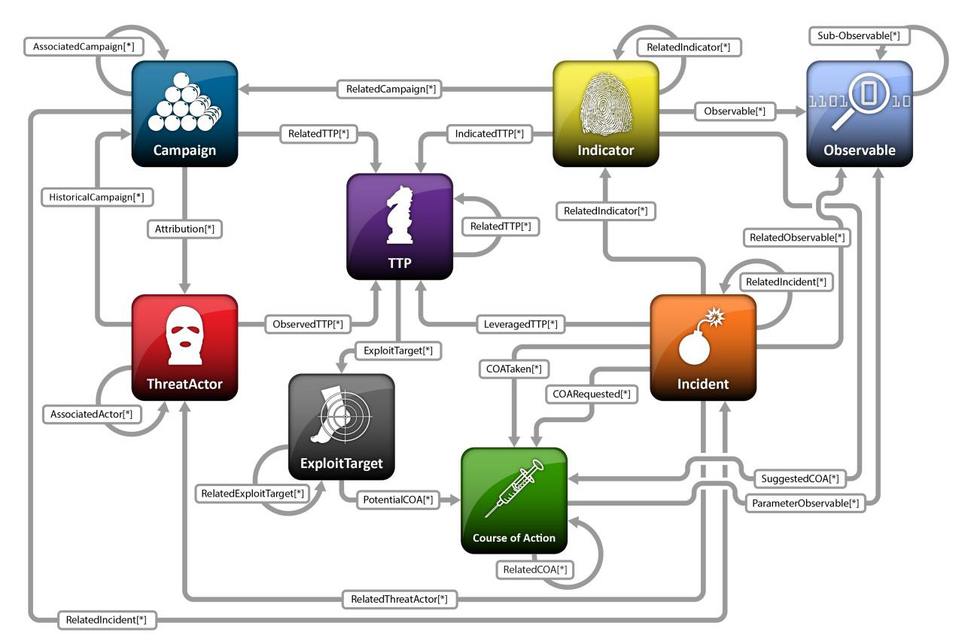
OASIS: STIX intelligence model and expressions
TTP = tactics, techniques, and procedures
11

Slide 12
Mapping: The CIS Critical Security Controls for Effective Cyber Defense
CSC 1: Inventory of Authorized and Unauthorized Devices
CSC 2: Inventory of Authorized and Unauthorized Software
CSC 3: Secure Configurations for Hardware and Software on Mobile Devices, Laptops, Workstations, and Servers
CSC 4: Continuous Vulnerability Assessment and Remediation
CSC 5: Controlled Use of Administrative Privileges
CSC 6: Maintenance, Monitoring, and Analysis of Audit Logs
CSC 7: Email and Web Browser Protections
CSC 8: Malware Defenses
CSC 9: Limitation and Control of Network Ports, Protocols, and Services
CSC 10: Data Recovery Capability
CSC 11: Secure Configurations for Network Devices such as Firewalls, Routers, and Switches
CSC 12: Boundary Defense
CSC 13: Data Protection
CSC 14: Controlled Access Based on the Need to Know
CSC 15: Wireless Access Control
CSC 16: Account Monitoring and Control
CSC 17: Security Skills Assessment and Appropriate Training to Fill Gaps
CSC 18: Application Software Security
CSC 19: Incident Response and Management
CSC 20: Penetration Tests and Red Team Exercises
12

Slide 13
Trends and challenges
Tighter integration and speed of response between cyber threat intelligence sharing and defense measures
Harmonizing across the diverse parties and their different cyber threat sharing entities, models, architectures, interfaces and structured expressions
Keeping up with constant changes cyber threat intelligence sharing platforms and technologies
Expanding and scaling to include cloud-based services, NFV, and IoT cyber threat information sharing needs
Improved cyber observable, threat sighting, and malware characterization functionality
Detecting cyber threats embedded in encrypted streams at network boundaries
Shifting to JSON expressions for cyber threats to accommodate increasing cyber threat information floods
New trusted automated indicator information exchange distribution architectures and features
13

