Slide 1
Cyber Threat Intelligence Sharing
CYBER(16)007013
new developments
Tony Rutkowski, mailto:tony@yaanatech.com
EVP, Industry Standards and Regulatory Affairs
Rapporteur, DTR CYBER-009, Structured threat information sharing
22 May 2016

Slide 2
OASIS CTI TC basics
Principal activity today is centered in OASIS Cyber Threat Intelligence Technical Committee formed in May 2015
Initial mission is “to define a set of information representations and protocols to address the need to model, analyze, and share cyber threat intelligence”
In the initial phase of TC work, three specifications developed through MITRE standards activities were transitioned from the US Department of Homeland Security (DHS) for development and standardization under the OASIS open standards process
STIX (Structured Threat Information Expression)
TAXII (Trusted Automated Exchange of Indicator Information
CybOX (Cyber Observable Expression)
MAEC (Malware Attribute Enumeration and Characterization) [incorporated]
The CTI TC has attracted an ever growing, diverse global membership that maintains very active cyber security standards working groups
Financial services security community are especially engaged in the work
The standards are essential components of the U.S. Cybersecurity Act of 2015 and the EU Network and Information Security (NIS) Directive – both adopted in December 2015
STIX, TAXII, and CybOX recently received the European Identity Conference (EIC) 2016 Award for Best Innovation/New Standard in Information Security

Slide 3
OASIS CTI TC Roster
Aetna | 1
Airbus Group SAS | 3
AIT Austrian Institute of Technology | 3
Anomali | 6
Australia and New Zealand Banking Group (ANZ Bank) | 1
Bank of America | 2
Blue Coat Systems, Inc. | 3
Center for Internet Security (CIS) | 1
CenturyLink | 1
Check Point Software Technologies | 1
Computer Incident Response Center Luxembourg (CIRCL) | 3
Cisco Systems | 8
Citrix Systems | 1
Cyber Threat Intelligence Network, Inc. (CTIN) | 3
Dell | 2
DHS Office of Cybersecurity and Communications (CS&C) | 3
Depository Trust & Clearing Corporation (DTCC) | 3
EclecticIQ | 7
EMC | 5
Ericsson | 1
eSentire, Inc. | 1
Financial Services Information Sharing and Analysis Center (FS-ISAC) | 2
FireEye, Inc. | 6
Fortinet Inc. | 4
Fox-IT | 1
Fujitsu Limited | 9
Georgetown University | 1
Google Inc. | 1
Hewlett Packard Enterprise (HPE) | 2
Hitachi, Ltd. | 3
Huawei Technologies Co., Ltd. | 1
IBM | 9
iboss, Inc. | 1
IID (Internet Identity} | 2
IJIS Institute | 1
Individual | 7
Integrated Networking Technologies, Inc. | 1
Intel Corporation | 5
Johns Hopkins University Applied Physics Laboratory | 4
JPMorgan Chase Bank, N.A. | 2
Kaiser Permanente | 2
LookingGlass | 2
Lumeta Corporation | 1
Mitre Corporation | 16
MTG Management Consultants, LLC. | 1
National Council of ISACs (NCI) | 3
National Security Agency | 4
NEC Corporation | 2
New Context Services, Inc. | 5
New Zealand Government | 1
North American Energy Standards Board | 1
Object Management Group | 1
Open Identity Exchange | 1
Oracle | 2
Palo Alto Networks | 1
PhishMe Inc. | 1
Queralt, Inc. | 1
Raytheon Company-SAS | 1
Resilient Systems, Inc.. | 1
Retail Cyber Intelligence Sharing Center (R-CISC) | 1
Securonix | 1
Semper Fortis Solutions | 1
Siemens AG | 1
Soltra | 22
Splunk Inc. | 5
Symantec Corp. | 2
TELUS | 2
The Boeing Company | 1
Threat Intelligence Pty Ltd | 2
ThreatConnect, Inc. | 5
ThreatQuotient, Inc. | 1
TruSTAR Technology | 1
U.S. Bank | 6
United Kingdom Cabinet Office | 12
US Department of Defense (DoD) | 4
US Department of Homeland Security | 3
VeriSign | 6
ViaSat, Inc. | 6
Yaana Technologies, LLC | 2
as of 15 May 2016

Slide 4
OASIS CTI TC Structure
OASIS CTI
CTI Plenary
[list, weekly*]
STIX Subcommittee [list, wiki]
TAXII Subcommittee [list, wiki]
CybOX Subcommittee [list, wiki, bimonthly]
Interoperability Subcommittee
[list, monthly]
Marketing Group [list]
Patterning Mini WG
Versioning Mini WG
Sightings Mini WG
Campaign Mini WG
i18n Mini WG
Informal ad hoc activity
* tools, meeting frequency

Slide 5
OASIS CTI TC Deliverables
STIX 1.2.1 Specification [mid-Aug 2016*]
TAXII 1.1.1 Specification [mid-Aug 2016]
CybOX 2.1.1 Specification [mid-Sep 2016]
Interoperability Guidelines
STIX 2.0 Specification Pre-Draft [Q1 2017]
TAXII 2.0 Specification Pre-Draft [Q1 2017]
CybOX 3.0 Specification Core Pre-Draft [Q1 2017]
Interoperability Demonstration Policy
CybOX 3.0 Specification Objects Pre-Draft [Q1 2017]
= approved as committee specification
CybOX 3.0 Roadmap
= working draft
* Estimated approval as OASIS standard
CybOX 3.0 Visualation

Slide 6
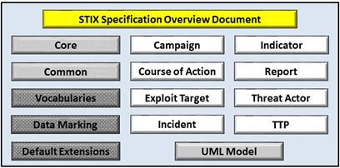
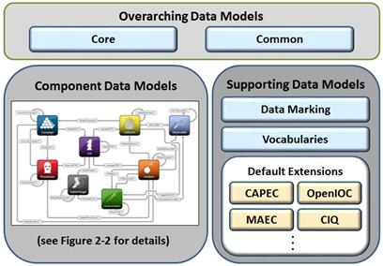
STIX basics (ver. 1.2.1 & 2.0)
The objective of the Structured Threat Information Expression (STIX[TM]) effort is to specify, characterize, and capture cyber threat information. STIX addresses a full range of cyber threat use cases – including threat analysis, capture and specification of indicators, management of response activities, and information sharing – to improve consistency, efficiency, interoperability, and overall situational awareness.
STIX 2.0 features being considered include JSON expressions, Sightings/ Observation/Indicator, Versioning, Indicator Type Vocabulary, Common Object Properties, Packaging, Campaign, TTPs

Slide 7
STIX 2.0 Development Roadmap
Task name / Title | Status | Start By | Make Motion By | Depends (predecessors) | Risk | Comments
Cross-Cutting
ID | Ballot Open |  |  |  | Very Low
Timestamp | Complete |  |  |  | Done
Custom Properties | Ballot Open |  |  |  | Very Low
Versioning | Development |  | May 17, 2016 |  | Very Low | Needs wordsmithing & better normative text
Custom Objects | Development |  | May 24, 2016 |  | Very Low
Data Markings | Development |  | May 24, 2016 | Bundle/Packaging | Low | Need to figure out the end result of the bundle-level markings discussion
Bundle / Packaging | Review |  | May 24, 2016 |  | Low | Need to resolve ID issue and data markings issue
Internationalization | Development |  | May 31, 2016 |  | Medium | Needs agreement
External References | Development | May 24, 2016 | May 31, 2016 |  | Low | Needs to be validated
Information Source | Development | May 24, 2016 | June 3, 2016 | Identity approach | Medium
Kill Chain | Not Started | June 3, 2016 | June 17, 2016 | TTP scope | Low
Top Level Objects
Campaign | Development | May 16, 2016 | May 27, 2016 |  | Low
Indicator | Development | May 30, 2016 | June 6, 2016 |  | Low | Indicator type vocab, decay rate
TTP | Concept | May 16, 2016 | June 3, 2016 |  | High | Need to determine high-level architecture
Sighting | Review | May 30, 2016 | June 13, 2016 |  | Low | Needs to be validated
Observation | Review | May 30, 2016 | June 13, 2016 |  | Low | Needs to be validated
CybOX Container | Review | May 30, 2016 | June 13, 2016 |  | Low | Needs to be validated
Report | Development | May 30, 2016 | June 13, 2016 |  | Low
(Other TTP Objects) | Not Started | June 6, 2016 | June 20, 2016 | TTP scope | Medium | Need to figure out what TTP group will address
Identity | Concept | June 6, 2016 | June 20, 2016 |  | High | Need to define fields
COA | Not Started | June 6, 2016 | June 20, 2016 |  | Medium
Threat Actor | Not Started | June 13, 2016 | June 27, 2016 | Identity approach | Medium | Relies heavily on identity
Incident | Not Started | June 13, 2016 | June 27, 2016 | Target approach (for victim) | High | MVP only
Asset | Not Started | June 13, 2016 | June 27, 2016 |  | High | MVP only
Target | Not Started | June 13, 2016 | July 4, 2016 | Identity approach (for victim) | High | Relies heavily on identity
Vulnerability | Not Started | June 27, 2016 | July 4, 2016 |  | Low
Configuration | Not Started | June 27, 2016 | July 4, 2016 |  | Low
Weakness | Not Started | June 27, 2016 | July 4, 2016 |  | Low
Source: STIX States Update, OASIS TC CTI Early Session Meeting Minutes, May 2016

Slide 8
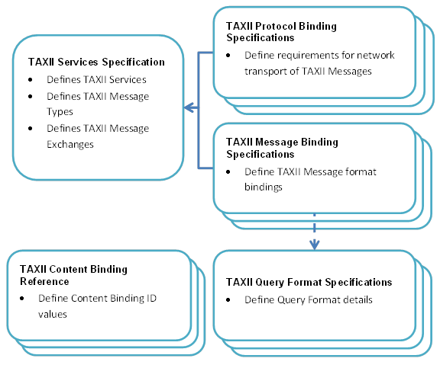
TAXII basics (ver. 1.1.1 & 2.0)
Trusted Automated eXchange of Indicator Information (TAXII [™]) defines a set of services and message exchanges that, when implemented, sharing of actionable cyber threat information across organization and product/service boundaries. TAXII, through its member specifications, defines concepts, protocols and messages to exchange cyber threat information for the detection, prevention, and mitigation of cyber threats
Models supported
Specification components
TAXII 2.0 features being considered include: Publish and Subscribe model over an HTTP RESTful interface; TAXII Servers are plumbing for CTI between TAXII Clients; each TAXII Server has some defined out-of-the box channels that clients can publish or subscribe
Hub and Spoke
Source/ Subscriber
Peer to Peer

Slide 9
CybOX basics (ver. 2.1.1 & 3.0)
CybOX provides a common structure for representing cyber observables across and among the operational areas of enterprise cyber security that improves the consistency, efficiency, and interoperability of deployed tools and processes, as well as increases overall situational awareness by enabling the potential for detailed automatable sharing, mapping, detection, and analysis heuristics.
Objects
CybOX 3.0 features being considered include: High-level Change to create: 1)a Core/Common set ( Separation of Patterns and Instances, First-class Relationships, Cryptographic Hash Capture Refactoring) and 2) Object-related Changes Object Refactoring for Semantic Accuracy, Expansion of "Atomic" Objects)

Slide 10
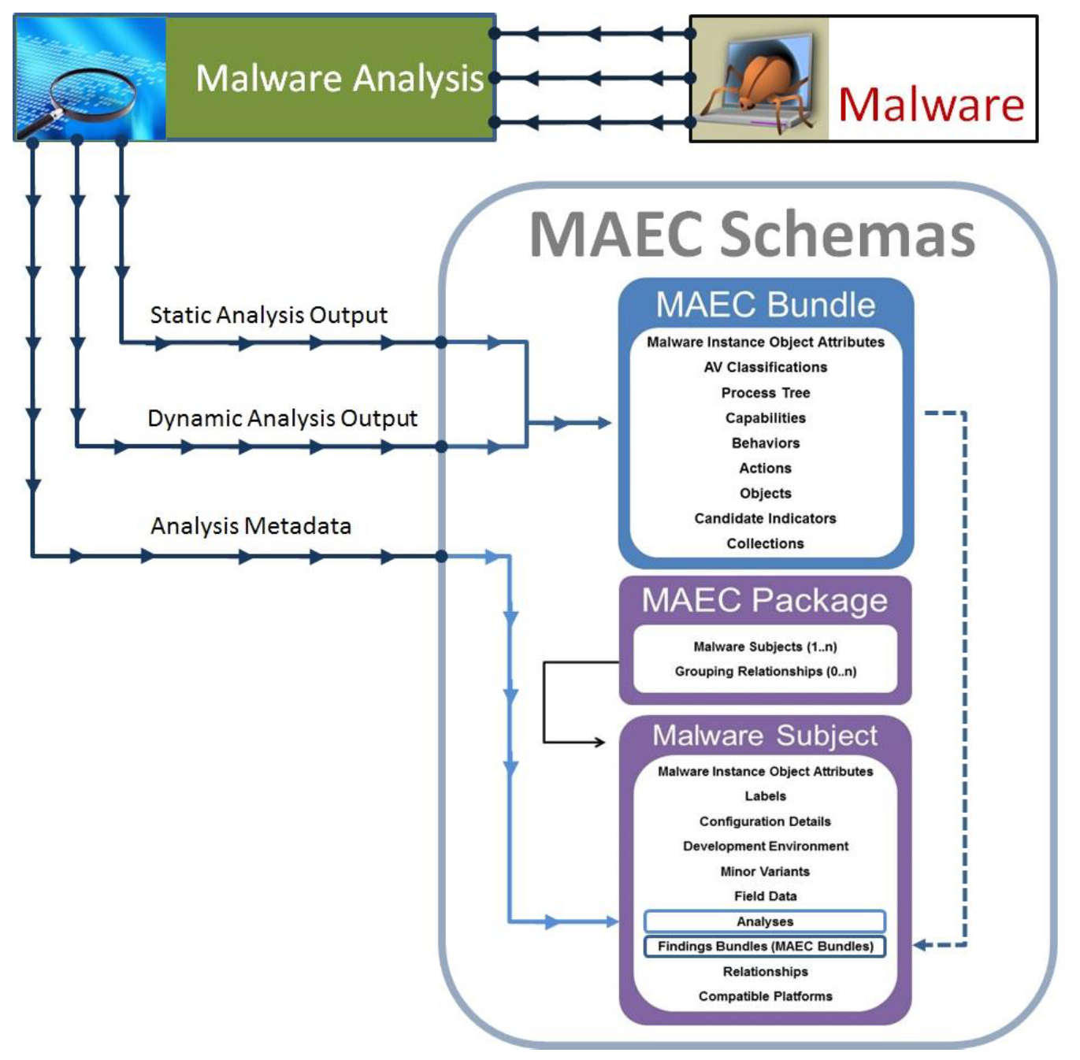
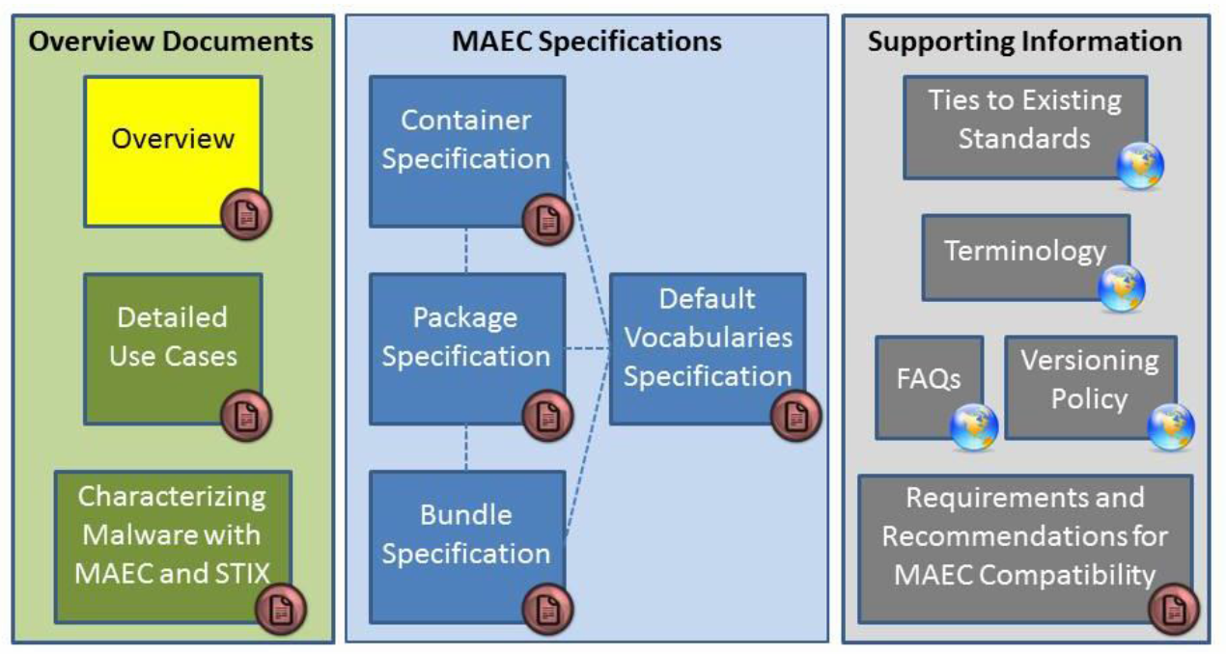
MAEC basics (ver. 4.1 & further)
Malware Attribute Enumeration and Characterization (MAEC™) is a standardized language for sharing structured information about malware based upon attributes such as behaviors, artifacts, and attack patterns.
MAEC future work being considered includes: defining additional actions, defining behaviors, associating actions, behaviors, and Capabilities

Slide 11
TC CYBER Cyber Threat Intelligence Roadmap
Focus on specific platform and forum
STIX, TAXII, & CybOX in OASIS TC CTI seem like leading candidates
Most developed and innovative
Largest and most diverse participants globally including financial community
Strong government commitments
Good match to EU and US legislative cyber security information sharing mandates, including ENISA NISD standards report
Strong ETSI-OASIS collaborative relationship with formal agreement expressly encompassing TC CYBER and TC CTI work
Next steps
Prepare uses cases and gap analysis for meeting requirements
Cyber security information sharing legislative mandates, including EU-US harmonization
NFV security
IoT security
Gateway defence encrypted traffic inspection
Generic Internal Network Interface information acquisition
Other uses
Develop a fast bridge mechanism with the Critical Security Controls
Collaborate with CIS and the Secure and Resilient Cyber Ecosystem (SRCE) Focus Group
Collaborate with appropriate EU and EU Member governmental bodies

