Slide 1
STIX Malware Object
Observations from Implementation

Slide 2
Overview of the malware object
Property Name | Type
type (required) | string
labels (required) | list of type open-vocab
external_references (optional) | list of type external-reference
is_family (required) | boolean
name (required) | string
malware_types (required) | list of type open-vocab
description (optional) | string
kill_chain_phases (optional) | list of type kill-chain-phase
first_seen (optional) | timestamp
last_seen (optional) | timestamp
os_execution_envs (optional) | list of type string
architecture_execution_envs (optional) | list of type open-vocab
implementation_languages (optional) | list of type open-vocab
samples (optional) | observable-objects
static_analysis_results (optional) | list of type analysis-type
dynamic_analysis_results (optional) | list of type analysis-type
av_results (optional) | list of type av-results-type
capabilities (optional) | list of type open-vocab
Either list of refs or list of cyber observables
List of analysis-type

Slide 3
Overview of the analysis-type
Property Name | Type
start_time (optional) | timestamp
end_time (optional) | timestamp
analysis_tools (optional) | list of type observable-objects
analysis_environment (optional) | dictionary
results (required) | dictionary
List of cyber-observables
List of dictionary which looks a lot like cyber-observables

Slide 4
Quick review of Cyber Observables and Observed Data
Cyber Observables:
Cyber Observable Objects are for characterizing host-based, network, and related entities. Each of these objects correspond to a data point commonly represented in CTI and digital forensics.
Cyber Observable Relationships are only resolvable within the same observable-objects container
A Cyber Observable Relationship is a connection between two or more Cyber Observable Objects within the scope of a given Observable Objects dictionary.
Observed Data
Observed Data conveys information that was observed on systems and networks using the Cyber Observable specification
Observed Data Object
Property Name | Type
type (required) | string
first_observed (required) | timestamp
last_observed (required) | timestamp
number_observed (required) | integer
objects (required) | observable-objects

Slide 5
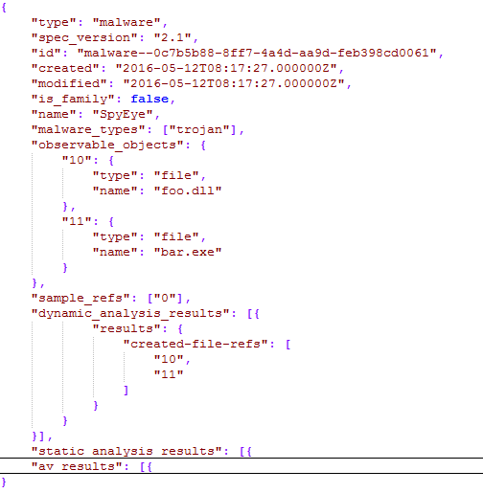
Example Implementation 1
Notes:
cyber-observables are included directly within the malware object. This is a deviation from other design patterns across STIX.
cyber-observables are included within the malware object
Observable objects are referenced directly by another section of the malware object, which is unclear from standard on implementation.
cyber-observables can reference each other within the same list of cyber-observables, but cannot be referenced externally.
Type: Dictionary

Slide 6
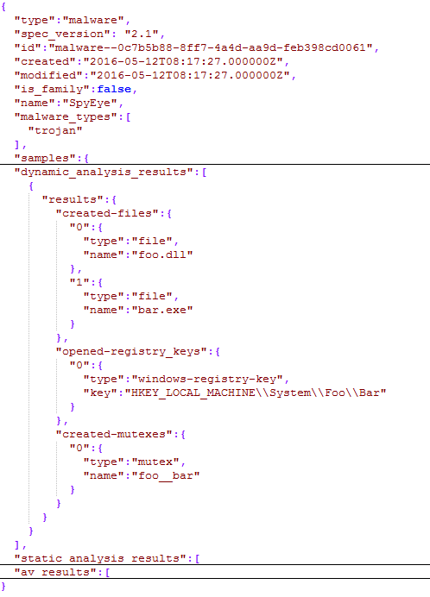
Example Implementation 2
Notes:
cyber-observables are included directly within the malware object. This is a deviation from other design patterns across STIX.
cyber-observables are directly within the malware object, rather than referenced
Type: Dictionary

Slide 7
Issues with Current Approach
cyber-observables are included directly within the malware object. This is a deviation from other design patterns across STIX.
cyber-observables in one implementation are referenced outside of the list. Standard is unclear on common way to perform this design pattern.
Dictionaries are included in the analysis-type that look very similar to lists of cyber-observables but as a dictionary have no required definition.

Slide 8
Suggested Approach
Suggested Approach
Original
Property Name | Type
type (required) | string
labels (required) | list of type open-vocab
external_references (optional) | list of type external-reference
is_family (required) | boolean
name (required) | string
malware_types (required) | list of type open-vocab
description (optional) | string
kill_chain_phases (optional) | list of type kill-chain-phase
first_seen (optional) | timestamp
last_seen (optional) | timestamp
os_execution_envs (optional) | list of type string
architecture_execution_envs (optional) | list of type open-vocab
implementation_languages (optional) | list of type open-vocab
samples_ref (optional) | observed-data-ref
static_analysis_results (optional) | list of type analysis-type
dynamic_analysis_results (optional) | list of type analysis-type
av_results (optional) | list of type av-results-type
capabilities (optional) | list of type open-vocab
Property Name | Type
type (required) | string
labels (required) | list of type open-vocab
external_references (optional) | list of type external-reference
is_family (required) | boolean
name (required) | string
malware_types (required) | list of type open-vocab
description (optional) | string
kill_chain_phases (optional) | list of type kill-chain-phase
first_seen (optional) | timestamp
last_seen (optional) | timestamp
os_execution_envs (optional) | list of type string
architecture_execution_envs (optional) | list of type open-vocab
implementation_languages (optional) | list of type open-vocab
samples (optional) | observable-objects
static_analysis_results (optional) | list of type analysis-type
dynamic_analysis_results (optional) | list of type analysis-type
av_results (optional) | list of type av-results-type
capabilities (optional) | list of type open-vocab

Slide 9
Suggested Approach
Original
Property Name | Type
start_time (optional) | timestamp
end_time (optional) | timestamp
analysis_tools (optional) | list of type observable-objects
analysis_environment (optional) | dictionary
results (required) | dictionary
Suggested Approach
Property Name | Type
start_time (optional) | timestamp
end_time (optional) | timestamp
analysis_tools (optional) | dictionary
analysis_environment (optional) | dictionary
results_ref (required) | observed-data-ref

Slide 10
Advantages/Disadvantages
Advantages
Eases creation and parsing of STIX information by reusing Observed Data throughout, rather than different ways to hold cyber observables.
Removes questions of how implementations operate.
All implementations operate based upon standards for cyber-observables, they do not need to do anything special for malware
Uses same design patterns as all other STIX objects
Uses same design pattern for other cyber-observables containers (i.e. Observed-Data object)
Removes the issues with lack of structure from using dictionaries.
Disadvantages
Changes the use cases of Observed Data from reporting observations of interesting live data to reporting data observed within analysis.
Does not have ability for objects/files created with one dynamic analysis tool to be referenced by something in static analysis and vice-versa.
Does not allow AV results to be associated with a specific file.

