Slide 1
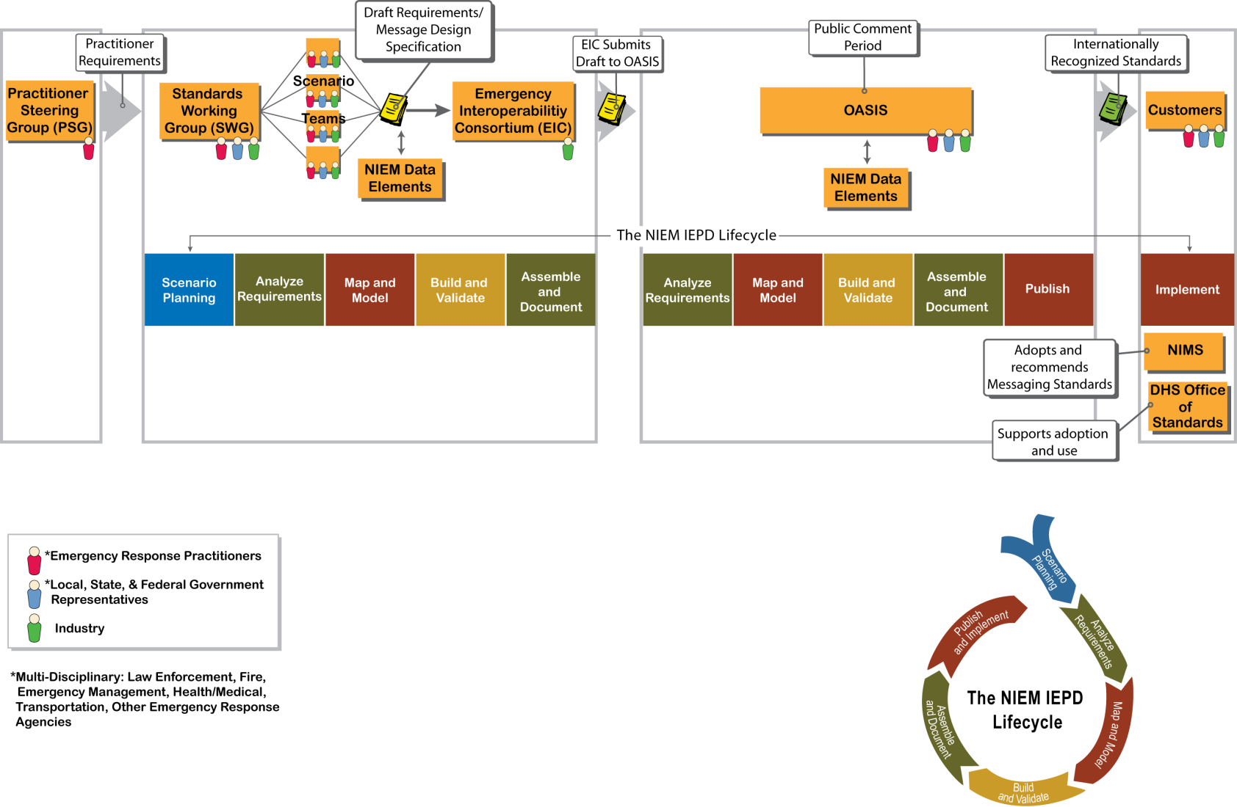
EDXL Standards Development Process

