Slide 1
EDXL in NIEM
Lizzie DeYoung

Slide 2
Agenda
NIEM Background
Adapters
EDXL in NIEM

Slide 3
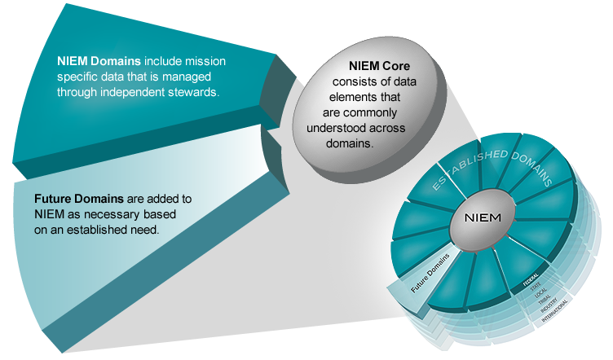
NIEM Background
Exchange Development Framework
Exchange development process
Core and domain elements / building blocks
Naming and Design Rules
IEPD (Information Exchange Package Documentation)

Slide 4
Adapters
Enables the use of external components
External component: A single unit-set of data that embodies a single concept from an external standard
Wraps external components
NIEM conformant wrapper
Signals that content inside of wrapper is non-NIEM conformant

Slide 5
Adapters
<?xml version="1.0" encoding="US-ASCII"?>
<xs:schema xmlns:edxl-cap=http://release.niem.gov/niem/adapters/edxl-cap/3.0/ ... xmlns:cap="urn:oasis:names:tc:emergency:cap:1.1" targetNamespace="http://release.niem.gov/niem/adapters/edxl-cap/3.0/" version="1">
<xs:annotation>
<xs:documentation>Common Alerting Protocol</xs:documentation>
</xs:annotation>
<xs:import namespace="urn:oasis:names:tc:emergency:cap:1.1" schemaLocation="../../../external/cap/1.1/cap.xsd" appinfo:externalImportIndicator="true">
<xs:annotation>
<xs:documentation>Common Alerting Protocol (CAP) is a simple but general format for exchanging effective warning messages based on best practices identified in academic research and real-world experience.</xs:documentation>
</xs:annotation>
</xs:import>
<xs:complexType name="AlertAdapterType" appinfo:externalAdapterTypeIndicator="true">
<xs:annotation>
<xs:documentation>A data type for a simple but general format for exchanging effective warning messages based on best practices identified in academic research and real-world experience.</xs:documentation>
</xs:annotation>
<xs:complexContent>
<xs:extension base="structures:ObjectType">
<xs:sequence>
<xs:element ref="cap:alert" minOccurs="0" maxOccurs="unbounded">
<xs:annotation>
<xs:documentation>A container for all component parts of the CAP alert message. The container provides basic information about the current message: its purpose, its source and its status, as well as unique identifier for the current message and links to any other, related messages.</xs:documentation>
</xs:annotation>
</xs:element>
</xs:sequence>
</xs:extension>
</xs:complexContent>
</xs:complexType>
<xs:element name="AlertAdapter" type="edxl-cap:AlertAdapterType" nillable="true">
<xs:annotation>
<xs:documentation>A simple but general format for exchanging effective warning messages based on best practices identified in academic research and real-world experience.</xs:documentation>
</xs:annotation>
</xs:element>
</xs:schema>

Slide 6
Adapters
Important parts
Reference and import the namespace
<xs:schema … xmlns:cap="urn:oasis:names:tc:emergency:cap:1.1" …>
<xs:import namespace="urn:oasis:names:tc:emergency:cap:1.1" schemaLocation="../../../external/cap/1.1/cap.xsd" …>
In the import statement, indicate the import is for an external component
<xs:import namespace="urn:oasis:names:tc:emergency:cap:1.1" … appinfo:externalImportIndicator="true">
Document the import statement
In the adapter type declaration, indicate it’s an external adapter
<xs:complexType name="AlertAdapterType" appinfo:externalAdapterTypeIndicator="true">
Reference the external component being wrapped
<xs:element ref="cap:alert" minOccurs="0" maxOccurs="unbounded">

Slide 7
EDXL in NIEM
EDXL Standards in NIEM
EDXL-CAP
EDXL-DE
EDXL-HAVE (v2.1+)
Versions 2.0 and 2.1
Adapter: niem/[edxl-cap][edxl-de][edxl-have]
Standard: niem/external/[cap][de][have]
Version 3.0
Adapter: niem/adapters/[edxl-cap][edxl-de][edxl-have]
Standard: niem/external/[cap][de][have]

Slide 8
Questions?

