Slide 1
NIEM IEPD Registry
Way Ahead Discussion
20 June 2018

Slide 2
Purpose
Solicit Domain/Community ideas for a NIEM Community IEPD registry. (action captured during our 2017 F2F)
Understand community needs (survey)
Enable discovery of re-usable content
Reduce implementation costs
Determine recommended minimum registry metadata
What needs to be captured to enable discovery and support reuse?
Identify potential registry host location
Determine additional resources required to provide configuration and full lifecycle management of registry web service.

Slide 3
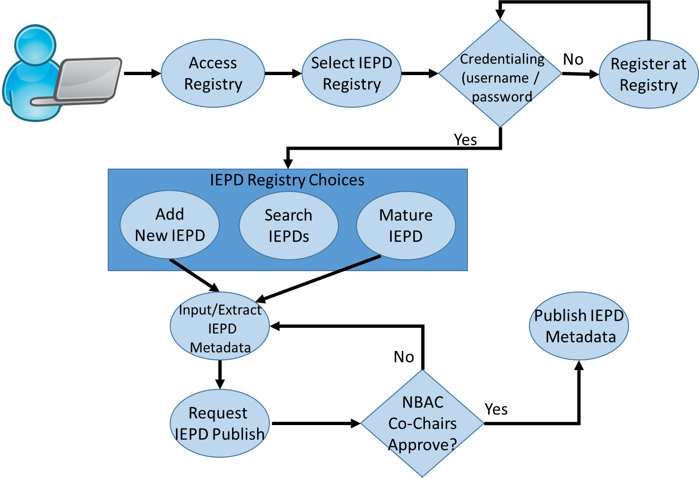
Proposed NIEM IEPD Registry Concept
*
*
Notes:
* Indicates issues we need to address:
Do we need to control access to the registry? If yes, how, and is there a cost? If no, then it needs to be read only to prevent garbage from being posted.
Do we need NBAC co-chair approval before adding something to the registry? Maybe only PMO staff post products and/or update the registry, and the producer sends a product to the PMO staff for review?

Slide 4
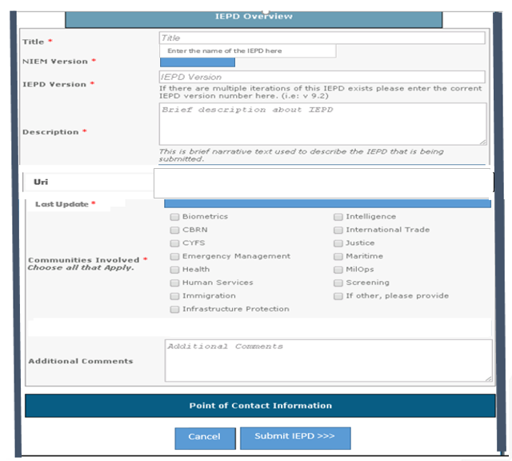
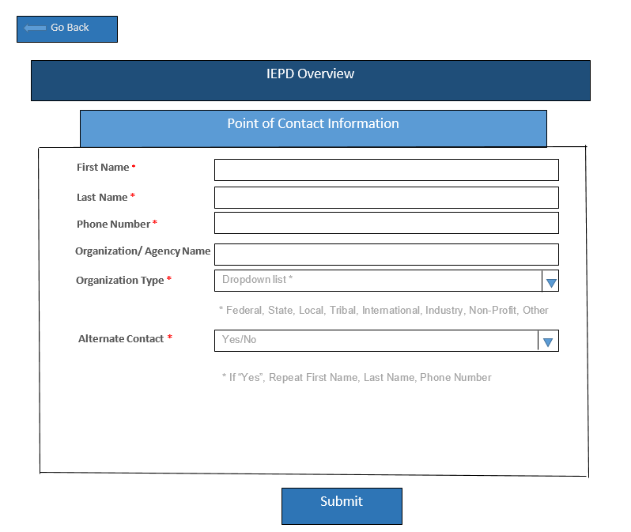
Recommended Metadata Requirements

Slide 5
Registry Sites Under Consideration
tools.niem.gov
Pros: existing registry, requires account to add content
Cons: manual entry of discovery metadata; hasn’t been maintained in years/buggy
DOJ IEPD Clearinghouse/NISS
Pros: existing registry
Cons: hasn’t been maintained in years
APAN.org
Pros: existing sites for NBAC, EM, and MilOps; access controls
Cons: must have APAN account (no guests); SharePoint limitations; limited search
GitHub
Pros: already hosts NIEM content; access controls
Cons: learning curve for managers; requires user accounts top add content; limited search (browser)

Slide 6
NIEM IEPD Registry Launch Requirements
Domain / Community Agreement to Register IEPD(s)
Consensus on minimum metadata requirements
Location identified (www.niem.gov/registry?)
Update NIEM procedures / training
Functional requirements documented and traced to operational registry
Socialization
GO LIVE! DISCOVER! REUSE!

