Slide 1
OASIS Electronic Trial Master File Standard Technical Committee Meeting Agenda Comment Review Period
January 5, 2015
9:00 – 10:00 AM PDT

Slide 2
Agenda
Topic |  | Presenter
9:00 - 9:05 | Call to Order | Jennifer
9:05 - 9:08 | Roll Call (secretary: Karen McCarthy Schau) | Zack
9:08 – 9:10 | Approval of 11/17 and 12/1 minutes | All
9:10 – 9:15 | Slates: W44 – W46 | Jennifer
9:15 – 9:35 | Workgroup status | All
9:35 – 9:55 | eTMF TC Next Steps | Zack
9:55 – 10:00 | New business & Next Meeting | Jennifer / All

Slide 3
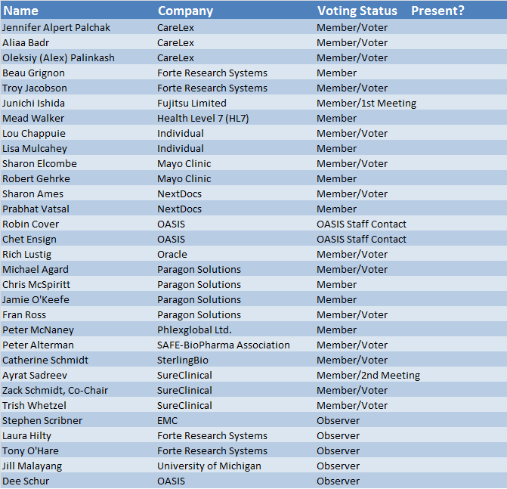
Roll Call

Slide 4
Use of Slates for Voting
TC’s often use Slates (vote on group of resolutions)
Slates posted and reviewed by TC prior to meeting (posted 12/23)
Slate announced, TC members ‘pull’ items to discuss
TC votes on items that remain on slate up for vote
TC then discusses items pulled from slate followed by vote
Voting on comment response only, does not limit alterations to actual Spec, MV, Code
Changes to be integrated in Spec, RDF/XML code, and MV spreadsheet and will be reviewed again by TC

Slide 5
Slate: W44
Comments and Proposed Resolutions ranging from Specification Section 6.1.2 to General Comment on Naming
“Move to approve Comment Resolutions as written for Slate W44 which includes Comment Log reference numbers 134.CSD1, 743.CSD1, 136.CSD1, 216.CSD1, 260.CSD1, 814.CSD1, 748.CSD1, 747.CSD1, 751.CSD1, 768.CSD1, 325.CSD1, 217.CSD1, 235.CSD1, 142.CSD1, 326.CSD1.”
Notes:
CFAST = Critical Path Institute (C-Path) and CDISC collaboration
FDA/PhUSE = Pharmaceutical Users Software Exchange

Slide 6
Slate: W45
Comments and Proposed Resolutions ranging from Grammar comment to general comment on figure captions
“Move to approve Comment Resolutions as written for Slate W45 which includes Comment Log reference numbers 767.CSD1, 766.CSD1, 147.CSD1, 541.CSD1, 548.CSD1, 119.CSD1, 122.CSD1, 117.CSD1, 118.CSD1, 120.CSD1, , 148.CSD1, 547.CSD1, 330.CSD1, 757.CSD1.”
Notes:
CFAST = Critical Path Institute (C-Path) and CDISC collaboration
FDA/PhUSE = Pharmaceutical Users Software Exchange

Slide 7
Slate: W46
Comments and Proposed Resolutions ranging from items pertaining to the OWL file – Corrections to Tables
“Move to approve Comment Resolutions as written for Slate W46 which includes Comment Log reference numbers 815.CSD1, 818.CSD1, 819.CSD1, 236.CSD1, 816.CSD1, 817.CSD1, 246.CSD1, 211.CSD1.”
Notes:
CFAST = Critical Path Institute (C-Path) and CDISC collaboration
FDA/PhUSE = Pharmaceutical Users Software Exchange

Slide 8
Voting On Slates
“I move to approve the comment resolutions for slates W44 – W46 as described in the Comment Log and listed in the meeting slides, with the exception that any references to individual names in the comments shall be removed prior to publication.”

Slide 9
Progress As Of Today
95% DONE!
776 of 814 Comment Resolutions
ready for vote OR
already voted & approved!
Notes:
Spec WkGp: (15) 228 of 243 (94%) complete
Metadata WkGp: (23) 548 of 571 (96%) complete

Slide 10
eTMF TC Next Steps
Changes/edits from Comment Resolution work integrated into Specification
Outstanding items:
Corrections to tables
Add audit trail details
Others?
TC review and publish completed Comment Resolutions on OASIS
TC review of updated/edited Specification
Update Metadata Vocab spreadsheet
Update RDF/XML code and test code for quality
Upon TC vote, publish revised eTMF Draft Specification (Spec, Code, Metadata) for public review of changes

Slide 11
New Business & Next Meeting
New Business
Research on Investigator Site Files (Ibell)
Other?
Upcoming TC Meetings (all 9am-10:30 PST unless otherwise agreed)
January 5 secretary = Karen McCarthy Schau
January 19 secretary = Needed!
February 9 secretary = Needed!

