Slide 1
Quick Thoughts on PGP Use Cases for KMIP
Michael Allen
Sr. Technical Director

Slide 2
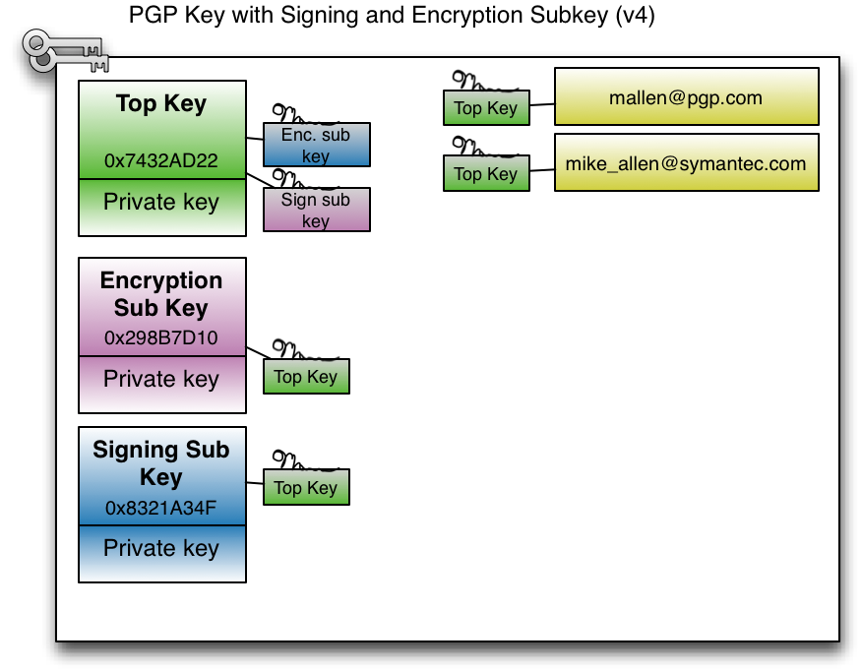
PGP Keys Are Different Beasts From X.509 Certificates

Slide 3
Common Use Cases: Registration
Enroll me and create for me a key. Give me a copy of that key, including the private portion.
Enroll me but, here, I have my own key. I only want you to have the public portion. Please sign it with whatever key you think is authoritative and give me back a signed copy.
I'm a stranger to you but I want you to have my public key so that other users in your organization can encrypt things to me.
I'm a stranger to you but I signed this other key that you manage. Here's a copy of the signed version of that key. Please remember that I signed it.

Slide 4
Common Use Cases: Searching
Do you have any kind of key for <email address>?
Do you have an <encryption / signing / other operation> key for <email address>?
Do you have any kind of key that matches key ID 0x12345678?
Do you have an <encryption / signing / other operation> key for key ID 0x12345678?
I'm trying to encrypt something to group <groupname>. Do you have a key for that group?

Slide 5
Common Use Cases: Trust and Encryption Actions
Is this certificate / key "OK"? (I.e. Should I trust it?)
I have encrypted copies of a data encryption key (symmetric) encrypted to keys 0x12345678, 0x90ABCDEF, and 0x87654321. Can you decrypt any one of them for me to give me back the bare DEK?

Slide 6
Michael Allen
mike_allen@symantec.com
650-527-0716

