Slide 1
Key Management Interoperability Protocol (KMIP) Bob Griffin co-chair, KMIP TC
www.oasis-open.org

Slide 2
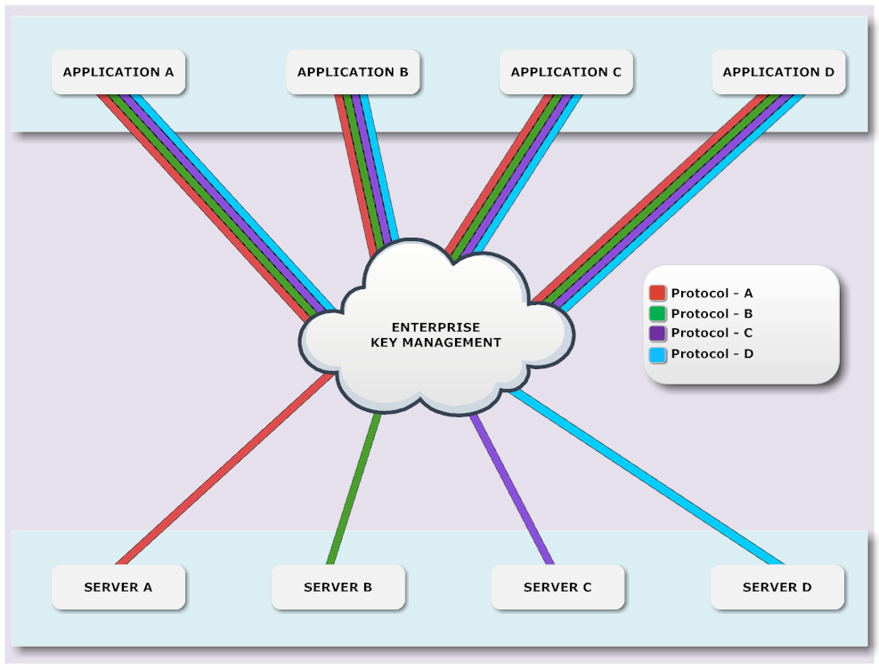
Prior to KMIP each application had to support each vendor protocol

Slide 3
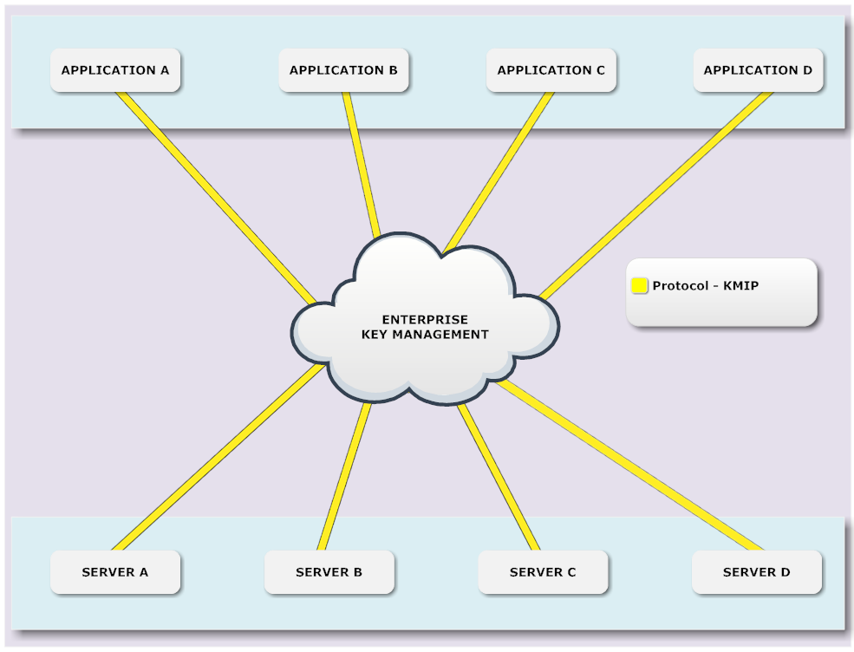
With KMIP each application only requires support for one protocol

Slide 4
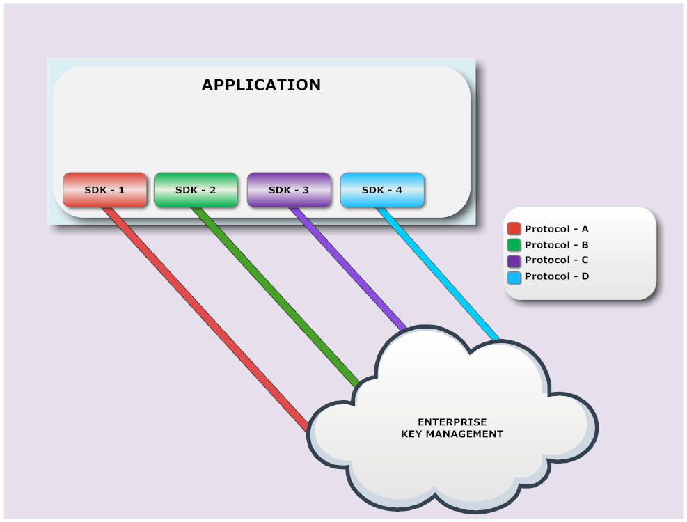
Prior to KMIP each application had to integrate each vendor SDK

Slide 5
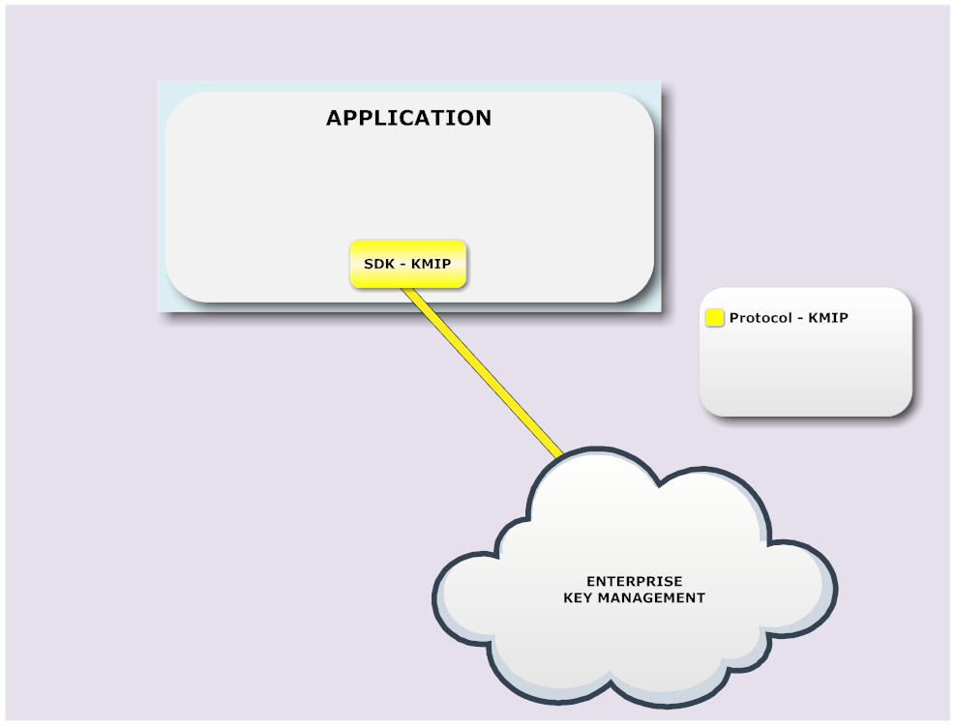
With KMIP each application only requires one vendor SDK integration

Slide 6
KMIP in the Cloud - 1
Private Cloud
Private Cloud
Enterprise B
Enterprise A
Tenant keys stored and managed in private cloud
Tenant app at CSP requests keys
KMS
KMS
Admin
Admin
KMIP
KMIP
Cloud Service Provider
Tenant A app
Tenant B app
CSP Admin
6
Confidential

Slide 7
KMIP in the Cloud - 2
Tenant keys stored and managed in private cloud
Tenant KMS at CSP receives keys
Tenant app at CSP requests keys
Private Cloud
Private Cloud
Enterprise B
Enterprise A
KMS
KMS
Admin
Admin
KMIP
KMIP
Cloud Service Provider
KMS A
KMS B
Tenant A app
Tenant B app
CSP Admin
7
Confidential

Slide 8
KMIP in the Cloud - 3
Tenant keys stored and managed in public cloud as shared service
Tenant app at CSP requests keys
Private Cloud
Private Cloud
Enterprise B
Enterprise A
Admin
Admin
KMIP
KMIP
Cloud Service Provider
CSP KMS
Tenant A app
Tenant B app
CSP Admin
8
Confidential

