Slide 1
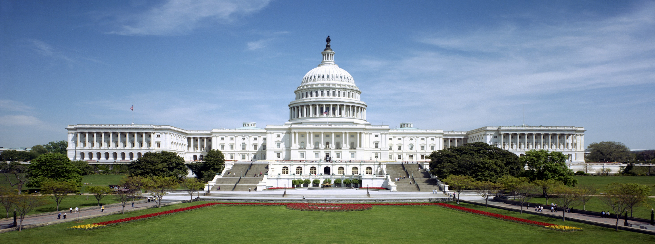
Legislative Lookup & Linking Referencing Architecture
xcential
Grant Vergottini Xcential
July 30, 2014

Slide 2
Legislative Lookup & Linking (LLL)
Web-based service to:
Convert citations to references
Resolve references to links
Dereference links
Users
Drafting Attorneys
Legislators & Legislative Staff
Public

Slide 3
Features
Processes citations styles found in U.S. Code and in legislation
Bluebook style citations not a specific requirement
Internal lookup using both Popular Names Table & Table 3
Popular names map names to laws
Table 3 maps laws to their disposition in the U.S. Code
Internal and External Data Sources
Internal Compilations – Public Laws with executed amendments
Law Revision Counsel (LRC) USLM XML for the U.S. Code
Cornell LII
GPO/FDSYS
Library of Congress

Slide 4
Processing Pipeline
Today’s discussion
Interpret
Resolve
Dereference
Transform
Reference
Link
Text/XML
HTML/*
Citation
Enter and exit wherever you want

Slide 5
Reference Notation
Started out as Akoma Ntoso notation
No fixed “document” notion
Big Levels vs. Small Levels
Qualification Language
Ranges
Case sensitive

Slide 6
Basic notation
FRBR inspired
reference ::= work [expression] [manifestation]

Slide 7
Work Part
work ::= [docPart] [fractionPart] [qualification]
docPart ::= [“/uslm”] “/” jurisdiction “/” category “/” docName
fractionPart ::= (“/” level)+
Examples:
16 USC § 47 → /uslm/us/usc/t16/s47
Pub. L. 101–369, § 2 → /uslm/us/pl/101/369/s2
July 30, 1947, ch. 392 → /uslm/us/act/1947-07-30/ch392
43 Stat. 883 → /uslm/us/stat/43/883

Slide 8
Levels
level ::= (bigLevel | smallLevel | specialLevel)
bigLevel ::= (“st” | “ch” | “sch” | “pt” | “spt” | “d” | “sd” | “s” | “app” | “reorgPlans” | “courtRules” | “rule” ) (num* | range)
smallLevel ::= (num* | range)
specialLevel ::= (“notes” | “toc” | “srcc” | (“note” num*)
Examples:
Pub. L. 101–650, title III, § 325(a)(2) → /uslm/us/pl/101/650/s325/a/2
* num in not necessarily numeric

Slide 9
Ranges
range ::= levelNum “…” [levelNum]
Limitations:
No holes in range
Language not supported includes: “other than…”, “except for…”
No gaps in range
Language not supported includes: “(a) through (c), (h) through (j)”
Specify multiple references instead
Question: Should we use ellipsis (…) or three periods (. . .)?
Examples:
50 U.S.C. App. 451 et seq. → /uslm/us/usc/t50/app451…
7 USC 8(b): “sections 7 through 7a-1” → /uslm/us/usc/t7/s7…7a-1

Slide 10
Qualification
qualification ::= “(“ ref “)”
Resolves ambiguity in citations due to duplicates (often errors)
Distinguishing language used included “as amended by”, “as added by”, “as redesignated by”, or “relating to”.
Other qualifications: Effective but not operative
Examples:
28 USC § 1932 → /uslm/us/usc/t28/s132(/us/pl/104/317/s403/a/1)
28 USC § 1932 → /uslm/us/usc/t28/s132(/us/pl/104/134/s101)

Slide 11
Expression Part
expression ::= “@” {version|date}
version ::= “v” number
date ::= year “-” month “-” day
Examples:
28 USC § 121(2) on March 1, 2014 → /uslm/us/usc/t28/s121/2@2014-03-01
28 USC § 121(2) as of today → /uslm/us/usc/t28/s121/2@
28 USC § 121(2) as enacted → /uslm/us/usc/t28/s121/2@v1

Slide 12
Manifestation Part
Manifestation ::= “.” (“xml” | “html” | “pdf” | “txt” | “rdf”)
Examples:
28 USC § 121(2) as XML → /uslm/us/usc/t28/s121/2.xml
28 USC § 121(2) as HTML → /uslm/us/usc/t28/s121/2.html
50 U.S.C. App. 451 et seq. as PDF → /uslm/us/usc/t50/app451….PDF

