Slide 2
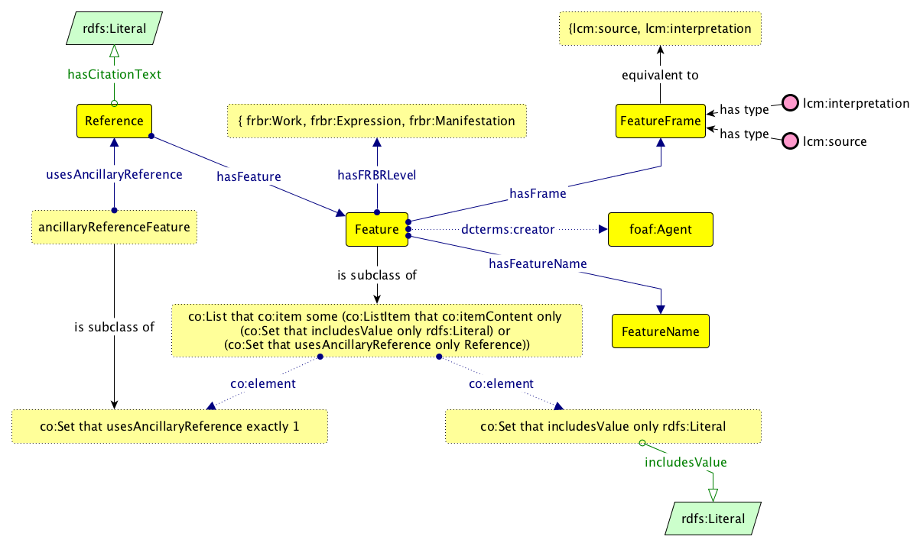

Slide 3
{ source, interpretation }
rdfs:Literal
equivalentTo
hasCitationText
rdf:type
source
xsd:float
FeatureFrame
Reference
rdf:type
interpretation
inFrame
hasConfidence
hasFeature
Feature
dcterms:creator
foaf:Agent
hasGenericValue
hasValue
hasSpecification
rdfs:Literal
hasCode
FeatureValue
FeatureSpecification
hasControlledValue
lcm:valueString (or rdf:value ?)
skos:prefLabel
hasFRBRLevel
rdfs:Literal
owl:Thing
rdfs:Literal
hasFRBRLevel
rdf:type
workLevel
FRBRLevel
rdf:type
expressionLevel
rdf:type
manifestationLevel
equivalentTo
{ workLevel, expressionLevel, manifestationLevel }

Slide 4
{
"name": "document type",
"frame": "source",
"frbr": "work",
"levels": {
"values" : { "elements": "Stat." }
}
}
{
"specification": {
"code": "document_type",
"name": "document type",
"frbr": "work“
},
"frame": "source",
"value": { “string”: "Stat.“ }
}
{
"name": "document number",
"frame": "source",
"frbr": "work",
"levels": {
"values": { "elements": "124" },
"next": {
"values": { "elements": "119" }
}
}
}
{
"specification": {
"code": "document_number",
"name": "document number",
"frbr": "work“
},
"frame": "source",
"value": { “string” : ["124“, “119”] }
}
(why not have 2 features, each with a value ?)

Slide 5
{
"name": "language",
"frame": "interpretation",
"frbr": "expression",
"confidence": 0.9,
"author": { "fullname": "John Smith"},
"levels" : {
"values": { "elements": [ "en", "eng", "English" ] },
"next": {
"values": { "elements": [ "en-us", "American English" ] }
}
}
}
{
"specification": {
"code": "lang",
"name": "language",
"frbr": "expression“
},
"frame": "interpretation",
"confidence": 0.9,
"author": { "fullname": "John Smith" },
"value": {
"string": ["en-US", "eng-US", "English (American)"],
"generic": {
"string": ["en", "eng", "English"]
}
}
}
(« en-US » comes first in the list if we assume this is the actual value of the feature)

Slide 6
{
"name": "as modified by",
"frame": "interpretation",
"frbr": "expression",
"levels" : {
"values": { "reference": "second-reference" },
}
}
{
“specification”: {
"code": "as_modified_by",
"name": "modifié par",
"frbr": "expression",
}
"frame": "interpretation",
"value": {
"string": [ "as modified by amendment foo XYZ"],
"controlledValue": "id-of-another-reference"
}
}

Slide 7
dctypes:Text
{ source, interpretation }
rdfs:Literal
Annotation
subClassOf
equivalentTo
hasCitationText
rdf:type
source
subClassOf
xsd:float
FeatureFrame
Reference
rdf:type
interpretation
hasConfidence
inFrame
target
Feature
dcterms:creator
foaf:Agent
body
hasSpecification
rdfs:Literal
TextualBody
hasCode
FeatureSpecification
subClassOf
hasGenericValue
skos:prefLabel
hasFRBRLevel
rdfs:Literal
hasFRBRLevel
FeatureBody
rdf:type
workLevel
hasControlledValue
oa:value
FRBRLevel
rdf:type
expressionLevel
rdf:type
manifestationLevel
owl:Thing
rdfs:Literal
equivalentTo
{ workLevel, expressionLevel, manifestationLevel }

