Slide 1
OASIS LegalRuleML
RuleML2015
Berlin, August 2nd, 2015

Slide 2
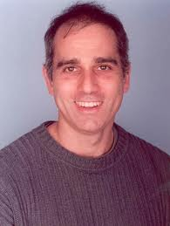
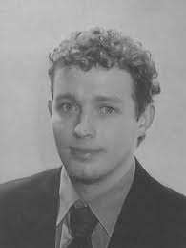
LegalRuleML TC
Adam Wyner
Uni. Aberdeen
Monica Palmirani,
CIRSFID, UniBO
Secretary
Chair
Guido Governatori,
NICTA, Australia
Adrian Paschke,
Uni. Berlin
Chair
Secretary
Tara Athan, Athan Services
Harold Boley, UNB

Slide 3
Outline
Introduction to LegalRuleML
Motivations, Goals, Principles
Design principles
LegalRuleML main blocks: meta, context, rules
Legal Statements and References
Temporal Events and Temporal Situations
Deontic
Penalty and Reparation
Defeasible
Alternatives
Metadata (Authority, Jurisdiction, Actor, Figure, Roles)
Future work

Slide 4
Motivating Example
National Consumer Credit Protection Act 2009: Section 29
(Prohibition on engaging in credit activities without a licence)
(1) A person must not engage in a credit activity unless the person holds a licence authorising the person to engage in the credit activity.
Civil penalty: 2,000 penalty units.
...
Criminal penalty: 200 penalty units, or 2 years imprisonment, or both.

Slide 5
Motivations
Legal texts are the privileged sources for norms, guidelines and rules that often feed different concrete Web applications.
Legislative documents, Contracts, Judgements
Guidelines (Soft Law) in eGovernment, eJustice, eLegislation, eHealth, banks, assurances, credit card organizations, Cloud Computing, eCommerce, aviation and security domain etc.
Proper and expressive conceptual, machine readable models of norms

Slide 6
Goal
The LegalRuleML TC, set up inside of OASIS at Jan 12, 2012 (www.oasis-open.org) with 25 members, aims to produce a rule language for the legal domain:
Based on the legal textual norms
Oriented to legal professionals
Compact integrated annotation
Logic-neutral
Flexible and extensible

Slide 7
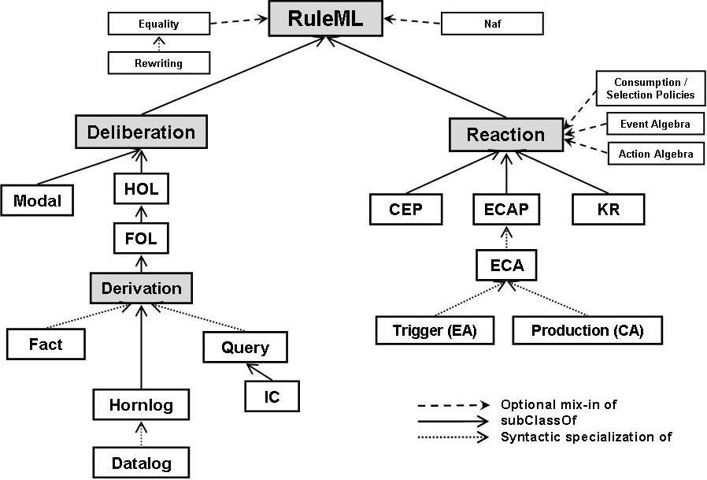
RuleML Family of Sublanguages
LegalRuleML
Consumer
RuleML
Extension
7

Slide 8
Main Requirements
Support for modelling different types of statements:
Constitutive rules (e.g. definitions)
Prescriptive rules (e.g. obligation, permission, etc.)
Facts …
Implement isomorphism [Bench-Capon and Coenen, 1992]
Implement defeasibility [Gordon, 1995, Prakken and Sartor, 1996, Sartor, 2005]
Model legal procedural rules

Slide 9
LegalRuleML Design Principles (1/2)
Multiple Semantic Annotations:
A legal rule may have multiple semantic annotations where each annotation can represent a different legal interpretation.
Each such annotation can appear in a separate annotation block as internal or external metadata.
Tracking the LegalRuleML Creators:
As part of the provenance information, a LegalRuleML document or any of its fragments can be associated with its creators.
Linking Rules and Provisions:
LegalRuleML includes a mechanism, based on IRI, that allows N:M relationships among the rules and the textual provisions
avoiding redundancy in the IRI definition and errors in the associations
LegalRuleML is independent respect any Legal Document XML standard, IRI naming convention

Slide 10
LegalRuleML Design Principles (2/2)
Temporal Management:
LegalRuleML must represent these temporal issues in unambiguous fashion
Formal Ontology Reference:
LegalRuleML is independent from any legal ontology and logic framework.
LegalRuleML is based on RuleML:
LegalRuleML reuses and extends concepts and syntax of RuleML.
Mapping to Rdf:
LegalRuleML metadata can be expressed in RDF for implementing Linked Data model.

Slide 11
Open Rule Architecture
Legal document in XML
Combine rules with other dataset
Interoperability and interchange
Retrieve rules and documents
Legal Ontology
Connection
with URI
Extraction in RDF
Linked Open Data
Logic Rules
Connection
with URI
ENGINE
Application Level

Slide 12
Language Design Principles
Minimality, which requires that the language provides only a small set of needed language constructs.
Referential transparency, which means that the same language construct always expresses the same semantics regardless of the context in which it is used. E.g., obligation
Orthogonality, where language constructs are independent of each other, thuspermitting their systematic combination. E.g., jurisdiction and authority
Pattern-based design, where design patterns are a distillation of common wisdom in organizing the structural parts, the grammar and the constraints of a language. E.g., Associations is a collection of Association.
Metamodel based, where the metamodel for a language, also defines the vocabulary for describing the language, including syntactic categories.

Slide 13
Partial Metamodel for Defeasible Concepts

Slide 14
Partial Metamodel for Statements Concepts

Slide 15
RuleML/LegalRuleML XML Design principle
Node and Edge Elements
There is a distinction between type (also called node) elements and role (also called edge) elements, the element name of the
Node starts with an upper case letter <Jurisdiction>.
edge with a lower case letter <hasJurisdiction>.
Node elements correspond to classes of the metamodel while edge elements correspond to relationships between members of these classes.

Slide 16
Document Structure: Metadata, Contexts, Statements
Textual References
Metadata
Contexts
Statement Context parameters like agents, times, sources, strength
Context
Association to Statements
N:M relationship
Statements
Rules, Facts, …

Slide 17
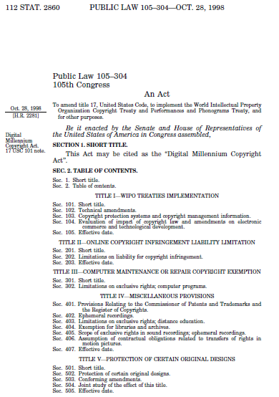
LegalRulML Approach
Context 1 of rule1
Context 2 of rule1
Digital Millennium Copyright Act
<lrml:Rule key="rule1">
<lrml:if> ...</lrml:if>
…. <lrml:then>... </lrml:then>
</lrml:Rule>...
<lrml:Rule key="rule2">
<lrml:if> ...</lrml:if>
…. <lrml:then>... </lrml:then>
</lrml:Rule>...
Multiple rules as interpretations of the same text

Slide 18
LegalRulML Approach
Digital Millennium Copyright Act
Context of rule3
<lrml:Rule key="rule3">
<lrml:if> ...</lrml:if>
…. <lrml:then>... </lrml:then>
</lrml:Rule>...
Multiple sources for the same rule

Slide 19
LegalRulML Approach
Digital Millennium Copyright Act
Context1 of rule4
Context2 of rule4
Context3 of rule4
<lrml:Rule key="rule4">
<lrml:if> ...</lrml:if>
…. <lrml:then>... </lrml:then>
</lrml:Rule>...
Multiple contexts (interpretations) for the same rule

Slide 20
LegalRulML Approach
2013
2013
Digital Millennium Copyright Act
Context T1 of rule2
Digital Millennium Copyright Act
NEW VERSION
Digital Millennium Copyright Act
NEW VERSION
<lrml:Rule key="rule2">
<lrml:if> ...</lrml:if>
…. <lrml:then>... </lrml:then>
</lrml:Rule>...
Versioning of the rules according
with the updating of the law
Context T2 of rule2-v2
<lrml:Rule key="rule2-v2">
<lrml:if> ...</lrml:if>
…. <lrml:then>... </lrml:then>
</lrml:Rule>...

Slide 21
LegalRuleML main blocks: Metadata
Metadata
Legal Sources
References
Agents, Figures
Authority
Time Instants
Temporal Characteristics
Jurisdiction
Role

Slide 22
LegalRuleML main blocks: Statements
Metadata
Legal Sources
References
Agents, Figures
Authority
Time Instants
Temporal Characteristics
Jurisdiction
Role
<lrml:Rule key="rule1">
<lrml:if> ...</lrml:if>
<lrml:then>... </lrml:then>
</lrml:Rule>...
<lrml:Rule key="rule2">
<lrml:if> ...</lrml:if>
<lrml:then>... </lrml:then>
</lrml:Rule>...

Slide 23
LegalRuleML main blocks: Context
Metadata
Legal Sources
References
Agents, Figures
Authority
Time Instants
Temporal Characteristics
Jurisdiction
Role
Context
association of metadata with rules
Context different author association of metadata with rules
Context different time and jurisdiction association of metadata with rules
Context
association of alternative interpretations of the same text
<lrml:Rule key="rule1">
<lrml:if> ...</lrml:if>
<lrml:then>... </lrml:then>
</lrml:Rule>...
<lrml:Rule key="rule2">
<lrml:if> ...</lrml:if>
<lrml:then>... </lrml:then>
</lrml:Rule>...

Slide 24
Document Structure: Metadata, Contexts, Statements
<lrml:LegalRuleML> <lrml:References> <Reference> ... </lrml:References> ... <lrml:Context key="ruleInfo1-v2">
<lrml:Association>
<lrml:appliesSource keyref="#sec2.1-list1-itm31-par1-v2"/>
<lrml:toTarget keyref="#rulebase1-v2"/>
</lrml:Association>
</lrml:Context>
<lrml:hasStatements key="rulebase-v2">
<lrml:ConstitutiveStatement key="rule1a-v2">
<ruleml:if> ...</ruleml:if>
<ruleml:then>... </ruleml:then>
</lrml:ConstitutiveStatement>
</lrml:hasStatements>...
</lrml:LegalRuleML>
Textual References
Rule Context parameters like agents, times, sources
Association between Text and Rules
N:M relationship
Rules

Slide 25
LegalRuleML main blocks
Metadata
Legal Sources
References
Agents
Authority
Time Instants
Temporal Characteristics
Jurisdiction
Role
Context
association of metadata with rules
<lrml:Rule key="rule1">
<lrml:if> ...</lrml:if>
<lrml:then>... </lrml:then>
</lrml:Rule>...

Slide 26
Legal Statements and References (2/2)
<lrml:LegalSources>
<lrml:LegalSource key="ref1“ sameAs="http://www.law.cornell.edu/uscode/text/17/504#psection-1"/>
</lrml:LegalSources>
URI
<lrml:References>
<lrml:Reference refersTo="ref2“ refID="/us/USCode/eng@/main#title17-sec504-clsc-pnt1“ refIDSystemName="AkomaNtoso2.0-2012-10"/>
</lrml:References>
Non-URI

Slide 27
Temporal Events and Temporal Situations
Event that define the
validity of the rules
<lrml:TimeInstants>
<ruleml:Time key="t1">
<ruleml:Data xsi:type="xs:date">1978-01-01</ruleml:Data>
</ruleml:Time>
</lrml:TimeInstants>
Type of event:
In force
Efficacy
<lrml:TemporalCharacteristic key=“tblock1">
<lrml:forRuleStatus iri="&lrmlv;#Efficacious"/>
<lrml:hasStatusDevelopment iri="&lrmlv;#Starts"/>
<lrml:atTimeInstant keyref="#t1"/>
<lrml:hasStatusDevelopment iri="&lrmlv;#End"/>
<lrml:atTimeInstant keyref="#t2"/>
</lrml:TemporalCharacteristic>

Slide 28
LegalRuleML main blocks: rules
Metadata
Legal Sources
References
Agents
Authority
Time Instants
Temporal Characteristics
Jurisdiction
Role
Context
association of metadata with rules
<lrml:Rule key="rule1">
<lrml:if> ...</lrml:if>
<lrml:then>... </lrml:then>
</lrml:Rule>...

Slide 29
Example
National Consumer Credit Protection Act 2009: Section 29
(Prohibition on engaging in credit activities without a licence)
(1) A person must not engage in a credit activity unless the person holds a licence authorising the person to engage in the credit activity.
Civil penalty: 2,000 penalty units.
…
Criminal penalty: 200 penalty units, or 2 years imprisonment, or both.

Slide 30
Deontic operators
Obligation +: a Deontic Specification for a state, an act, or a course of action to which a Bearer is legally bound, and if it is not achieved or performed results in a Violation.
Prohibition +: a Deontic Specification for a state, an act, or a course of action to which a Bearer is legally bound, and if it is achieved or performed results in a Violation.
Permission +: a Deontic Specification for a state, an act, or a course of action where the Bearer has no Obligation or Prohibition to the contrary.
Right +: a Deontic Specification that gives a Permission to a party (the Bearer) and implies there are Obligations or Prohibitions on other parties (the AuxiliaryParty) such that the Bearer can (eventually) exercise the Right.

Slide 31
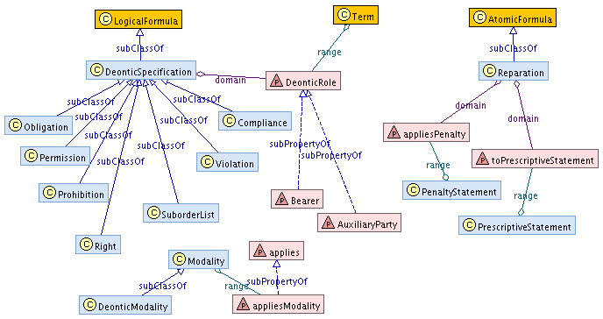
Metamodel in RDFS Partial Metamodel for Deontic Concepts
LegalRuleML classes are shown with blue fill, LegalRuleML properties with pink fill, RuleML classes with orange fill

Slide 32
Penalty and Reparation
Reparation
Penalty
PrescriptiveStatement
PenaltyStatement +: a Legal Statement of a sanction (e.g. a punishment or a correction).
Reparation +: an indication that a PenaltyStatement is linked with a PrescriptiveStatement, meaning that a sanction may apply when the PrescriptiveStatement entails a Deontic Specification, and there is a Violation of the Deontic Specification.
A penalty of 200 criminal unit is a reparation for violating the prohibition on engaging in a credit activity without a financial licence.

Slide 33
Defeasibility
body always head body -> head strict
body sometimes head body => head defeasible
body not complement head body ~> head defeater
R2 > R1
R1: A person must not engage in a credit activity. prohibition
R2: But if the person has a financial licence they may engage in a credit activity. permission
<lrml:hasQualification>
<lrml:Overrides over="#R2" under="#R1"/>
</lrml:hasQualification>

Slide 34
Example
National Consumer Credit Protection Act 2009: Section 29
(Prohibition on engaging in credit activities without a licence)
(1) A person must not engage in a credit activity unless the person holds a licence authorising the person to engage in the credit activity.
Civil penalty: 2,000 penalty units.
…
Criminal penalty: 200 penalty units, or 2 years imprisonment, or both.

Slide 35
Example
National Consumer Credit Protection Act 2009: Section 29
(Prohibition on engaging in credit activities without a licence)
(1) A person must not engage in a credit activity unless the person holds a licence authorising the person to engage in the credit activity.
Civil penalty: 2,000 penalty units.
…
Criminal penalty: 200 penalty units, or 2 years imprisonment, or both.
R1
R2
P1
P2
P3
P4

Slide 36
LegalRuleML modelling
At a given time t=2009, the author Guido, the authority “Consumer Credit Agency”, in the jurisdiction “Australia”, source text sec29
ps1: Person(x) => [FORB]EngageCreditActivity(x)
ps2: HasLicence(x) => [PERM]EngageCreditActivity(x)
ps2 > ps1
pen1: [OBL] PayCivilUnits(x,2000)
pen2:
[OBL] PayPenalUnits(x,200),
[OBL] Imprisonment(x,2y),
[OBL] PayPenaltyUnitsPlusImprisonment(x,200,2y)
rep1: [Violation]ps1, pen1
rep2: [Vioaltion]ps1, pen2

Slide 37
LegalRuleML main blocks
Metadata
Legal Sources
References
Agents
Authority
Time Instants
Temporal Characteristics
Jurisdiction
Role
Context
bridge between metadata and rules
<lrml:Rule key="rule1">
<lrml:if> ...</lrml:if>
<lrml:then>... </lrml:then>
</lrml:Rule>...

Slide 38
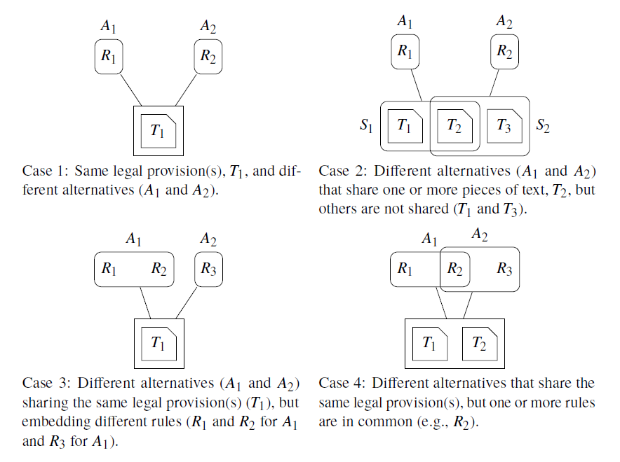
Alternatives

Slide 39
Alternative interpretations of the same text
Criminal penalty: 200 penalty units, or 2 years imprisonment, or both.
pen2a:
SUBORDERLIST {
[OBL] PayPenalUnits(x,200),
[OBL] Imprisonment(x,2y),
[OBL] PayPenaltyUnitsPlusImprisonment(x,200,2y)
}
Guido
pen2b:
OR {
[OBL] PayPenalUnits(x,200)
[OBL] Imprisonment(x,2y),
[OBL] PayPenaltyUnitsPlusImprisonment(x,200,2y)
}
Monica
<lrml:Alternatives key="alt1">
<lrml:fromLegalSources>
<lrml:LegalSources>
<lrml:hasLegalSource keyref="#sec29-par3"/>
</lrml:LegalSources>
</lrml:fromLegalSources>
<lrml:hasAlternative keyref="#pen2a"/>
<lrml:hasAlternative keyref="#pen2b"/>
</lrml:Alternatives>

Slide 40
LegalRuleML modelling
In a giving time t=2009, the author Guido, the authority “Consumer Credit Agency”, in the jurisdiction “Australia”, source text sec29
ps1: Person(x) => [FORB]EngageCreditActivity(x)
ps2: HasLicence(x) => [PERM]EngageCreditActivity(x)
ps2 > ps1
pen1: [OBL] PayCivilUnits(x,2000)
pen2a:
SUBORDERLIST {
[OBL] PayPenalUnits(x,200),
[OBL] Imprisonment(x,2y),
[OBL] PayPenaltyUnitsPlusImprisonment(x,200,2y)}
pen2b:
OR { [OBL] PayPenalUnits(x,200)
[OBL] Imprisonment(x,2y),
[OBL] PayPenaltyUnitsPlusImprisonment(x,200,2y) }
rep1: [Violation]ps1, pen1
rep2a: [Vioaltion]ps1, pen2a
rep2b: [Vioaltion]ps1, pen2b
Context_Author: Guido
Context_Author: Monica
Context_Author: Guido
Context_Author: Monica

Slide 41
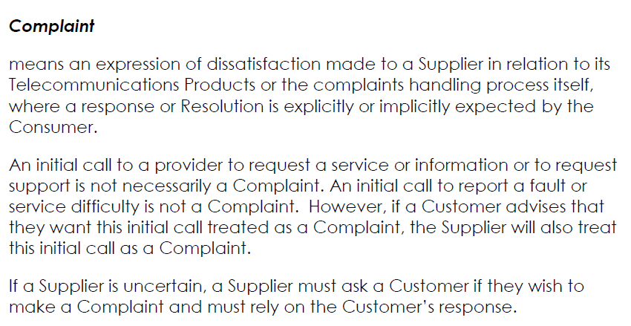
TCP Code C628:2012

Slide 42
TCP Code C628:2012
Complaint
means an expression of dissatisfaction made to a Supplier in relation to its Telecommunications Products or the complaints handling process itself, where a response or Resolution is explicitly or implicitly expected by the Consumer.
An initial call to a provider to request a service or information or to request support is not necessarily a Complaint. An initial call to report a fault or service difficulty is not a Complaint. However, if a Customer advises that they want this initial call treated as a Complaint, the Supplier will also treat this initial call as a Complaint.
If a Supplier is uncertain, a Supplier must ask a Customer if they wish to make a Complaint and must rely on the Customer’s response.
R1
R2
R3
R4
R5

Slide 43
Defeasibility
body always head body -> head strict
body sometimes head body => head defeasible
body not complement head body ~> head defeater
R2 > R1
R1: A person must not engage in a credit activity.
R2: But if the person has a financial license they can engage in a credit activity.
<lrml:hasQualification>
<lrml:Overrides over="#R2" under="#R1"/>
</lrml:hasQualification>

Slide 44
Complaint example from Telecommunications Consumer Protections Code C628:2012, Australia
Date of Assent: 30 May 2012
Date of Registration: 11 July 2012
sec2.1-v2
2.1
Complaint
means an expression of dissatisfaction made to a Supplier in relation to its Telecommunications Products or the complaints handling process itself, where a response or Resolution is explicitly or implicitly expected by the Consumer.
An initial call to a provider to request a service or information or to request support is not necessarily a Complaint. An initial call to report a fault or service difficulty is not a Complaint. However, if a Customer advises that they want this initial call treated as a Complaint, the Supplier will also treat this initial call as a Complaint.
If a Supplier is uncertain, a Supplier must ask a Customer if they wish to make a Complaint and must rely on the Customer‟s response.
Date of Efficacy: 1 September 2012
sec2.1-list1-itm31-v2
rule1a
par1-v2
rule1b
par2-v2
rule2
rule3
rule4
rule1b<rule2
rule1b<rule3
rule3<rule4
par3-v2
rule5

Slide 45
Complaint example from TCP Code C628:2012, Australia
<lrml:hasStatements key="rulebase1-v2">
<lrml:ConstitutiveStatement key="rule1b-v2">
<ruleml:if>
<ruleml:Atom key="rule1-atom2-v2">
<ruleml:Rel iri="#rule1-rel2-v2">is an expression of dissatisfaction made to a Supplier in relation to its Telecommunications Products or the complaints handling process itself, where a response or Resolution is explicitly or implicitly expected by the Consumer</ruleml:Rel>
<ruleml:Var>X</ruleml:Var>
</ruleml:Atom>
</ruleml:if>
<ruleml:then>
<ruleml:Atom key="rule1-atom1-v2">
<ruleml:Rel iri="#complaint-v2"/>
<ruleml:Var>X</ruleml:Var>
</ruleml:Atom>
</ruleml:then>
</lrml:ConstitutiveStatement>

Slide 46
Complaint example from TCP Code C628:2012, Australia
<lrml:PrescritiveStatement key="rule5-v2">
<lrml:if>
<ruleml:Atom key="rule5-atom1-v2">
<ruleml:Rel iri="rule5-rel1-v2">is uncertain if/wishes to make a Complaint</ruleml:Rel>
<ruleml:Var type="#supplier-v2">S</ruleml:Var>
<ruleml:Var type="#customer-v2">C</ruleml:Var>
</ruleml:Atom>
</lrml:if>
<lrml:then>
<lrml:Obligation key="rule5-ob1-v2">
<lrml:And key="rule5-and1-v2">
<ruleml:Atom key="rule5-atom2-v2">
<ruleml:Rel iri="rule5-rel2-v2">asks/if they wish to make a Complaint</ruleml:Rel>
<ruleml:Var>S</ruleml:Var>
<ruleml:Var>C</ruleml:Var>
</ruleml:Atom>
<ruleml:Atom key="rule5-atom3-v2">
<ruleml:Rel iri="#rule5-rel3-v2">relies on the response of</ruleml:Rel>
<ruleml:Var>S</ruleml:Var>
<ruleml:Var>C</ruleml:Var>
</ruleml:Atom>
</lrml:And>
</lrml:Obligation>
</lrml:then>
</lrml:PrescriptiveStatement>

Slide 47
Defeasibility
<lrml:hasQualification>
<lrml:Overrides over="#rule2-v2" under="#rule1b-v2“/>
</lrml:hasQualification>
<lrml:hasQualification>
<lrml:Overrides over="#rule3-v2" under="#rule1b-v2"/>
</lrml:hasQualification>
<lrml:hasQualification>
<lrml:Overrides over="#rule4-v2" under="#rule3-v2"/>
</lrml:hasQualification>
<lrml:hasQualification>
<lrml:Overrides over="#rule5-v2" under="#rule3-v2"/>
</lrml:hasQualification>

Slide 48
#2-Copyright law: copyright infringement
US “Digital Millenium Act” and modifications
goal: in t_{x} calculate the proper statutory damage in case of violation of the copyright taking in consideration all the exceptions and the modifications respect an fact.
17 USC Sec. 504
Remedies for infringement: Damages and profits
Three main versions
Enter in force of the norm | Interval of efficacy of the norm | Statutory Damages
Oct. 19, 1976 | [1976-10-19, March 1, 1989 [ | $250 <= statutoryDamages <= $10,000
Oct. 31, 1988 | [March 1, 1989, Dec. 9, 1999 [ | $500 <= statutoryDamages <= $20,000
Dec. 9, 1999 | [Dec. 9, 1999, ∞ | $750 <= statutoryDamages <= $30,000

Slide 49
Version 1
(c) Statutory Damages. -
(1) Except as provided by clause (2) of this subsection, the copyright owner may elect, at any time before final judgment is rendered, to recover, instead of actual damages and profits, an award of statutory damages for all infringements involved in the action, with respect to any one work, for which any one infringer is liable individually, or for which any two or more infringers are liable jointly and severally, in a sum of not less than $250 or more than $10,000 as the court considers just. For the purposes of this subsection, all the parts of a compilation or derivative work constitute one work.
(2) In a case where the copyright owner sustains the burden of proving, and the court finds, that infringement was committed willfully, the court in its discretion may increase the award of statutory damages to a sum of not more than $50,000. In a case where the infringer sustains the burden of proving, and the court finds, that such infringer was not aware and had no reason to believe that his or her acts constituted an infringement of copyright, the court it its discretion may reduce the award of statutory damages to a sum of not less than $100.
http://www.law.cornell.edu/uscode/text/17/504
R1
R2
R3

Slide 50
Version 1 [Jan. 1, 1978, March 1, 1989 [
(c) Statutory Damages. -
The copyright owner may elect an award of statutory damages for infringements in a sum of not less than $250 or more than $10,000 as the court considers just.
Version 2 [March 1, 1989, Dec. 9, 1999 [
(c) Statutory Damages. -
The copyright owner may elect an award of statutory damages for infringements in a sum of not less than $500 or more than $20,000 as the court considers just.
Version 3 [Dec. 9, 1999, ∞
(c) Statutory Damages. -
The copyright owner may elect an award of statutory damages for infringements in a sum of not less than $750 or more than $30,000 as the court considers just.

Slide 51
Rules
R1: if a piece of work is covered by copyright, then it is forbidden to use it.
C1: an infringer is defined as somebody who used a piece of work when it was forbidden to use it.
Section 504
R2: if the copyright owner claims statutory damages then the penalty for the infringer is to pay statutory damages of between $250 and $10,000.
R3: if the copyright owner sustains the burden of proof and the infringer infringes copyright willfully then the penalty for the infringer is to pay statutory damages of between $250 and $50,000.
R4: if the infringer sustains the burden of proof and the infringer infringes NOT willfully then the penalty for the infringer is to pay statutory damages of between $100 and $10,000.
Defeasability: R4 > R3 > R2

Slide 52
Conclusion and Future plans
LegalRuleML is an emerging XML standard for modelling legal rules oriented to the legal expert, that provides a compact and expressive syntax
RDF approach helps to foster the Open Rules in Linked Data and in Semantic Web
Last outcomes
integration with Reaction RuleML
meta-model for permitting export in RDF
Future outcomes
extensibility mechanisms of the schema
parameters in the syntax
case-law management

Slide 53
Where to find material of the tutorial
Schemas and Examples SVN: https://tools.oasis-open.org/version-control/browse/wsvn/legalruleml/trunk/examples/approved/?opt=dir&sc=1
XML schemas: https://tools.oasis-open.org/version-control/browse/wsvn/legalruleml/trunk/schemas/xsd/?sc=1#_trunk_schemas_xsd_
Documentation of the LegalRuleML TC: https://www.oasis-open.org/committees/tc_home.php?wg_abbrev=legalruleml
Glossary: https://lists.oasis-open.org/archives/legalruleml/201408/msg00011/Glossary-v20.odt

Slide 54
Thank you for your attention!

