Slide 1
OCPP Technical Committee Convener Call
14 July 2016

Slide 2
Agenda
Roll call
Member Comment Review
TC Launch Timeline
TC Resources
Promotion
Next Steps

Slide 3
Member Comment Review
Public archive of member comments http://lists.oasis-open.org/archives/oasis-charter-discuss/
Call for Comments ended 12 July 2016
Comments were received
Conveners to prepare a comment resolution log and final version of the charter prior to the Call for Participation

Slide 4
TC Launch Timeline
Draft Charter
Statement of work, scope, and other requirements defined in TC Process
Submitted by Convener to TC Admin 27 June
Call for Comment
14-day review by OASIS membership at-large
Issued by TC Admin 29 June, ended 12 July
Convener Call
Convener, TC Proposers review member comments, finalize charter
14 July
Comment Log & Final Charter
Due to TC Admin no later than 24 July
Convener may request a single, 10-day extension
Call for Participation
Minimum 45-day before first meeting (face-to-face)
Latest possible date 26 July
1st TC Meeting
Official TC launch, elections for chair/co-chairs
Earliest possible date 12 September

Slide 5
TC Launch Timeline
Upcoming actions:
Call for participation – no later than 26 July
Reminder of deadline to join with voting rights – 10 days prior to 1st meeting
Call for nominations for chair – 9 days prior
Last day to join with voting rights – 7 days prior
List of eligible voters to mailing list – 6 days prior
Inaugural meeting – TBD

Slide 6
TC Resources
Members-only TC web site / collaboration tools (“Kavi”)
Only OASIS members may view
Public TC web site (subset of Members-only)
TC mailing list
Publicly archived
Only TC Members may post
Only TC Members and Observers are subscribed (automatically)
TC comment list (non-member feedback to TC)
TC wiki*
JIRA issue tracking system*
Version control system*
*Created upon request

Slide 7
Promoting Your Work
TC Web Site (Public and Members-Only)
FAQ
LinkedIn Discussion
Press Release
Webinar
Interop Demos

Slide 8
OASIS Press Release
Must have at least 3 Sponsors
Chair(s) quoted on behalf of TC
Sponsors featured and quoted in release
Scheduled at least 7 days after 1st TC meeting
Deadlines posted to TC list in advance

Slide 9
TC Proposers’ Checklist
Submit Statement of Support to Convener (if not already done)
Join TC no later than 7 days prior to first TC meeting to secure voting rights
Post TC chair/co-chair nominations to TC list or at first meeting
Tweet, blog, post to Twitter, LinkedIn…
Invite or recommend other potential participants
Use TC list for chair nominations, scheduling; No work until 1st meeting

Slide 10
Convener’s Duties
Draft Charter
Draft charter in collaboration with potential TC Proposers
Identify at least 5 TC Proposers (from at least 2 organizational members)
Collect Statements of Support from TC Proposers’ Primary Reps
Submit draft charter to TC Admin
Call for Comment
Subscribe to oasis-charter-discuss list
Respond directly to each post, acknowledging receipt
Convener Call
Prepare summary of comments received (in advance of call)
Discuss and document resolution of each comment
Post Comment Resolution Log no later than 28 days from CfC start
Final Charter
Update charter per Comment Resolution Log (if appropriate)
Compile final TC Proposers list with Statements of Support
Submit to TC Admin within 5 days of Convener Call
Call for Participation
Join TC online
Post or update Discussion on LinkedIn OASIS Group
Prepare FAQ (or delegate to other TC Proposer), submit to Communications
Nominate yourself or others for chair/co-chairs via TC mailing list or at 1st meeting
Work with TC Admin to draft agenda for 1st meeting
1st TC Meeting
Convene meeting
Conduct election of chair/co-chairs

Slide 11
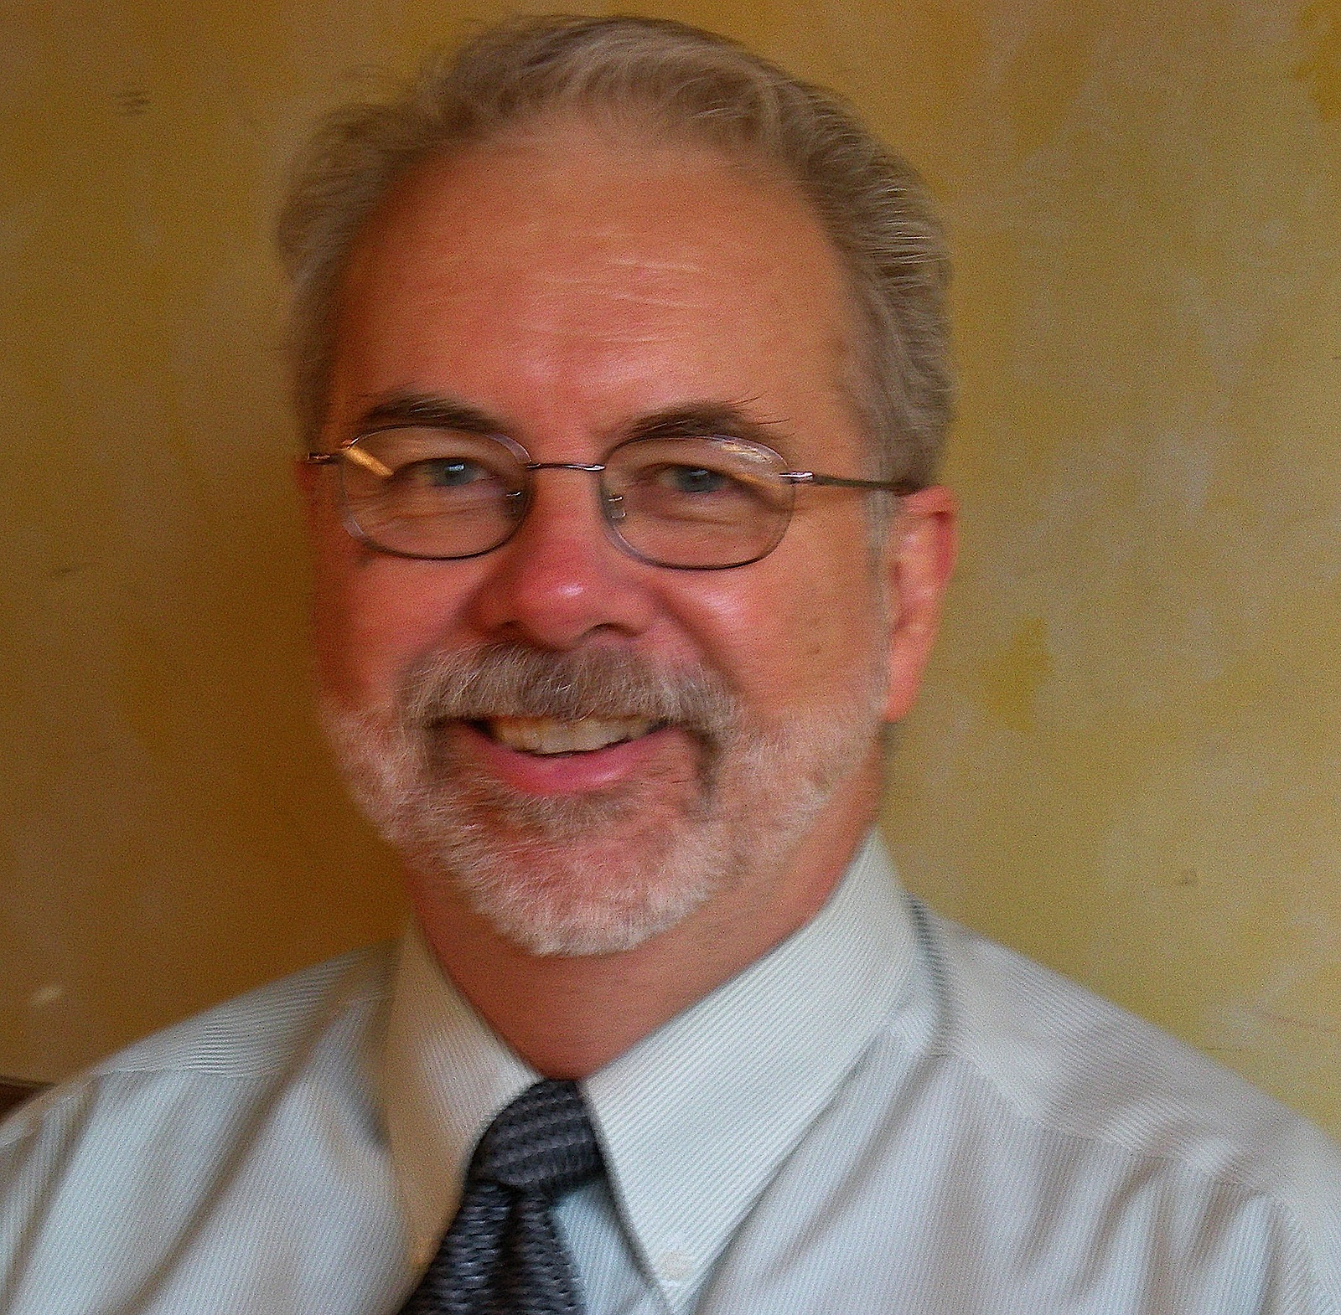
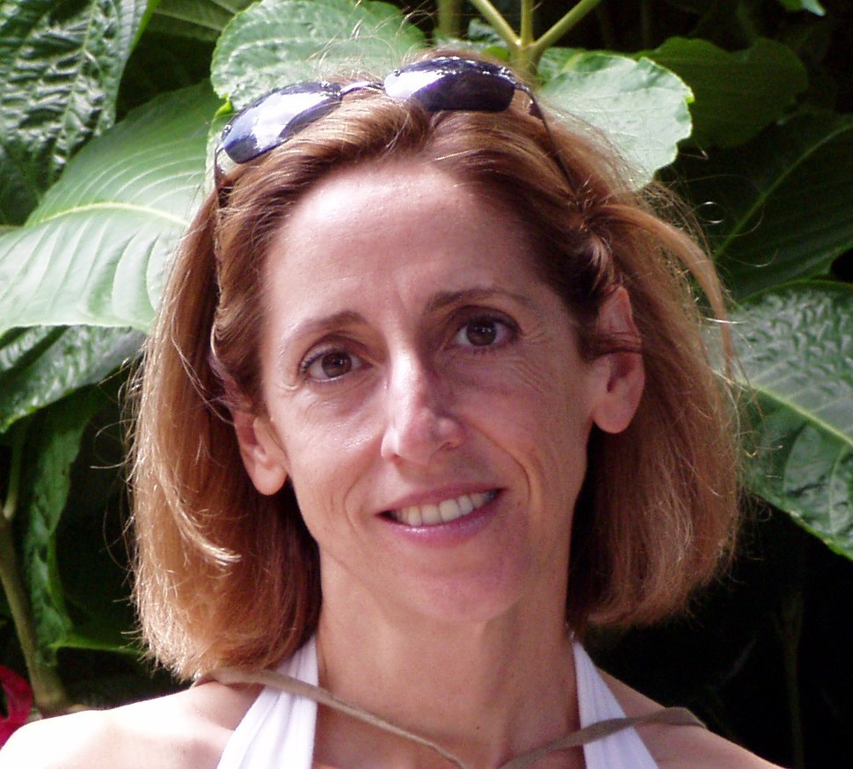
Contact Information
TC Admin:
Chet Ensign
chet.ensign@oasis-open.org
Communications, Recruiting:
Carol Geyer
carol.geyer@oasis-open.org

