Slide 1
Privacy Requirements Definition and Verification
POC: Stuart Shapiro
sshapiro@mitre.org
Approved for Public Release: 12-4246. Distribution Unlimited.

Slide 2
Privacy Requirements Definition and Testing as an Integrated Process
Privacy Testing as Part of Overall System Development Process
Objective: Expand requirements definition and testing to ensure privacy is enforced in systems development throughout the development life cycle
Vision & Strategy/
Privacy Principles
Privacy included in System Integration Testing and Validation
Privacy Requirements included in System Design
Application
Requirements/
Privacy
Requirements
Integration, Test,
and Evaluation
Privacy included in Unit Testing
Design
Development

Slide 3
Structuring Privacy Requirements
Contextual Privacy Requirements
Privacy Framework
Business Process
System Development
Privacy Principles
General Privacy Requirements
System
Detailed System Requirements
Operations
System Tests

Slide 4
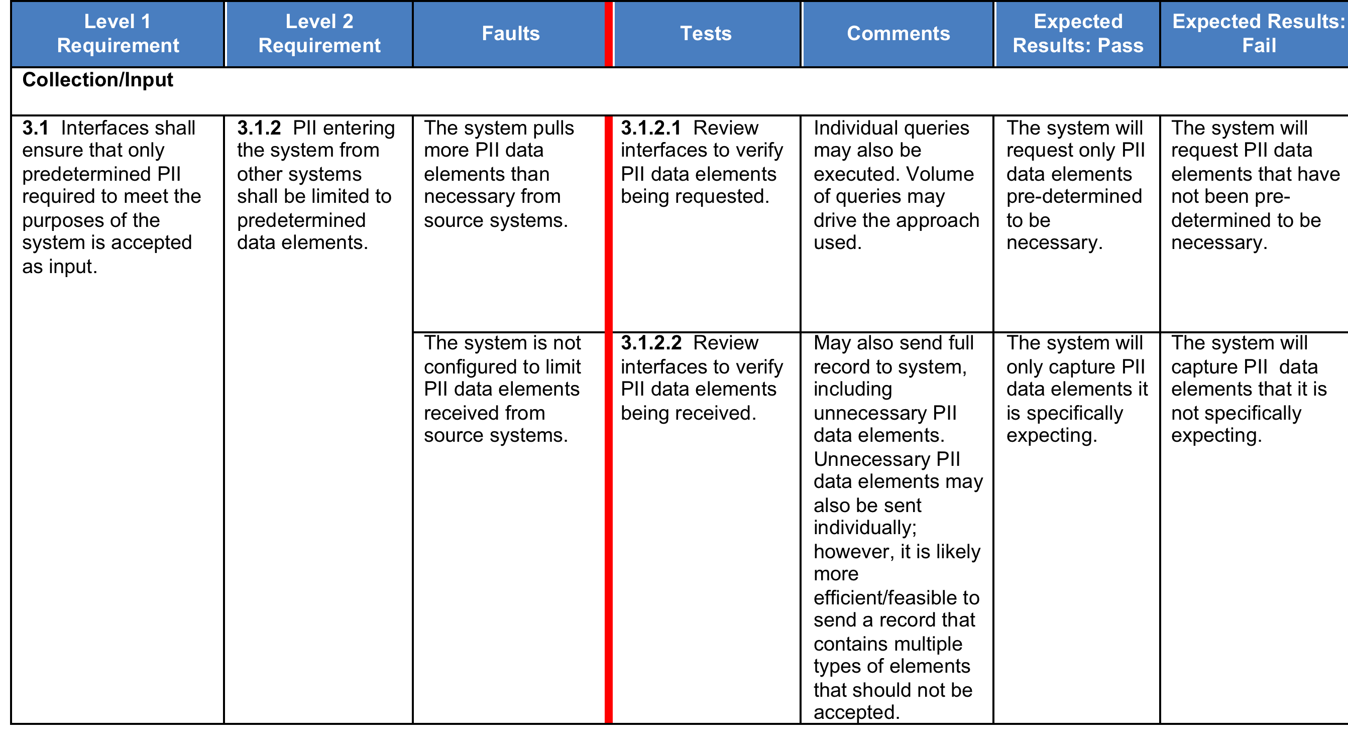

Slide 5
Implementing and Testing Privacy System Requirements Example: PII Minimization
PII entering the system from other systems shall be limited to predetermined data elements.
Software
Requirements
System retrieves unnecessary data elements
Execute Test
Plan
Unit Test
Plan
Implemented
Component
Fail
Execute queries against a data source to verify data elements being retrieved
System only retrieves necessary data elements
Pass

