Slide 1
OaSIS CTI Interop Showcase @ RSA 2017
13-17 February San Francisco, CA

Slide 2
Booth design
Latest booth space design, based on:
Option with the most votes (#4)
And miscellaneous feedback from the group

Slide 3
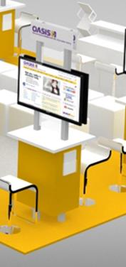
Booth space & location
South Expo Hall, Booth #2121 Reminder of what’s included in your workstation?
Small counter (size: 35” x 24”) and chair
Monitor (32”)
Electricity
Wired internet connectivity
Logo signage (above the monitor)
Equipment: Each participating company is responsible for bringing its own company equipment (including a computer) to the event. Please be mindful that all equipment MUST fit within your workstation. Monitors (32”) will be provided -- VGA and HDMI cords will available if the request has been received in advance.

Slide 4
Presentation area
Designate a lead from the group to help with organization of this activity
What the group needs to decide:
Presentation content to cover all companies (overall story) or individual company demonstrations (please note we have 12 companies involved)
Based on the above, designate one presenter (on behalf of the group) or a rep from each company to present
Review the schedule, which includes: Monday, 13 Feb - 5:00 - 7:00 PM Tuesday, 14 Feb - 10:00 AM – 6:00 PM Wednesday, 15 Feb - 10:00 AM - 6:00 PM Thursday, 16 Feb - 10:00 AM – 3:00 PM
And discuss ways to generate interest onsite (marketing ideas). Depending on the final booth design costs – a small amount of money may be available to purchase a giveaway to help encourage folks. That should be determined before the holidays.

Slide 5
Registration
Exhibit Staff Badges—Each company is entitled to receive two “Exhibitor Badges.” Please forward the names of your two individuals (including full name, job title, email and cell number) by 16 December. Any extra booth staff pass options will be noted in January and will be allocated on a first-come, first-served basis.
If you would like to register to attend the RSA conference, RSA is offering an early bird discount until 16 January. Other conference discounts are posted on the RSA website: https://www.rsaconference.com/events/us17/register.
Complimentary Show Passes—XE7WASISA. Please share this code with your customers and prospects.

Slide 6
Coming soon in 2017
Shipping Information
CTI Interop Showcase Flyer
Press Release
__________________________________________________________________
Questions?

