Slide 1
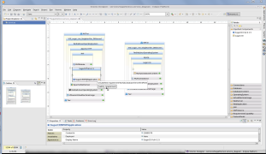
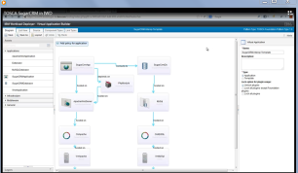
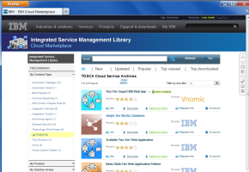
Interoperability Demonstration Overview
Shown at Eurocloud/ICS
Not shown in this demo
Service Designer
IBM Workload Deployer
TOSCA design tools
Other design tools
Service marketplaces
Other marketplaces
ISM Cloud Marketplace
SAP HANA
Marketplace
TOSCA cloud managers
Workload Deployer and SmartCloud
Other clouds
Cloud Services
FlexFrame Orchestrator
Suite
TOSCA ecosystem
Telco Cloud Solution
Cloud Monitoring
Other cloud optimization tools

