Slide 1
Business Payments Coalition: E-Invoicing Initiative
Todd Albers
1/8/2018
Payments, Standards, & Outreach Group
Federal Reserve Bank of Minneapolis

Slide 2
Disclaimer
The opinions expressed are those of the individual presenters & not those of the Federal Reserve System or any Federal Reserve Bank
©2017 Federal Reserve Bank of Minneapolis. Materials are not to be used without consent.
Notes:
This is always a tough slide to fit into my presentation flow, but I need provide you with this disclaimer, that basically states what you hear from me today is my opinion, and it does not represent the federal reserve system or any of the federal reserve banks.
See, it just doesn’t fit. Anyway, with that completed, let me introduce myself and provide some background.

Slide 3
Strategies for Improving the U.S. Payment System
Five strategies in pursuit of five desired outcomes
SPEED
1. Actively engage with stakeholders on initiatives designed to improve the U.S. payment system.
2. Identify effective approach(es) for implementing safe, ubiquitous, faster payments.
3. Reduce fraud risk and advance the safety, security and resiliency of the payment system.
4. Achieve greater end-to-end efficiency for domestic and cross-border payments.
5. Enhance Federal Reserve Bank payment, settlement and risk management services to address identified gaps.
SECURITY
EFFICIENCY
INTERNATIONAL
COLLABORATION
Notes:
The genesis for the Federal Reserves interest in e-invoicing came with the release of the Strategies for Improving the U.S. Payment System paper in 2015. The SIPS paper outlined 5 strategies and tactics the Federal Reserve will pursue, in collaboration with industry stakeholders, to help the country achieve these desired outcomes Speed, Security, Efficiency, International, and Collaboration for the US payment system.
I’m not going to spend any great deal of time detailing out the strategies, but, you may have heard of the Faster Payments Task Force, which was focused on identifying effective approaches for implementing safe, ubiquitous, and faster payment capabilities. Or you may have heard about the Secure Payments Task Force, which focused on reducing payment fraud and advancing the safety, security and resiliency of the payment system.
Finally, the Federal Reserve has several efficiency initiatives to enhance the US payment system through work on standards, such as ISO 20022, payment information directories, and business-to-business payment transaction improvements, and efforts to enhance the Fed-provided services for same-day ACH, risk management and settlement.

Slide 4
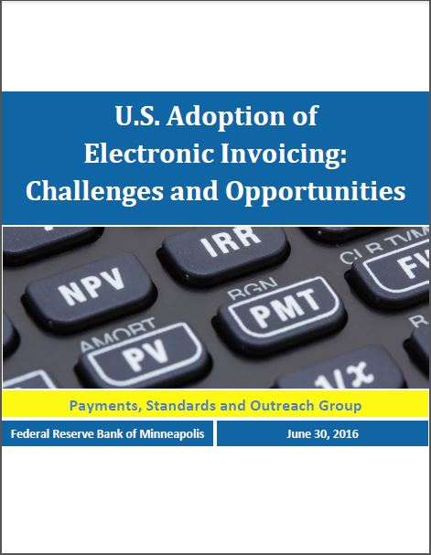
Focus on B2B Payment Efficiency
Specifically calls to explore the possibility of developing & implementing a standard, ubiquitous B2B electronic invoice & processing platform
Exploration resulted in a whitepaper reporting on the current global activities with e-invoices, potential benefits, & the barriers to greater adoption in the U.S. market
Notes:
Specific to e-invoicing, the SIPS paper called out to explore the possibility of developing & implementing a standard, ubiquitous B2B electronic invoice & processing platform similar to solutions done in other countries – i.e. think Europe and Australia.
The fed convened a expert group at the end of 2015, and the results of their work was the whitepaper I have referenced several times today - U.S. Adoption of Electronic Invoicing: Challenges and Opportunities.
The whitepaper also lead into a establishing a work group under the business payments coalition to catalog the electronic invoice technical standards in use in the U.S.

Slide 5
Federal Reserve Next Steps in the Payments Improvement Journey
Summarizes progress toward desired outcomes
Outlines the Federal Reserve’s planned next steps
Serves as a call to action for all stakeholders
Notes:
In September, the Fed released an updated to the SIPS paper, called the Next Steps in the Payments Improvement Journey.
This paper provided an update on each of the desired outcomes, what progress has been made, what challenges and opportunities exist for each desired outcome, and what are the next steps the Federal Reserve will pursue on the journey to improve the US payment system.

Slide 6
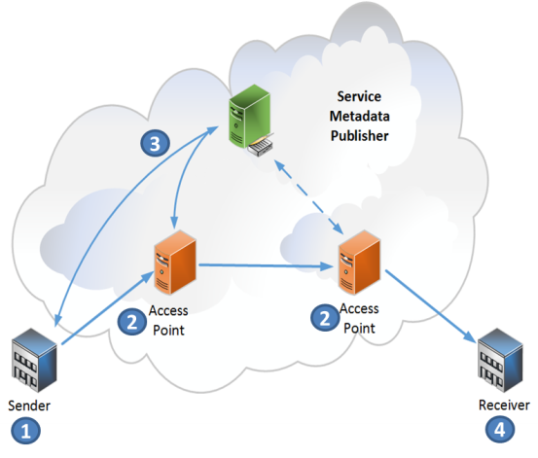
Next Steps towards B2B Payment Efficiency
Calls out to support industry efforts to develop and promote adoption of standards that enable end-to-end electronic processing of business invoices, payments, and remittance information.
As part of the Business Payments Coalition, the Federal Reserve will support a 3-year initiative to design an electronic invoice Interoperability Framework for the U.S. Market.
©2018 Federal Reserve Bank of Minneapolis. Materials are not to be used without consent.
6
Notes:
In the Next Steps paper, several new tactics for efficiency were described outlining what the Federal Reserve will pursue with industry stakeholders to support efforts to develop and promote the adoption of standards which enable end to end electronic processing for business invoices, payments, and remittance information.
This work will be done through a group called the Business Payments Coalition. The work that the Federal Reserve will support is for the business payments coalition to develop and design an electronic invoice interoperability framework for the US market.
I will tell you more in a couple of slides what this means. But first, I want to introduce you to the Business Payments Coalition.

Slide 7
Business Payments Coalition
Mission: Work together to solve problems related to processing information associated with B2B payments in order to promote use of electronic payments & straight through processing (STP).
Participation: Formed in 2011, the coalition members consist of National group of associations, small & large businesses, financial institutions, technology & software vendors, standards development organizations & others.
Notes:
The Business Payments Coalition is made up of a group of volunteers from national associations, small & large businesses, financial institutions, technology & software vendors, standards development organizations and others focused on working together to solve issues related to processing B2B payment transaction, including invoicing and remittance. Ultimately, coalition’s goal is to move the market towards more straight through processing.
Along with e-invoicing, the business payments coalition provides education and resources on ISO 20022, developed and manages the small business payments toolkit, convenes the vendor forum, which provides a community for vendors and service providers to collaborate on barriers to B2B transaction automation, and is currently working on developing a set of standards for remittance advices that would be payment method agnostic.

Slide 8
E-Invoicing Work Group
Develop a catalog of electronic invoice syntax, formats, and subsets used in the U.S.
Mission:
Established in the fall of 2016, Identify ways to accelerate the adoption of B2B
e-invoicing by all types and sizes of U.S. Businesses
Objectives:
Define what a electronic invoice is for the U.S. market
Develop an interoperability framework
Develop an implementation guide
©2018 Federal Reserve Bank of Minneapolis. Materials are not to be used without consent.
8
Notes:
The e-invoicing work group was established to support the SIPS desired outcomes. The work groups’ mission is to identify ways to accelerate the adoption of B2B e-invoicing by all types and sizes of US businesses.
If you go back a few slides, remember when I mentioned by 2024 the US market will grow to only 38% e-invoicing? Well, this work group is looking at ways to accelerate the growth rate to get the U.S. market more in line with what other countries are working towards.
Several of the objectives of this work group include:
Develop a catalog of electronic invoice syntax, formats, and subsets used in the US – which was completed and published in October.
Define what an electronic invoice is for the us market
Develop an interoperability framework
Develop an implementation guide
For the last 2 bullets, The Next Steps paper highlighted the Fed commitment and support for a 3 year initiative to develop the interoperability framework requirements.

Slide 9
Accelerating B2B Transactions
Putting the final piece of the puzzle together
Same Day
ACH
E-Invoicing
Interoperability Framework
Remittance data
FedWire & CHIPS
ISO 20022
TCH Real-Time Payment System
Notes:
The focus has been accelerating the clearing and settlement of the payment. The missing piece has been processing of the invoice from the sender to receiver. The E-Invoicing Interoperability Framework completes the puzzle by addressing the challenges businesses need to overcome with exchanging business documents, such as invoices, between them.

Slide 10
Opportunity for the U.S.
Adopt an open, standards-based approach to enable straight through processing
Engage industry to develop a U.S. centric e-invoicing and remittance interoperability framework implementation model
Leverage lessons and strategies from successful models in other countries

Slide 11
E-Invoicing and Remittance Interoperability Framework
An interoperability framework is an overarching set of policies, standards and guidelines that enable businesses to communicate irrespective of the system or standards they use
It is a logical model for document and message delivery
It is payment-method agnostic
It is a standards-based, structured framework that is designed to be flexible to meet a variety of business needs

Slide 12
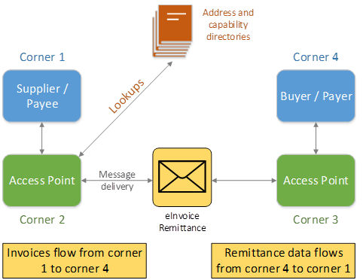
Examples of an Interoperability Framework Model
Telecommunications
Using established telecommunication standards, end users can communicate across networks and borders
An e-Invoicing and Remittance Interoperability Framework
similarly, would use established standards over an open network; trading partners can exchange documents

Slide 13
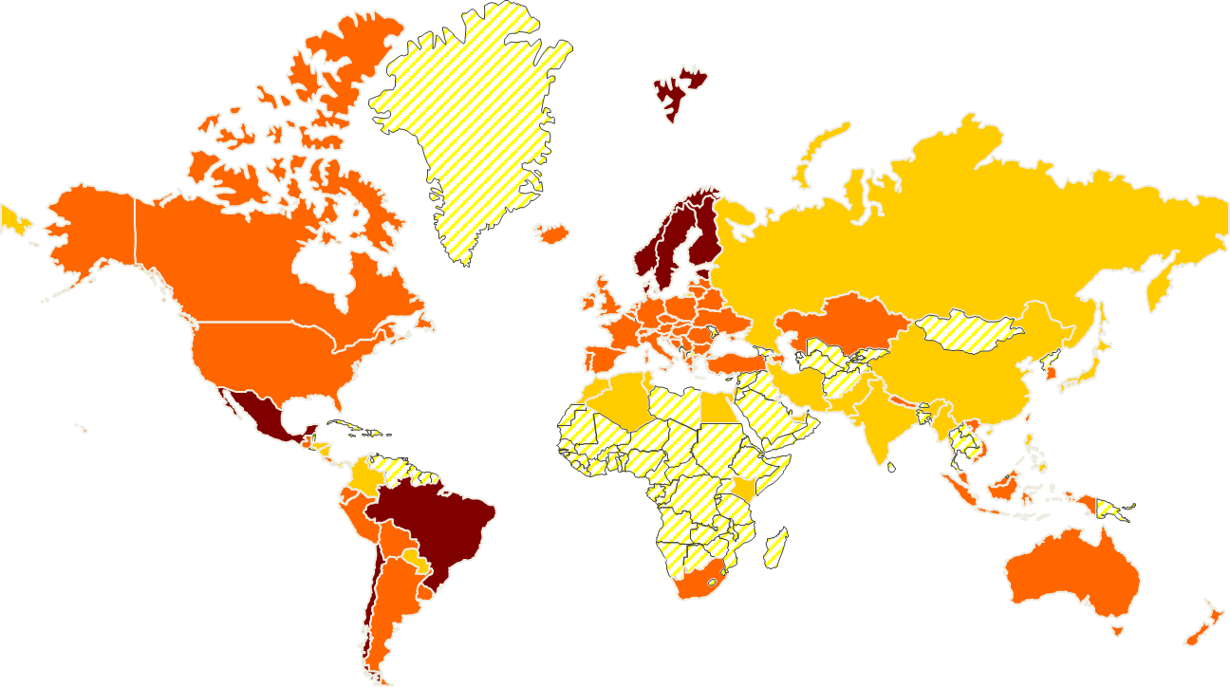
Global Movement – Standardized Business Documents and Delivery
Norway - Proposal to use OASIS BDX for eDelivery for ISO 20022 messages
Pan European Procurement Online (PEPPOL) – Uses OASIS BDX and UBL for B2G documents (pre-award, tendering, and invoices)
E-Freight Project uses OASIS BDX and UBL for freight & transportation
E-Codex – Uses OASIS BDX for eSignature for judiciary sector
Australia – Digital Business Council uses OASIS BDX and UBL
New Zealand – Looking at using the Digital Business Council specifications uses OASIS BDX and UBL

Slide 14
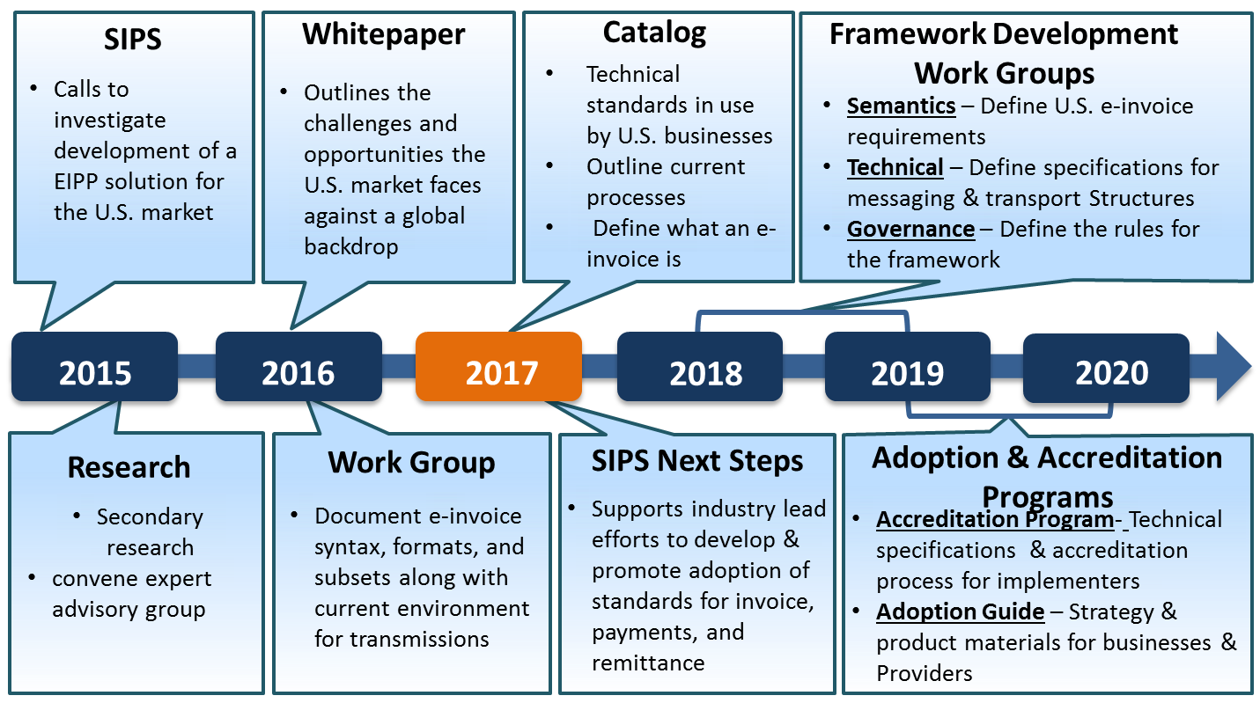
Roadmap to a E-Invoicing Interoperability Framework
©2018 Federal Reserve Bank of Minneapolis. Materials are not to be used without consent.
140
Notes:
So, how do we get there? How do we move the market to a interoperability framework? As I mentioned with the SIPS Next Steps paper, the Federal Reserve will support the development of a interoperability framework.
On this slide is a the roadmap that the Business Payments Coalition e-invoicing work group will be working towards to develop a set of requirements for the market.
One of the benefits we have for not moving sooner on this in the U.S., is we doesn’t need to start from a blank slate – a lot of the work has been done. We can leverage the work from Europe and Australia with our requirements.
Also, many of the service providers in attendance at this conference have a presence in these markets where frameworks have been created. Leveraging the learnings and tools from those implementations, the e-invoicing work group has a great head start. The market just needs that catalyst to lead the effort to make the change!
With that said, a lot of work needs to be done. The work groups are just forming, and we are looking for organizations to participate in the business payments coalition to help out with transforming the US market and move it towards more e-invoicing and, ultimately, straight through processing!
If you want to join, please feel free to stay afterwards and exchange business cards or you can find me hanging out on the exhibition floor.
Thank you, again for attending this session.

Slide 15
Questions?
Notes:
I want to thank you for attending this session.

Slide 16
Thank You!
Contact me with additional questions or interest in joining the Business Payments Coalition at todd.albers@mpls.frb.org
Notes:
Thank you very much for attending my session today. I appreciate the fact you participated in the session, and I hope that I was able to provide you with information on how this industry effort could potentially impact you in the future and how you manage incoming invoices for processing.
One last call out, if you are interested in participating with the work groups, please feel free to stay behind or send me an email at todd.albers@mpls.frb.org.
Again thank you.

