Slide 1
XACML Showcase
RSA Conference 2012

Slide 2
What is XACML?
XML language for access control
Coarse or fine-grained
Extremely powerful evaluation logic
Ability to use any available information
Superset of Permissions, ACLs, RBAC, etc
Scales from PDA to Internet
Federated policy administration
OASIS and ITU-T Standard

Slide 3
Trends Driving Fine-Grained Access Control
Complex authorization scenarios
  Multiple attributes and attribute sources required for evaluation
De-perimeterization
  A firewall is no longer sufficient security
Service Oriented Architecture
  Multiple access contexts for each service
Software as a Service (looking forward)
  Complex interactions of internal and external components

Slide 4
Powerful Policy Expression
“Anyone can use web servers with the ‘spare’ property between 12:00 AM and 4:00 AM”
“Salespeople can create orders, but if the total cost is greater that $1M, a supervisor must approve”
“Anyone view their own 401K information, but nobody else’s”
“The print formatting service can access printers and temporary storage on behalf of any user with the print attribute”
“The primary physician can have any of her patients’ medical records sent to a specialist in the same practice.”

Slide 5
Key XACML Features
Federated Policy Administration
  Multiple policies applicable to same situation
  Combining rules to resolve conflicts
Decision may include Obligations
  In addition to Permit or Deny
  Obligation can specify present or future action
  Examples: Log request, require human approval, delete data after 30 days
Protect any resource
  Web Server, Java or C++ Object, Room in building, Network Access, Web Service, Geographic Data, Health Records, etc.

Slide 6
XACML Benefits
Standard Policy Language
  Investment protection
  Skills reuse
Leverage XML tools
Policy not in application code
  Reduce cost of changes
  Consistent application
  Enable audit

Slide 7
XACML Architecture
PDP
PDP
PDP
Client
Application
Decision
PDP
Resources
PEP
Enforcement
Administration
Attribute
Repositories
Policy
Repository
Authorities

Slide 8
XACML 3.0 New Features
Administration/Delegation Profile
Request context generalization
New Combining Algorithms
Generalized Multiple Decision Requests
Advice (non-binding Obligations)
New time and Xpath functions

Slide 9

European Identity Award 2011
XACML 3.0

Slide 10
XACML Showcase - RSA 2012
Demonstrating policies that govern access to Intellectual Property
Metadata carried in documents
Based on draft Intellectual Property Control Profile
Documents served from different server types

Slide 11



Showcase Participants

Slide 12
Intellectual Property Control Profile
Policy-based access control to IP resources, such as proprietary, patent, and copyright information.
Standardized attribute name and value pairs promote more granular authorization model.
The potential loss of IP is not only an existential threat to companies, but also a security threat to nation states.
(continued)

Slide 13
Intellectual Property Control Profile
  Subject Attributes
    Organizational Affiliation
    Organization Type
    Organizational Relationship
    Affiliation-Type
    Agreement-Id
(continued)

Slide 14
Intellectual Property Control Profile
  Resource Attributes
    Copyright, Patent, Proprietary, Public Domain, Trademark
    IP Owner, IP Designee, Agreement Type, Agreement Id, Effective Date, Expiration Date
  Obligations
    Encrypt, Marking
    (not part of showcase)

Slide 15
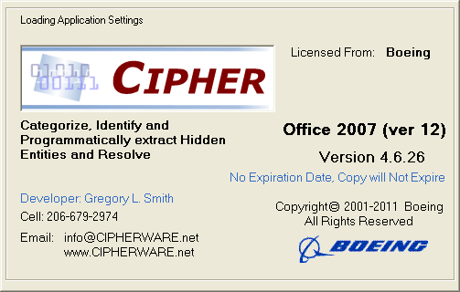
What is Boeing CIPHER?
Windows based application designed to examine electronic documents for:
  1. Information that is hidden from view and
  2. User defined key word phrases
The software is used extensively within Boeing,
the U.S. Military and Fortune 500 companies
to support:
  Trusted Download - supports searching for key words and embedded objects to determine category
  Export Compliance - supports searching for program specific key words and identifies hidden or obscured information to determine exportability
  Information / Software Release processes - supports searching for categorization phrases to determine release-ability
  Document Categorization - supports searching for key phrases to identify intellectual property, PII, and unique technologies
  Metadata (“tagging”) – supports tagging of documents with metadata based on key words or patterns.
  Computer Forensics - supports identification of embedded objects, code (malware) to determine threat level

Slide 16
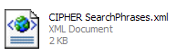
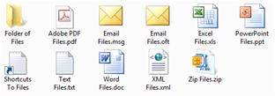
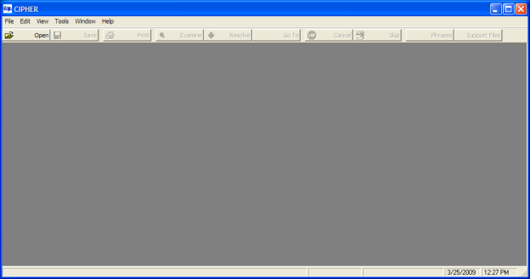
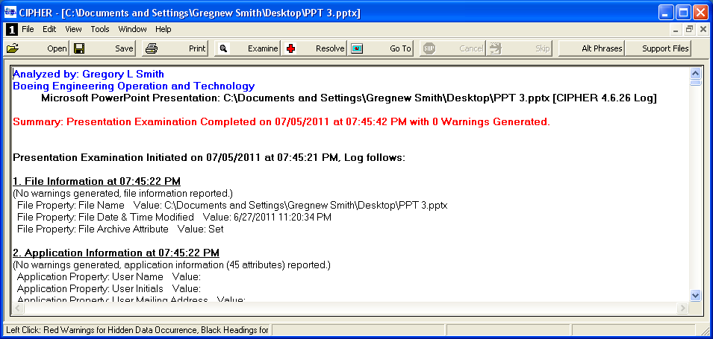
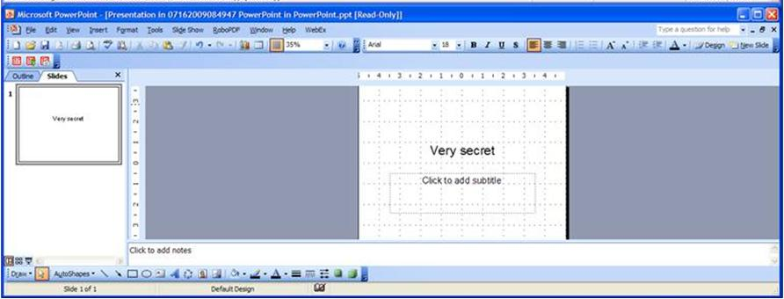
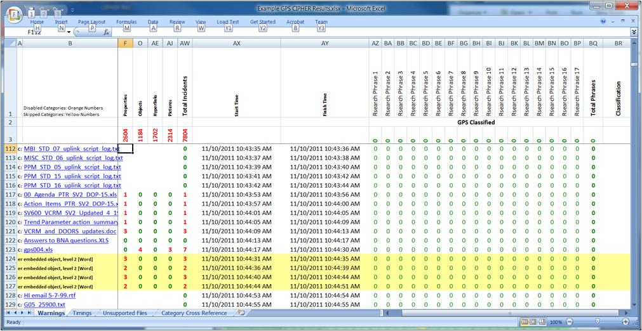
CIPHER Document Categorization Use Case
Key word phrases are defined using CIPHER and stored for future use.
File(s) to be analyzed are dragged and dropped on the CIPHER application.
CIPHER opens the file in its native application and analyzes the file for previously defined key word phrases. The analysis results are documented in a log.
6. The file(s) is/are optionally saved.
Based on which key phrases are located and their confidence factors, CIPHER assigns metadata attributes to the document and writes them in the document properties.
.
When multiple documents are analyzed, a results Excel workbook is created detailing the results of all of the documents.

Slide 17
Showcase Configurations
Documents
Client
Attributes
Decision
Document Server
PDP
PEP
Enforcement
Attributes
Attributes
Administration
Attribute
Repositories
Policy
Repository
Authorities

