Slide 1
XLIFF 2.0 Glossary Module / TBX-Basic
Facilitating Interoperability and Compatibility

Slide 2
XLIFF 2.0 – Glossary Module
“XLIFF is the XML Localisation Interchange File Format…intended to give any multilingual content owner a single interchange file format that can be understood by any localization provider, using any conformant localization tool.”
“Simple glossaries…can be optionally embedded in an XLIFF document using the namespace mechanism to include elements from the Glossary module.”
XLIFF 2.0 Specification (http://docs.oasis-open.org/xliff/xliff-core/v2.0/cos01/xliff-core-v2.0-cos01.html)

Slide 3
TBX-basic
“A TBX-Basic file is an XML document that conforms to the constraints of the TBX-Basic terminological markup language (TML) and contains terminological information.”
- TBX-Basic
Translation-oriented Terminology Made Simple (Melby 2008) (http://www.ttt.org/tbx/AKMtradumaArticle-publishedVersion.pdf)

Slide 4
Glossary Structure

Slide 5
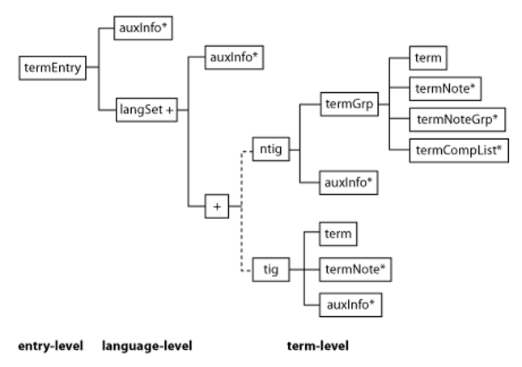
Tbx-Basic Structure
Figure from TBX-Basic Spec

Slide 6
Glossary Element:
<gls:glossEntry>
Definition:
Mapped to TBX-Basic:

Slide 7
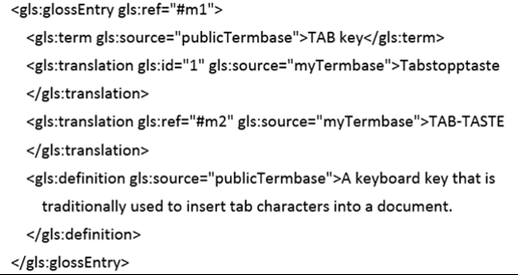
Example:
glossEntry
termEntry

Slide 8
Glossary Element:
<gls:term>
Definition:
Mapped to TBX-Basic:

Slide 9
Example:
gls:term
term

Slide 10
Glossary Element:
<gls:translation>
Definition:
Mapped to TBX-Basic:
(Nested in the langSet of the target)

Slide 11
Example:
gls:translation
term (of target language)

Slide 12
Glossary Element:
<gls:definition>
Definition:
Mapped to TBX-Basic:

Slide 13
Example:
gls:ref
descrip type=‘definition’

Slide 14
Glossary Element:
<gls:ref>
Definition:
Mapped to TBX-Basic:

Slide 15
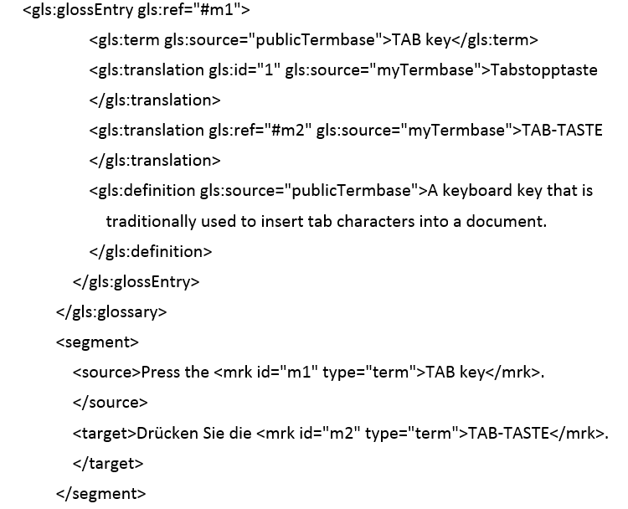
Example:
gls:ref & segments
descrip type=‘example’

Slide 16
Glossary Element:
<gls:source>
Definition:
Mapped to TBX-Basic:

Slide 17
Example:
gls:source
descrip type=‘entrySource/source’

Slide 18
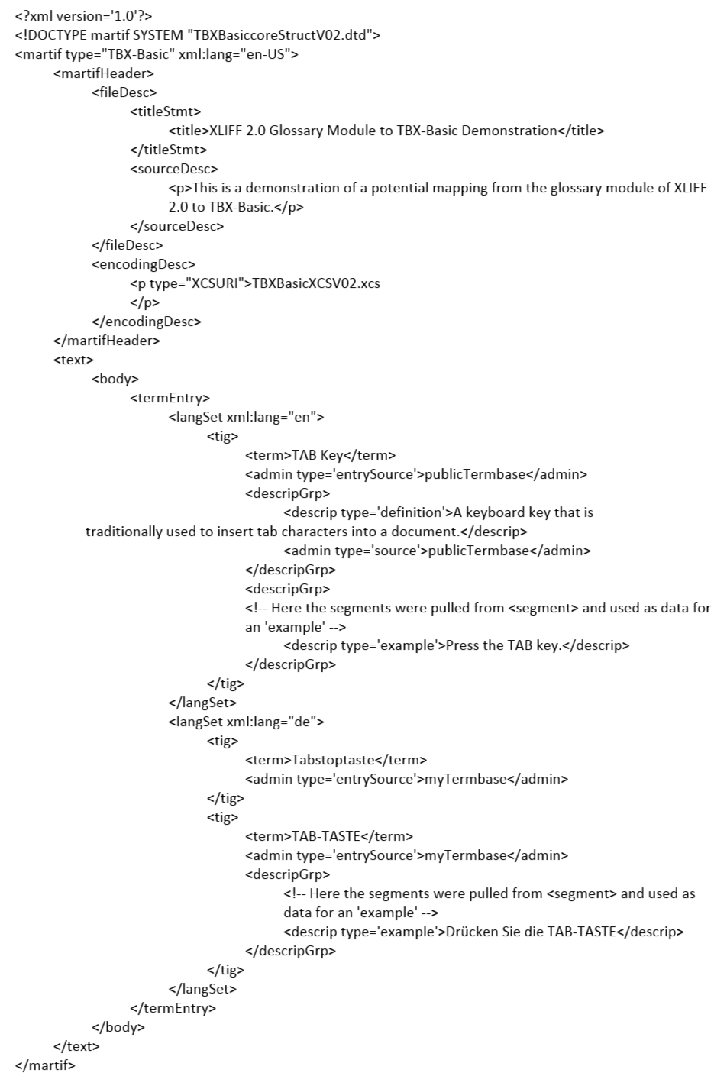
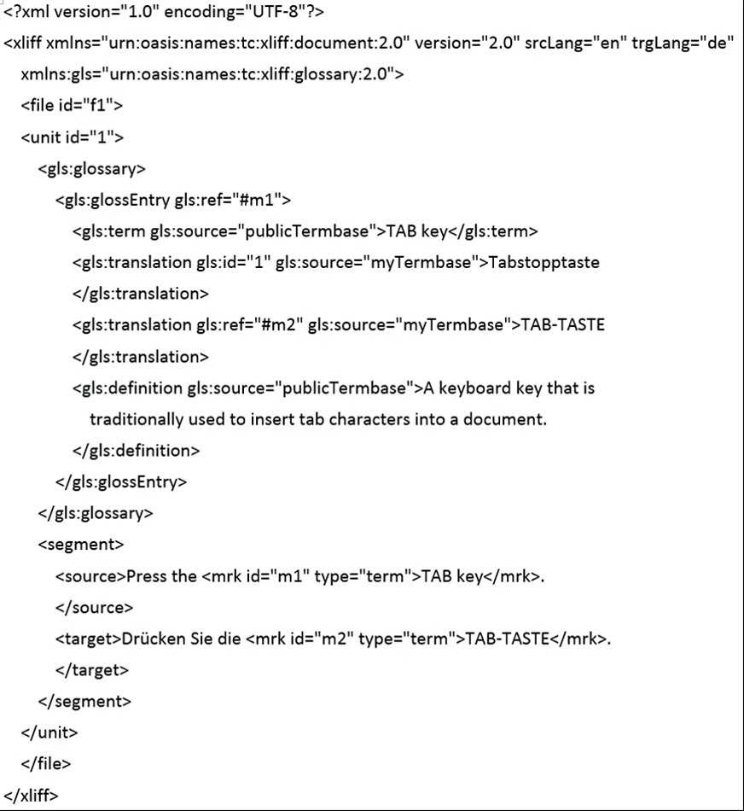
Complete Sample File (XLIFF on left, TBX on right)

Slide 19
XLIFF samples provided by: Soroush Saadatfar, PhD Student, LRC/CNGL
Presentation and TBX samples by: James Schofield Hayes, Linguistics Major, BYU Translation Research Group Research Assistant
Created for: Dr. Alan Melby and Dr. David Filip

