Slide 1
AMQP 1.0 Briefing Pack
by John O’Hara and Matthew Arrott
Co-Chairs OASIS AMQP Member Section
john.ohara@taskize.co.uk / marrott@novgp.com

Slide 2
Agenda
Introduction to messaging
The case for AMQP
What is AMQP 1.0?
Comparison to HTTP
AMQP 1.0 implementations
Summary

Slide 3
OASIS AMQP 1.0 Standard released
Software users and vendors can invest in AMQP 1.0 knowing it’s a stable, well-supported protocol standard
Aviation
SITA
Financial Services
Bank of America, N.A.
Barclays Bank Plc
Credit Suisse
Deutsche Börse
Goldman Sachs
JPMorgan Chase Bank, N.A.
Government
US Dept. of Homeland Security
Technology
Axway Software
Cisco Systems
Flame Computing Enterprises
HCL Technologies Ltd
Huawei Technologies
IIT Software GmbH
INETCO Systems Limited
Kaazing Corporation, N.A.
Microsoft Corporation
Mitre Corporation
Primeton Technologies
Progress Software
Red Hat Inc.
Software AG
Solace Systems Inc.
StormMQ Ltd.
Tervela Inc.
Thales e-Security
TWIST Process Innovations
VMware, Inc.
WS02 Inc.

Slide 4
The Business Case

Slide 5
Business value
‘As they shift toward an integrated digital business model, most companies move through four stages: ad-hoc solutions, digital business processes,
cohesive digital platform, digital business model’
How to Transform
the Business Model, 2012
Businesses need to efficiently exchange information within and between enterprises
What is needed is a data exchange protocol that directly addresses business requirements
This capability must be ubiquitous and unencumbered to encourage sustained investment
A protocol that is based around units-of-work (messages) allows business interactions to be elevated above technical details

Slide 6
Government value
Standardization of AMQP will accelerate its adoption
Progressing towards ISO status to further enhance commitment rates
Committed to longevity
Governments are among the largest consumers of IT products and services
Citizens demand these are both efficient & integrated
AMQP for Integrated Modular Government IT
Connect organizations nationally and internationally
AMQP connectivity can facilitate deep co-operation
and enable right-sized sourcing of IT contracts
Already deployed by government projects

Slide 7
Proprietary messaging protocols
Difficult to connect across organizations
Requires partners to negotiate to use the same vendor
Difficult to port applications
Requires re-coding all applications
Difficult to integrate
Application level bridges to adapt messages and formats
Restricted platform support
Limited to whatever vendor provides

Slide 8
AMQP 1.0 Advanced Message Queuing Protocol
Open, standard messaging protocol
Enables cross-platform apps to be built using brokers, libraries and frameworks from different vendors. Incorporates and standardizes two decades of messaging experience.
Features
Efficient – compact and easily processed
Reliable – fire-and-forget to reliable, exactly-once delivery
Portable data representation – cross-platform, full-fidelity exchange
Flexible – peer-peer, client-broker, and broker-broker topologies
Internet-scale – connects diverse networks
AMQP
Notes:
Efficient: AMQP 1.0 is a connection-oriented protocol that uses a binary encoding for the protocol instructions and the business messages transferred over it. It incorporates sophisticated flow-control schemes to maximize the utilization of the network and the connected components. That said, the protocol was designed to strike a balance between efficiency, flexibility and interoperability.
Reliable: The AMQP 1.0 protocol allows messages to be exchanged with a range of reliability guarantees, from fire-and-forget to reliable, exactly-once acknowledged delivery.
Flexible: AMQP 1.0 is a flexible protocol that can be used to support different topologies. The same protocol can be used for client-to-client, client-to-broker, and broker-to-broker communications.
Broker-model independent: The AMQP 1.0 specification does not make any requirements on the messaging model used by a broker. This means that it’s possible to easily add AMQP 1.0 support to existing messaging brokers.

Slide 9
Industry backing for AMQP 1.0
‘A platform independent and vendor neutral protocol like AMQP removes hurdles in advancing interoperability of message-oriented middleware technologies…’
Prasad Yendluri, VP & Deputy CTO, SoftwareAG ‘Standardizing AMQP and combining it with WebSocket technology is an excellent strategy when building an event driven architecture…’
John Fallows, CTO and Co-Founder, Kaazing
‘As an open and interoperable messaging protocol that can scale from mobile clients to the cloud… we look forward to working with the community to promote AMQP-based interoperability and innovation.’
Scott Guthrie, Corporate VP, Server & Tools Business Division, Microsoft ‘Standard transports enable lower cost business integration and messaging… we anticipate both AMQP's wide adoption by messaging servers…integration products.’
Alexis Richardson, Senior Director, VMware ‘AMQP 1.0 represents a significant improvement in the messaging arena and we expect to continue to support it in our products to meet customer needs.’
Mark Little, Vice President, Middleware Engineering, Red Hat

Slide 10
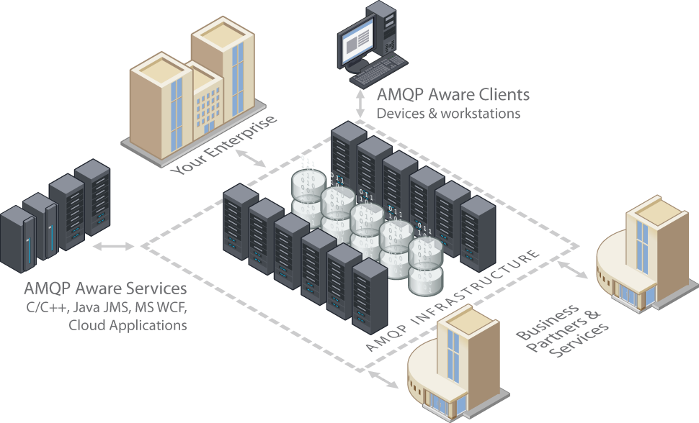
User view of AMQP 1.0
Applicability
Reliability
Interoperability
Ubiquity
Secure Investment
Transport for business messaging, e.g. ISO20022, FPML, FIXML and others…
Illustration © 2011 JPMorgan Chase & Co.. Used with permission.

Slide 11
The Capability

Slide 12
AMQP is for MOM
‘Message-Oriented Middleware allows application modules to be distributed over heterogeneous platforms and reduces the complexity of developing applications that span multiple operating systems …’

Slide 13
Tightly Coupled
In tightly coupled architectures, failures propagate quickly from their source back to the user and work stops.
Drivers
Tracking
Store Front End
Shipping Service
Notes:
In tightly coupled systems, failures propagate quickly from their source back to the user, and can prevent work being done.

Slide 14
Loosely Coupled
In loosely coupled architectures, failures are contained and users may continue to work. Queuing is an important tool for this approach.
Drivers
Tracking
Store Front End
Order Queue
Shipping Service

Slide 15
Loosely Coupled
Queuing also facilitates orderly scaling to handle increased demands through work-load sharing; without application modifications.
Tracking
Tracking
Store Front End
Order Queue
Shipping Service

Slide 16
Messaging concepts: queuing
S
R
Queue
R
S
S
R

Slide 17
Messaging concepts: pub/sub
S
R
Subs
Topic
S
R
R
R
S
R

Slide 18
Messaging concepts: message
Message
Properties
Properties
Key/value pairs exposed to the broker
Subscription rules can filter based on properties
Body
Opaque payload not exposed to the broker
Can be used for encrypted data
Key
Value
Key
Value
Key
Value
Key
Value
Body
Body

Slide 19
The Technology

Slide 20
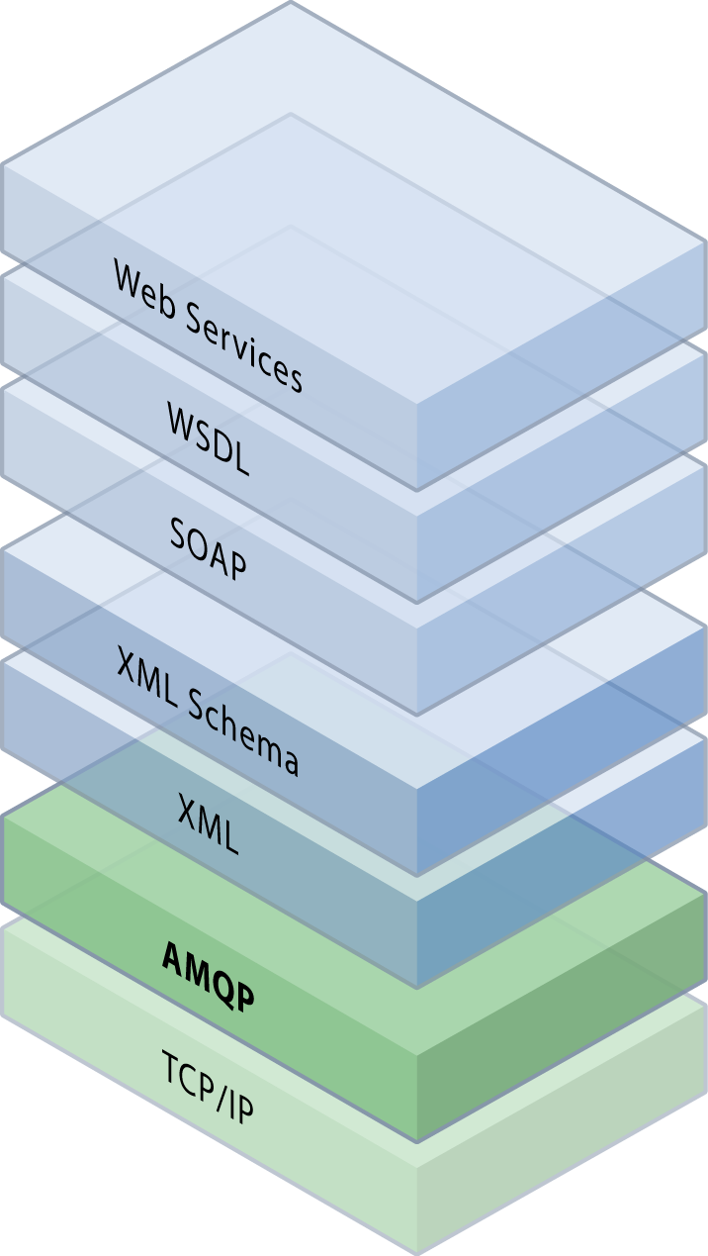
Features
OASIS AMQP 1.0 standardises transfer of responsibility between entities and enables information routing
Foundation for layered services
AMQP 1.0 innovation – predicated links
Links control what information flows
Links are to messaging as SQL was to databases
These capabilities are the basis for more effective business flows on the Internet
Add business semantics with ISO20022, FpML, FIXML, etc.

Slide 21
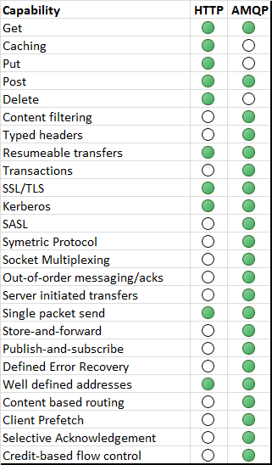
AMQP and HTTP compared
Complimentary protocols, not competitors
AMQP alongside HTTP on the Internet
AMQP for pub/sub and transactions
HTTP for request/response
Goal for native AMQP support in browsers
with transition via Javascript clients

Slide 22
Flexible topologies
S
R
AMQP Network

Slide 23
Flexible topologies
Broker
S
R

Slide 24
Flexible topologies
Broker
Broker
S
R

Slide 25
Flexible topologies
S
R

Slide 26
The Products

Slide 27
Apache Qpid
Open Source AMQP Messaging
Brokers and Client libraries supporting AMQP
Java Broker
Supports all versions of AMQP, including AMQP 1.0 since 0.18
JMS Client Java JMS client which works with any AMQP 1.0 compliant service C++ Broker AMQP 1.0 support in next release (scheduled for later this month)
Home of Proton toolkit library

Slide 28
Apache Qpid Proton
Proton is toolkit for speaking AMQP, including: The AMQP Messenger API, a simple but powerful interface to send and receive messages over AMQP The AMQP Protocol Engine, a succinct encapsulation of the full AMQP protocol machinery Proton is designed for maximum embeddability: Minimal dependencies Minimal assumptions about threading model Proton is designed to scale up and down: Transparently supports both simple peer to peer messaging and complex globally federated topologies Proton is multi-lingual: Designed for easy language bindings Includes full fidelity data exchange: maps, lists, data structures, ...

Slide 29
Microsoft Azure Service Bus
Unified set of messaging capabilities Consistent management and observation capabilities
Service Bus Relay
Rich options for interconnecting apps across network boundaries
Service Bus Brokered Messaging
Queuing, publish/subscribe
Easily build hybrid apps
Available as PaaS & on-premise server
Supports AMQP 1.0

Slide 30
SwiftMQ
Commercial JMS messaging since 2000
Based on a federated router network
Provides High Availability
First AMQP 1.0 implementation
Available since January 2012
Full-featured inc. transactions & link recovery
Fully integrated with JMS
Includes an AMQP bridge
Bridge between AMQP 1.0, AMQP 0.9.1 & JMS

Slide 31
AMQP 1.0 client libraries
Language | Library
C# | Service Bus .NET Client Library
Java | Apache Qpid Java Message Service (JMS) client IIT SwiftMQ Java client
C | Apache Qpid Proton-C
PHP | Apache Qpid Proton-PHP
Python | Apache Qpid Proton-Python
Ruby | Apache Qpid Proton-Ruby (coming soon)
Perl | Apache Qpid Proton-Perl (coming soon)
JavaScript | Apache Qpid Proton-JavaScript (coming soon)

Slide 32
The Demonstration

Slide 33
Inter-op demo ‘PictureMagic’
Linux (Azure)
SwiftMQ
Broker
Monitor
Service Bus
Transform Requests Topic
Transformer
Windows (on-prem)
Archiver
Twitter

Slide 34
Summary
AMQP 1.0 is the OASIS Standard for messaging
Open, standard, efficient, flexible, reliable
Enables cross-platform messaging applications
Mix languages, operating systems and vendors
Business messages exchanged at full-fidelity
Brokers and clients available now:
Apache Qpid Proton, SwiftMQ, Azure Service Bus
Many more coming soon, inc. ActiveMQ, RabbitMQ

Slide 35
More information
AMQP Member Section at OASIS
http://www.amqp.org
Apache Qpid
http://qpid.apache.org/
Apache Qpid Proton
http://qpid.apache.org/proton/
SwiftMQ
http://www.swiftmq.com
Microsoft Windows Azure Service Bus
https://www.windowsazure.com/en-us/develop/net/how-to-guides/service-bus-amqp-overview/

Slide 36
Thank you. Questions?
Let’s Connect

Slide 37
Tightly Coupled
Drivers
Tracking
Store Front End
Shipping Service
Notes:
In tightly coupled systems, failures propagate quickly from their source back to the user, and can prevent work being done.

Slide 38
Tightly Coupled
Drivers
Tracking
Store Front End
Shipping Service

Slide 39
Loosely Coupled
Drivers
Tracking
Store Front End
Order Queue
Shipping Service

Slide 40
Loosely Coupled
Drivers
Tracking
Store Front End
Order Queue
Shipping Service

Slide 41
Loosely Coupled
Drivers
Tracking
Store Front End
Order Queue
Shipping Service

Slide 42
Loosely Coupled
Tracking
Tracking
Store Front End
Order Queue
Shipping Service

Slide 43
Submission details (hidden)
Description
This session will present an overview of the AMQP 1.0, motivations, vendor support, and a demonstration of enterprise messaging interoperability.
Abstract
AMQP is the OASIS Standard for enterprise messaging. This session will cover the goals and architecture of AMQP 1.0. You will hear the latest news about major implementations and vendor support at the time of the conference. The bulk of the session will focus on an interoperability demonstration that will show how AMQP 1.0 provides robust enterprise-ready messaging capabilities to create diverse systems running in heterogeneous environments.

Slide 44
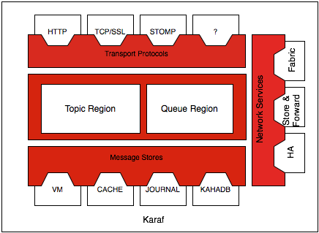
Apache ActiveMQ
Reliable Java broker
Multi-protocol
Multi-OS
Small footprint
Pluggable architecture allows protocols and features to be added or customized
Coming soon AMQP 1.0!
AMQP

