Slide 1
SARIF Interoperability standard for static analysis tools
Nonprofit, global consortium for standards and open source projects
David Keaton, OASIS SARIF Technical Committee Co-Chair
Carol Geyer, OASIS Chief Development Officer

Slide 2
Static Analysis Results Interchange Format
Defines a common output format for static analysis tools
Facilitates tools that detect and report code issues and vulnerabilities
Enables developers to aggregate results produced by multiple tools
Supports development of products with code that spans languages and operating systems
Allows access to a broader range of potential defects and vulnerabilities

Slide 3
SARIF Details
Allows not only interoperability of a single tool pipeline, but also integration of results from multiple static analysis tools, to gain a more complete picture.
SARIF v1.0 originally arose from efforts at Microsoft. SARIF v2.0 is being defined industry-wide via the OASIS process and has completed its first Committee Specification Draft public comment period.

Slide 4
What’s next for SARIF
Now working on second Committee Specification Draft. Public comment period will follow, possibly around December 2018.
Assuming a successful public comment period with no technical changes, advance to Committee Specification.
Next stages are Candidate OASIS Standard, followed by OASIS Standard.
OASIS Standard may be submitted as an ISO Standard in future.

Slide 5
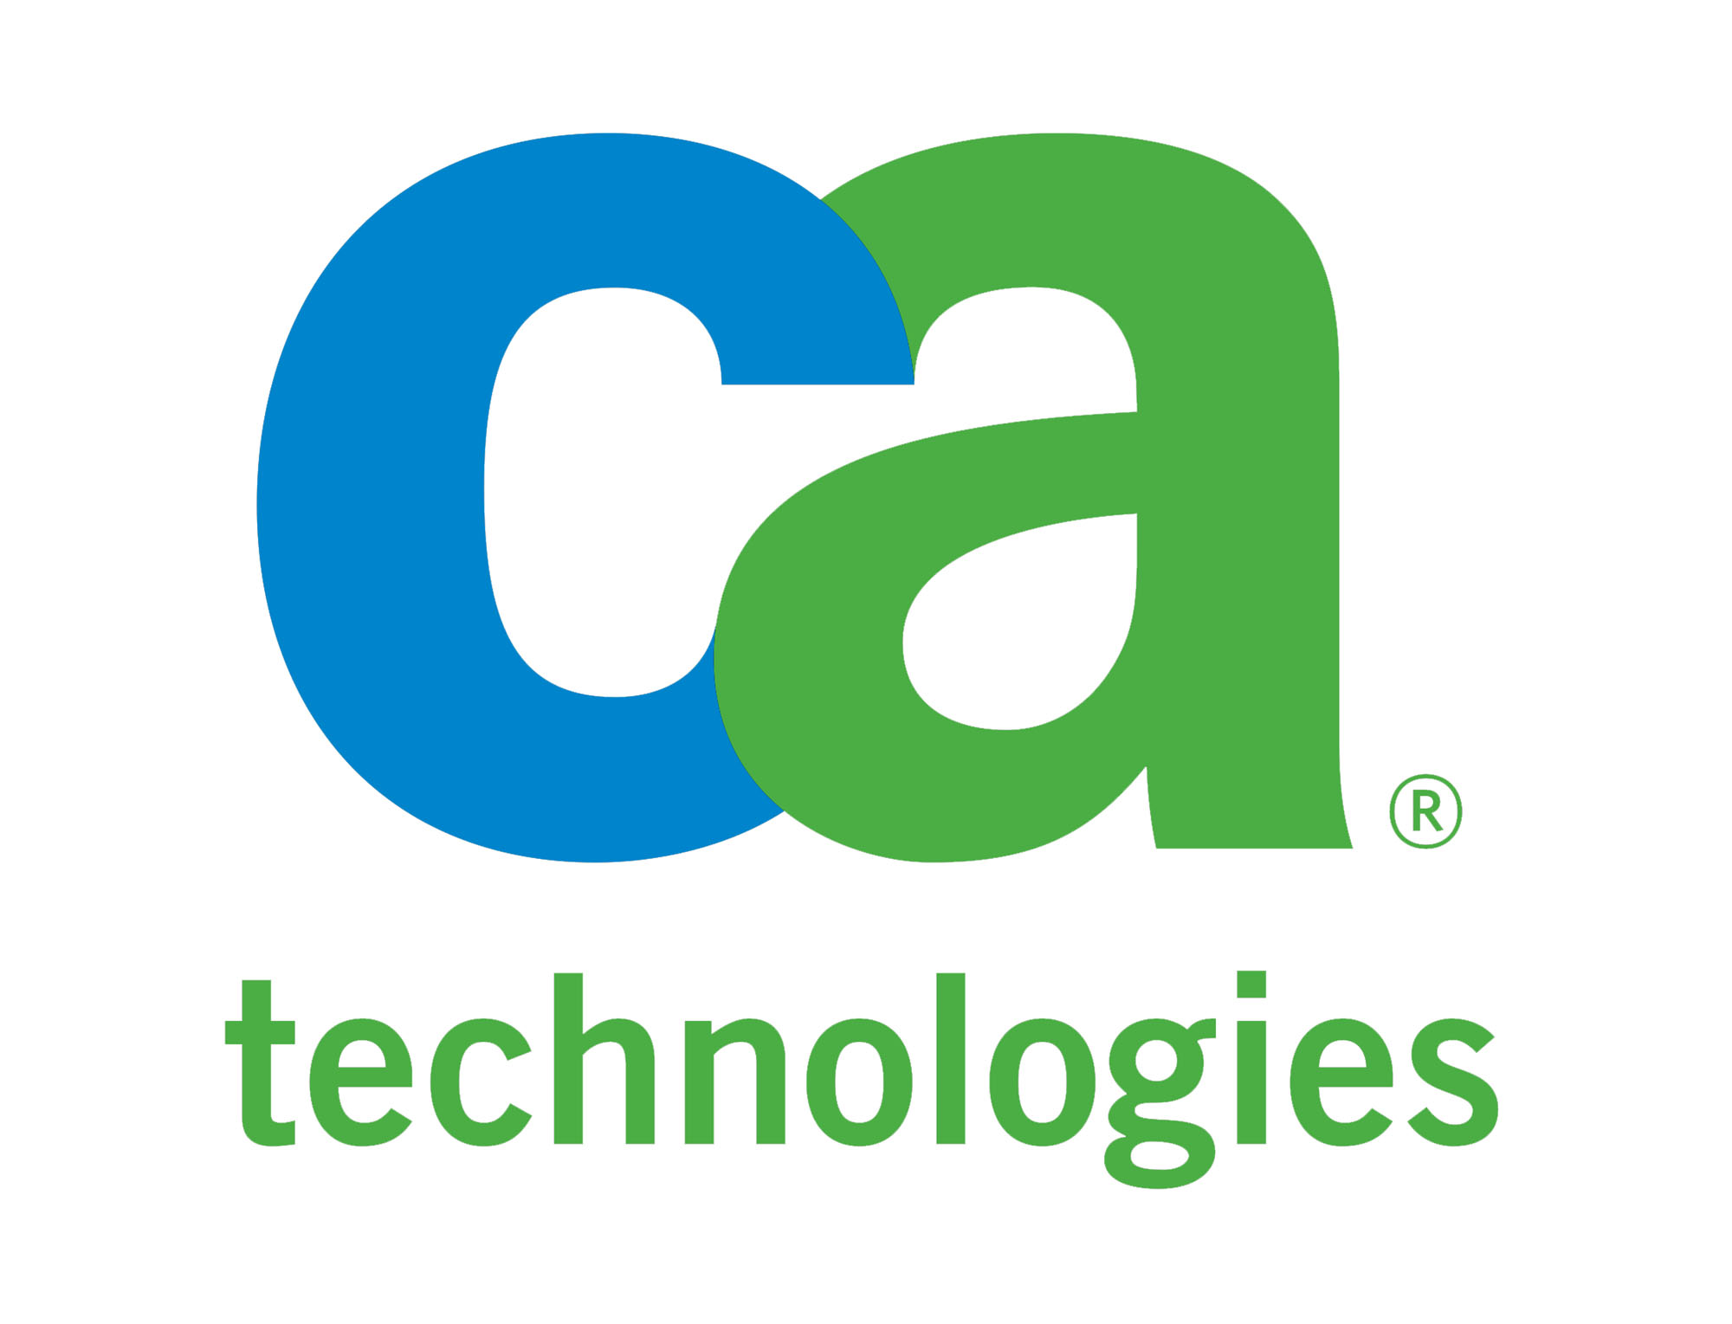
SARIF Technical Committee Members
Code Dx Kestrel MITRE Northrop Grumman Security Compass Semmle Splunk SWAMP and others…

Slide 6
Who should participate in SARIF?
Software providers
Cybersecurity companies
Government agencies and contractors
Security orchestration specialists
Programmers
Consultants

Slide 7
What will your company gain by being part of SARIF?
Recognition for your commitment to INTEROPERABILITY
Ability to INFLUENCE INTERNATIONAL STANDARD
Right to CONTRIBUTE IDEAS, COMMENTS, USE CASES
Opportunity to build consensus on key issues
Inside track on work in-progress
Head start on compliance

Slide 8
What will you gain by being part of SARIF?
Added credibility as co-author of an international standard
Experience in the international standards setting process
Personal connections with static analysis EXPERTS from around the world
Advice and insights from people who know what you’re dealing with

Slide 9
What’s involved?
Fund SARIF development via annual OASIS membership dues
*Attend TC F2F meetings (if/when TC decides to meet)
Subscribe to TC email list
Vote on TC decisions and documents
Attend TC conference calls (typically one-hour call once a month)
*Serve as a spec editor, lead a Subcommittee…
*Contribute ideas, use cases, comments
*Optional

Slide 10
Annual OASIS membership dues
Organization size / type | Sponsor | Contributor
>500 employees | $19,875 | $9,950
100-500 employees | $17,275 | $9,225
10-99 employees | $14,000 | $8,100
<10 employees | $ 6,800 | $3,915
University or Association | $12,425 | $1,350
National gov agency (OECD country) | $12,425 | *
Local gov or national gov (non-OECD) | $12,425 | $1,350
Individual (employee) $1,485
Individual (self-employed, unemployed) $ 360

Slide 11
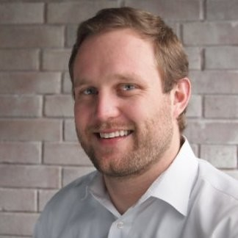
Questions, comments
"At a time when more corporate value – and liability – is being driven by software,, organizations need new ways to efficiently improve the quality and security of their systems. With SARIF, they will be able to do just that and better leverage the combined, unique insights available from the range of static analysis solutions available today.”
Chris Rommel, Executive Vice President VDC Research

Slide 12
More info
SARIF TC
https://www.oasis-open.org/committees/sarif
Co-Chairs:
David Keaton, dmk@dmk.com Luke Cartey, luke@semmle.com
OASIS Membership https://www.oasis-open.org/join/categories-dues
Carol Geyer, carol.geyer@oasis-open.org

