Slide 1
COEL Classification of Everyday Living
Nonprofit, global consortium for standards and open source projects
Joss Langford, OASIS COEL Technical Committee Co-Chair
David Snelling, OASIS COEL Technical Committee Co-Chair

Slide 2
Introduction
COEL is a business-to-business technology specification that provides machine-readable access to data describing what we do as humans.
The COEL specification is person-centric and will be highly relevant to any organisation that wants to collect and/or analyse data about individuals.
Overview briefing document

Slide 3
Opportunity Problem Solution
The ability to share data about human behaviour can be highly valuable for individuals, organisation and society.
We need: to define data types and interfaces for interoperability; a common semantic basis to describe behaviors and a privacy-by-design architecture.
COEL combines these 3 core elements in a specification that is open, auditable and international by design to provide a trustable framework for data sharing.

Slide 4
COEL Features
A unique and extensible data model - hierarchical taxonomy of human behaviours.
Clear definition of roles to support governance.
Data pseudonymised at source for security & privacy.
Event coding (the Atom) for any observable human behavioural event.
Independent records from multiple data sources in a common format for insight creation.
Integration using JSON over HTTPS for all interactions.
Lightweight delivery of data to facilitate IoT applications.

Slide 5
COEL Overview
COEL specification
sections
Intro & Architecture (1-2)
COEL by example (3)
COEL model & Atoms (4-5) (normative)
Interfaces (6-10) (normative)
Privacy-by-Design (11-12)
COEL-v1.0-cs02

Slide 6
The COEL ‘Atom’
What
Semantic code from COEL hierarchical taxonomy.
Who
Pseudonymized identifier for individual.
When
When the event occurred and the duration.
Where
Location information : exact or profane.
How
How the event was observed or recorded.
Consent
Summary of consent associated with data.

Slide 7
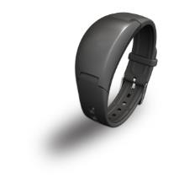
Professional wearables
Data Engine
(pseudonymous data)
COEL Use Cases
Service Provider
(pseudonymous data)
API
Operator
(directly identifying data)
Health Professional
Patient
https://www.activinsights.com/products/activinsights-band/

Slide 8
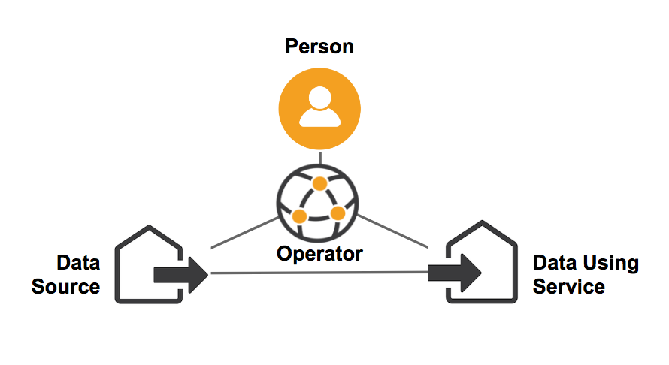
Personal Information Management Systems
COEL Use Cases
MyData
https://mydata.org/

Slide 9
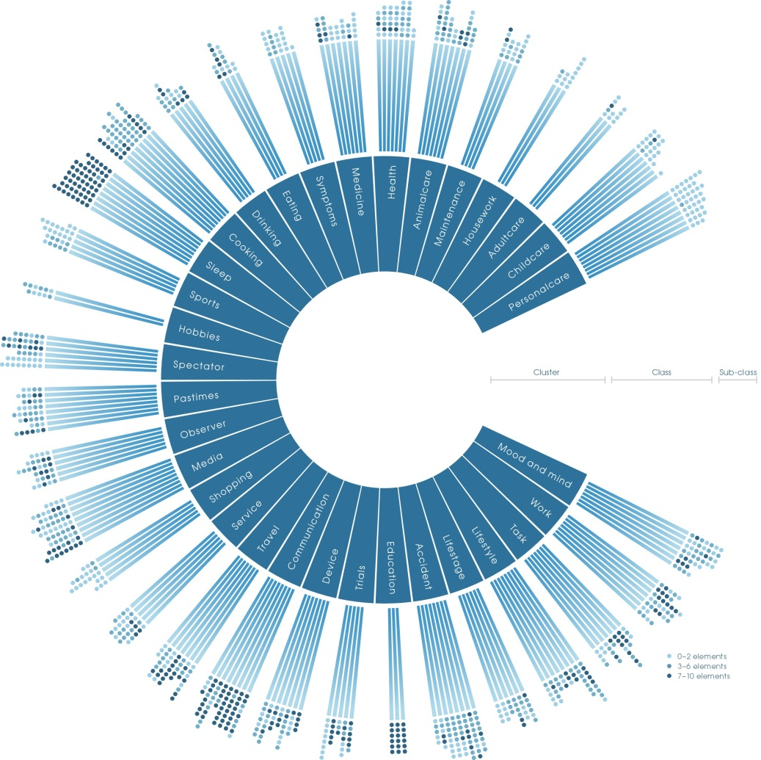
Visualizing everyday living
COEL Use Cases
https://coelition.org/business/resources/visualising-life/

Slide 10
We are looking for new applications & implementations.
Please share your thoughts about how & where COEL could be beneficial - with us, your TCs and colleagues.

Slide 11
Questions
COEL briefing paper
COEL-TC:
https://www.oasis-open.org/apps/org/workgroup/coel/
Co-Chairs:
Joss Langford joss@activinsights.com
David Snelling dave.snelling@uk.fujitsu.com
Specification:
COEL-v1.0-cs02
Coelition association web site: www.coelition.org

