Slide 1
Nabble
April 2016
Improving Collaboration Processes
Patrick Maroney - CTI TC Interoperability SC

Slide 2
Collaboration Improvements
Structured Hierarchical Content.
Granular & flexible subscription/notification options.
Content organized by specific interest areas.
Content organized by content types specific to interest areas.
Move/reorganize content (Topics, Sub-Topics Folders, Subfolders)
Easily follow all voices in a given conversation over any period of time.
Reply in sequence to any conversation/posting, at any point in time.
Edit/revise content.
Flexible viewing options.
Post rich content to existing topics/sub-topics via Email.
Create new topics in any folder/sub-folder via Email.

Slide 3
Structured Hierarchical Content

Slide 4
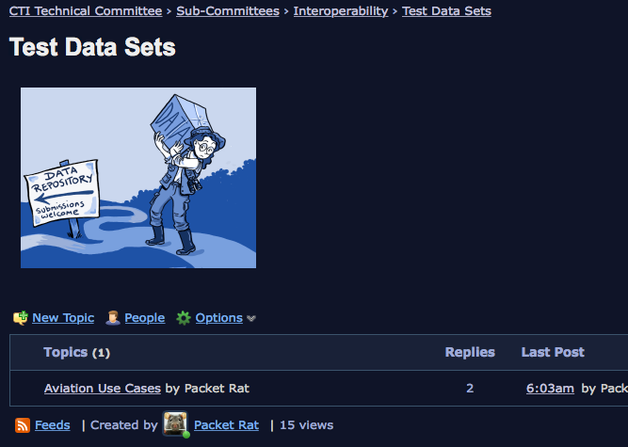
Content Organized by Specific Interest Areas

Slide 5
Further Organization of Content Types specific to Interest Areas

Slide 6
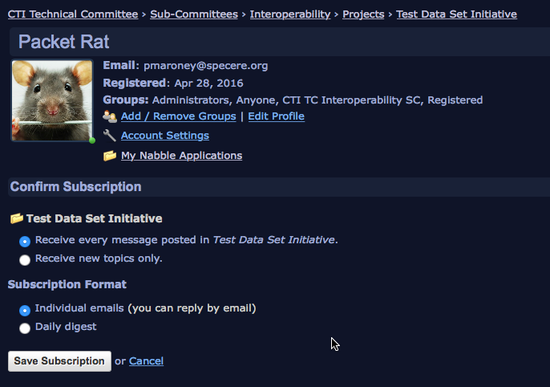
Granular & Flexible Subscription Options

Slide 7
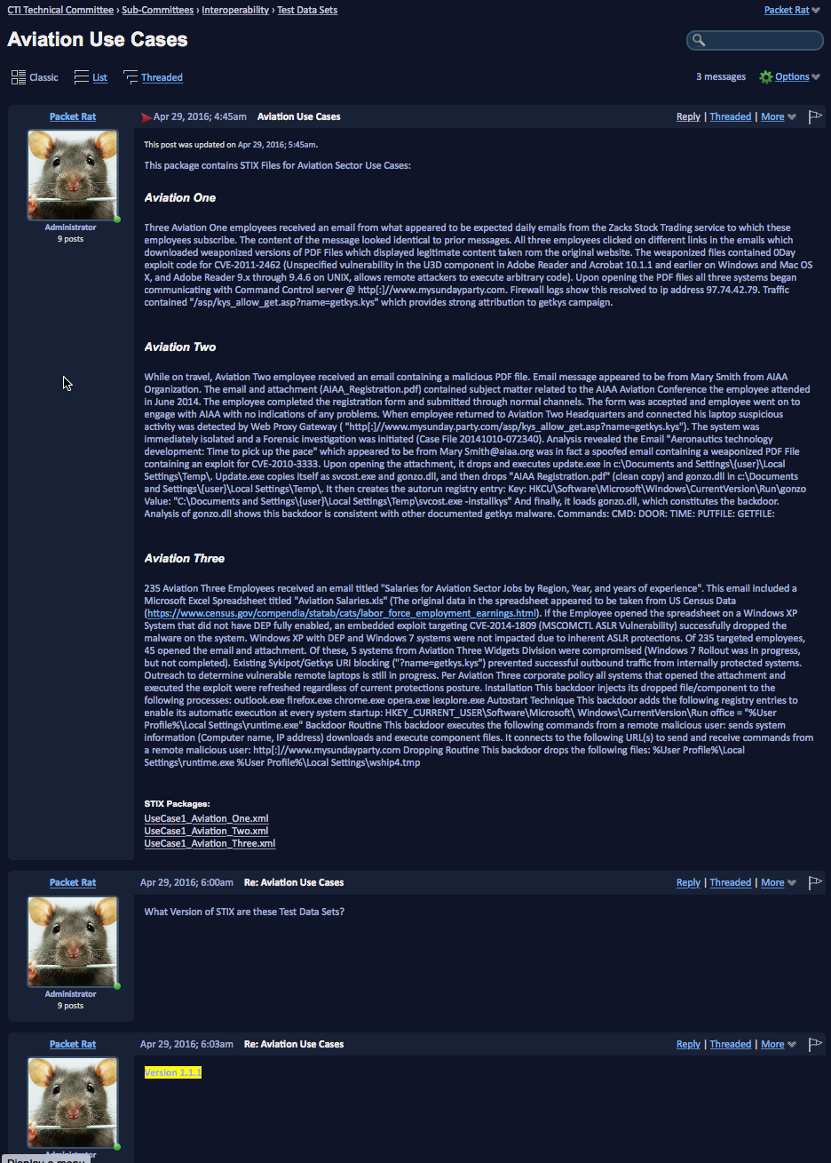
Flexible Viewing Options
Full Content Details
Threaded Summary Views

Slide 8
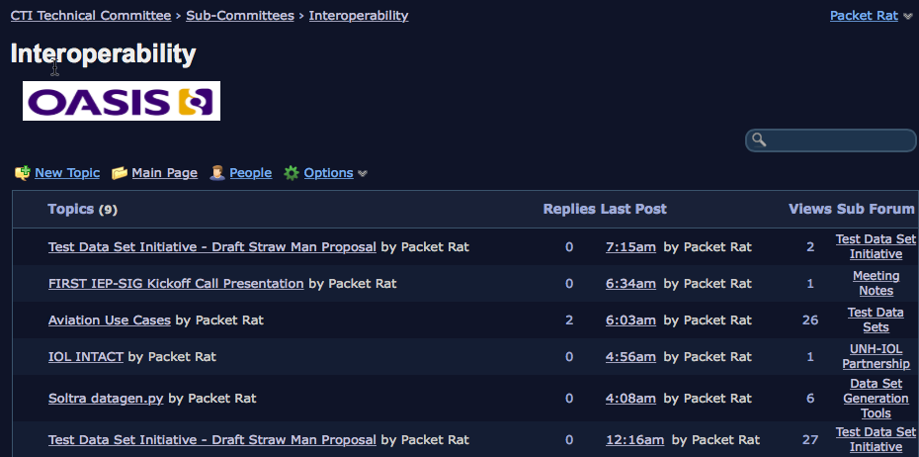
Flexible Viewing Options: Flat View by most recent update (from any point in hierarchy)

Slide 9
Create or respond to topics in any folder/sub-folder via Email

