Slide 1
Deconstructing the Cybersecurity Act of 2015:
V1.0
model, architecture, interfaces, expressions
Tony Rutkowski, mailto:tony@yaanatech.com
15 Jan 2016
Copyright © Yaana Technologies LLC 2016

Slide 2
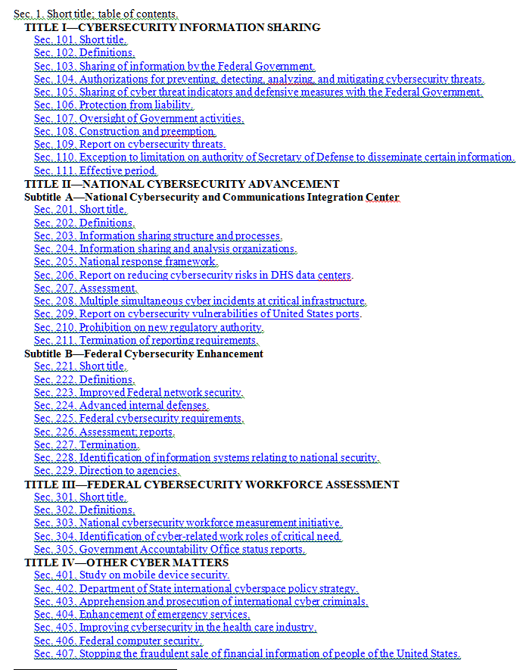
[USA] Cybersecurity Act of 2015
Title I: Basic purposes and requirements
Title II.A: Sharing architecture around the National Cybersecurity and Communications Integration Center (NCCIC) instantiated by amending Homeland Security Act of 2002 as amended
Title II.B: Steps to improve Federal agency cybersecurity
Title III: Cybersecurity education
Title IV: Miscellaneous
2

Slide 3
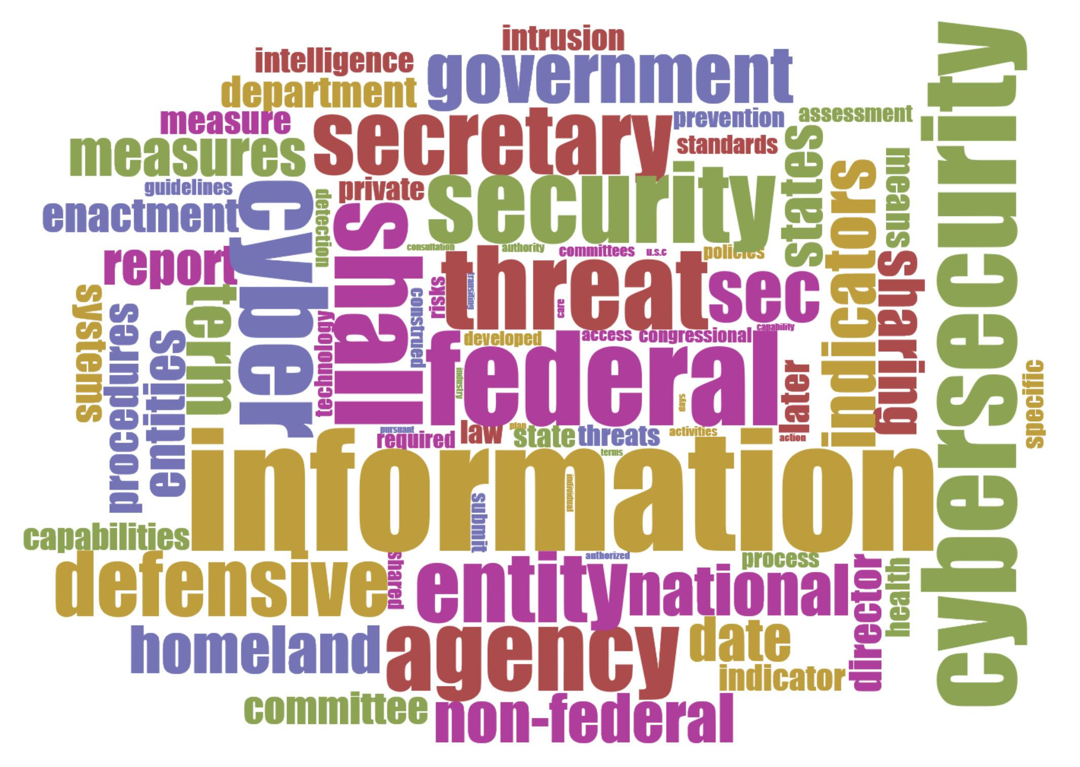
[USA] Cybersecurity Act of 2015
Rich Struse
OASIS CTI
Cirrus Word Cloud Display
3

Slide 4
Entity ontology of the Cybersecurity Act of 2015
Federal entity
non-Federal entity
Appropriate Federal entity
private entity
103(a) entities
[Sector-Specific] ISAC - Information Sharing and Analysis Center
sector coordinating councils
owners and operators of critical information systems
other appropriate non-Federal partners
DNI – Office of the Director of National Intelligence
DOD - Department of Defense
DOJ - Department of Justice
DHS - Department of Homeland Security
NSA – National Security Agency
NCCIC - National Cybersecurity and Communications Integration Center
voluntary information sharing relationship “
other determined by the Secretary
ISAO -Information Sharing and Analysis Organization
collaborates with State and local governments
Intelligence Community ¹
- Department of Treasury
DOE - Department of Energy
DOC - Department of commerce/NIST
State, tribal, or local government
DOS - Department of State
OMB – Office of Management and the Budget
HHT – Department of Health and Human Services
GAO – Government Accounting Office
International partners
Foreign power
Notes:
¹ See 50 U.S. Code § 3003(4)
* No definition
4

Slide 5
Cybersecurity Act architecture & interfaces
¹ to acquire, identify, or scan, or to possess, information that is stored on, processed by, or transiting an information system. CA §103
² an action, device, procedure, signature, technique, or other measure applied to an information system or information that is stored on, processed by, or transiting an information system that detects, prevents, or mitigates a known or suspected cybersecurity threat or security vulnerability. CA §103
³ Includes removal of certain personal information filtering function per CA §104(d)(2).
⁴ Such as State, local, and tribal governments, ISAOs, ISACs including information sharing and analysis centers, owners and operators of critical information systems, and private entities.
⁵ Collaborate on cyber threat indicators, defensive measures, and information related to cybersecurity risks and incidents; and enhance the security and resilience of global cybersecurity Partners. HAS §227(c)(8)
Federal entities
NCCIC (National Cybersecurity and Communications Integration Center HSA §227
International Partners ⁵
IP-NCCIC
[NCCIC ]
Monitor¹ & defend² information system
+
information that is stored on, processed by, or transiting the information system CA §103
Mediation and Filtering ³
FE-NCCIC
cyber threat indicators
defensive measures
cybersecurity risks
incidents pursuant to §103(a)
[NCCIC ]
Non-Federal entities⁴
Monitor¹ & defend² information system
+
information that is stored on, processed by, or transiting the information system CA §103
Mediation and Filtering ³
NFE-NCCIC
[NCCIC ]
interfaces
5

Slide 6
Cybersecurity Act information exchange expressions
cyber threat indicator | information that is necessary to describe or identify (A) malicious reconnaissance, including anomalous patterns of communications that appear to be transmitted for the purpose of gathering technical information related to a cybersecurity threat or security vulnerability [malicious reconnaissance: a method for actively probing or passively monitoring an information system for the purpose of discerning security vulnerabilities of the information system, if such method is associated with a known or suspected cybersecurity threat.] (B) a method of defeating a security control or exploitation of a security vulnerability; (C) a security vulnerability, including anomalous activity that appears to indicate the existence of a security vulnerability; (D) a method of causing a user with legitimate access to an information system or information that is stored on, processed by, or transiting an information system to unwittingly enable the defeat of a security control or exploitation of a security vulnerability; (E) malicious cyber command and control [a method for unauthorized remote identification of, access to, or use of, an information system or information that is stored on, processed by, or transiting an information system.] (F) the actual or potential harm caused by an incident, including a description of the information exfiltrated as a result of a particular cybersecurity threat; (G) any other attribute of a cybersecurity threat, if disclosure of such attribute is not otherwise prohibited by law; or (H) any combination thereof. [Cybersecurity threat: an action,...on or through an information system that may result in an unauthorized effort to adversely impact the security, availability, confidentiality, or integrity of an information system or information that is stored on, processed by, or transiting an information system.]
defensive measure | an action, device, procedure, signature, technique, or other measure applied to an information system or information that is stored on, processed by, or transiting an information system that detects, prevents, or mitigates a known or suspected cybersecurity threat or security vulnerability. [Defensive measure does not include a measure that destroys, renders unusable, provides unauthorized access to, or substantially harms an information system or information stored on, processed by, or transiting such information system not owned by (i) the private entity operating the measure; or (ii) another entity or Federal entity that is authorized to provide consent and has provided consent to that private entity for operation of such measure.]
cybersecurity risk | threats to and vulnerabilities of information or information systems and any related consequences caused by or resulting from unauthorized access, use, disclosure, degradation, disruption, modification, or destruction of such information or information systems [Includes related consequences caused by an act of terrorism]
incident | an occurrence that actually or imminently jeopardizes, without lawful authority, the integrity, confidentiality, or availability of information on an information system, or actually or imminently jeopardizes, without lawful authority, an information system
6

Slide 7
Cybersecurity Act of 2015 Timeline – first year actions
Pursuant to 2 USC Sec. 394, FRCP Rule 26. N.B., 6 months treated as 180 days, 9 months as 270 days, 18 months as 548 days, 1 year and annual as 365 days
DHS(3), DNI, DNI+OMB, Federal CIO, NIST(2), OMB, DOJ+DHS(2)
DHS(2), DNI, DOJ+DHS(3), Judicial
DHS(7), DOS(1), Federal agencies (5), HHS, OMB(4)
Federal agencies
DHS(4), DOS, HHS
NIST
Enacted, 18 Dec 2015
60 days, 16 Feb 2016
90 days, 17 Mar 2016
180 days, 15 Jun 2016
240 days, 15 Aug 2016
9 months, 13 Sep 2016
One Year, 18 Dec 2016
7

Slide 8
Cybersecurity Act of 2015 Timeline – actions after the first year
DHS(5), DHS+DOJ, DHS+ NIST(2), Federal agencies, DOS, GAO, NIST, OMB
Additional ad hoc reporting requirements exist for DHS (Sec. 105 & 223), DHS+NIST (Sec. 229), HHS (Sec. 405), NIST (Sec. 303), and OMB (Sec. 226)
DHS(3), DHS+NIST, DOS, Federal agencies, OMB
DHS(2), DHS+NIST, Federal agencies, GAO(3), OMB
Federal CIO, NIST, OMB
DHS, Federal agencies
18 months, 19 Jun 2017
2 years, 18 Dec 2017
3 years, 18 Dec 2018
4 years, 18 Dec 2019
5 years, 18 Dec 2020
6 years, 20 Dec 2021
7 years, 19 Dec 2022
8

Slide 9
EU NIS (Network and Information Security) Directive
Tentative agreement on same date as Cybersecurity Act of 2015 – 18 Dec
Requires implementation by each of the 28 Member States
Creates a bifurcation
Applies to “operators of essential services and digital service providers” that are active in energy, transport, banking, financial services, healthcare and other critical industry segments
“Should…not apply to undertakings providing public communication networks or publicly available electronic communication services within the meaning of Directive 2002/21/EC”
Relies on a “cooperation group” composed of Member States´ representatives, the Commission and ENISA to support and facilitate strategic cooperation
Member States can “take the necessary measures to ensure the protection of its essential security interests, to safeguard public policy and public security, and to permit the investigation, detection and prosecution of criminal offences”
All Member States should be adequately equipped, both in terms of technical and organisational capabilities, to prevent, detect, respond to and mitigate network and information systems' incidents and risks
A need for closer international cooperation to improve security standards and information exchange, and promote a common global approach to NIS issues; might be helpful to draft harmonised standards
Includes sharing information on risks and incidents,” especially including notification of personal data breaches
9

Slide 10
Meeting the challenge: questions and options
What information exchange requirements exist at the three identified NCCIC interfaces?
Federal-Entity, Non-Federal Entity, International Partner
What assumptions should be made about the capabilities and architectures within these three domains?
Are other interfaces needed?
What are the sector-specific interface sub-types?
What are the required information sharing expressions and other capabilities at these interfaces, and to what extent can existing specifications be mapped to these requirements?
What are the algorithms for the “personal information of a specific individual or information that identifies a specific individual” filter function?
Can an ad-hoc TC CTI or OASIS group assist in the Act’s implementation?
How can the TC CTI standards also be applied to meet EU NIS Directive
10

