Slide 1
Deconstructing the EU NIS Directive:
ETSI Doc. CYBER(16)006023r1
model, architecture, interfaces, expressions
Tony Rutkowski, mailto:tony@yaanatech.com
08 Feb 2016
Copyright © Yaana Technologies LLC 2016

Slide 2
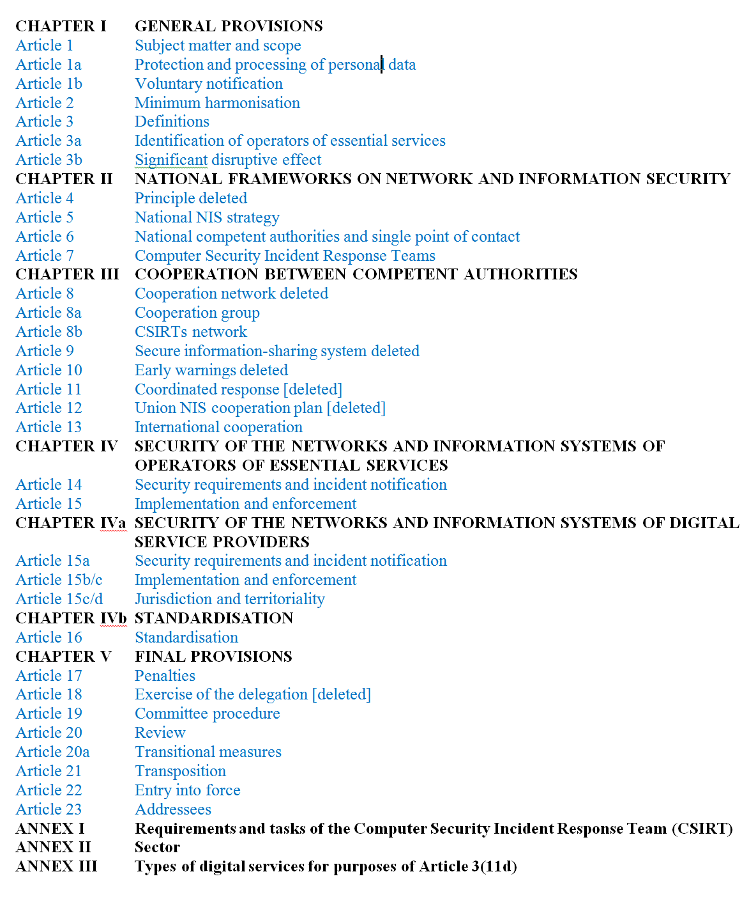
EU NIS Directive
Chap. I: Scope, purposes, and application
Chap. II: National frameworks on Network and Information Security; incident response team
Chap. III: Cooperation among authorities
Chap. IV: Essential services operator defensive measures and threat sharing
Chap. IVa: Digital service provider defensive measures and threat sharing
Chap. IVb: Standardisation
Chap. V: Implementation
Annexes. I, II, III: Response team requirements, essential sectors and digital services enumerations
2

Slide 3
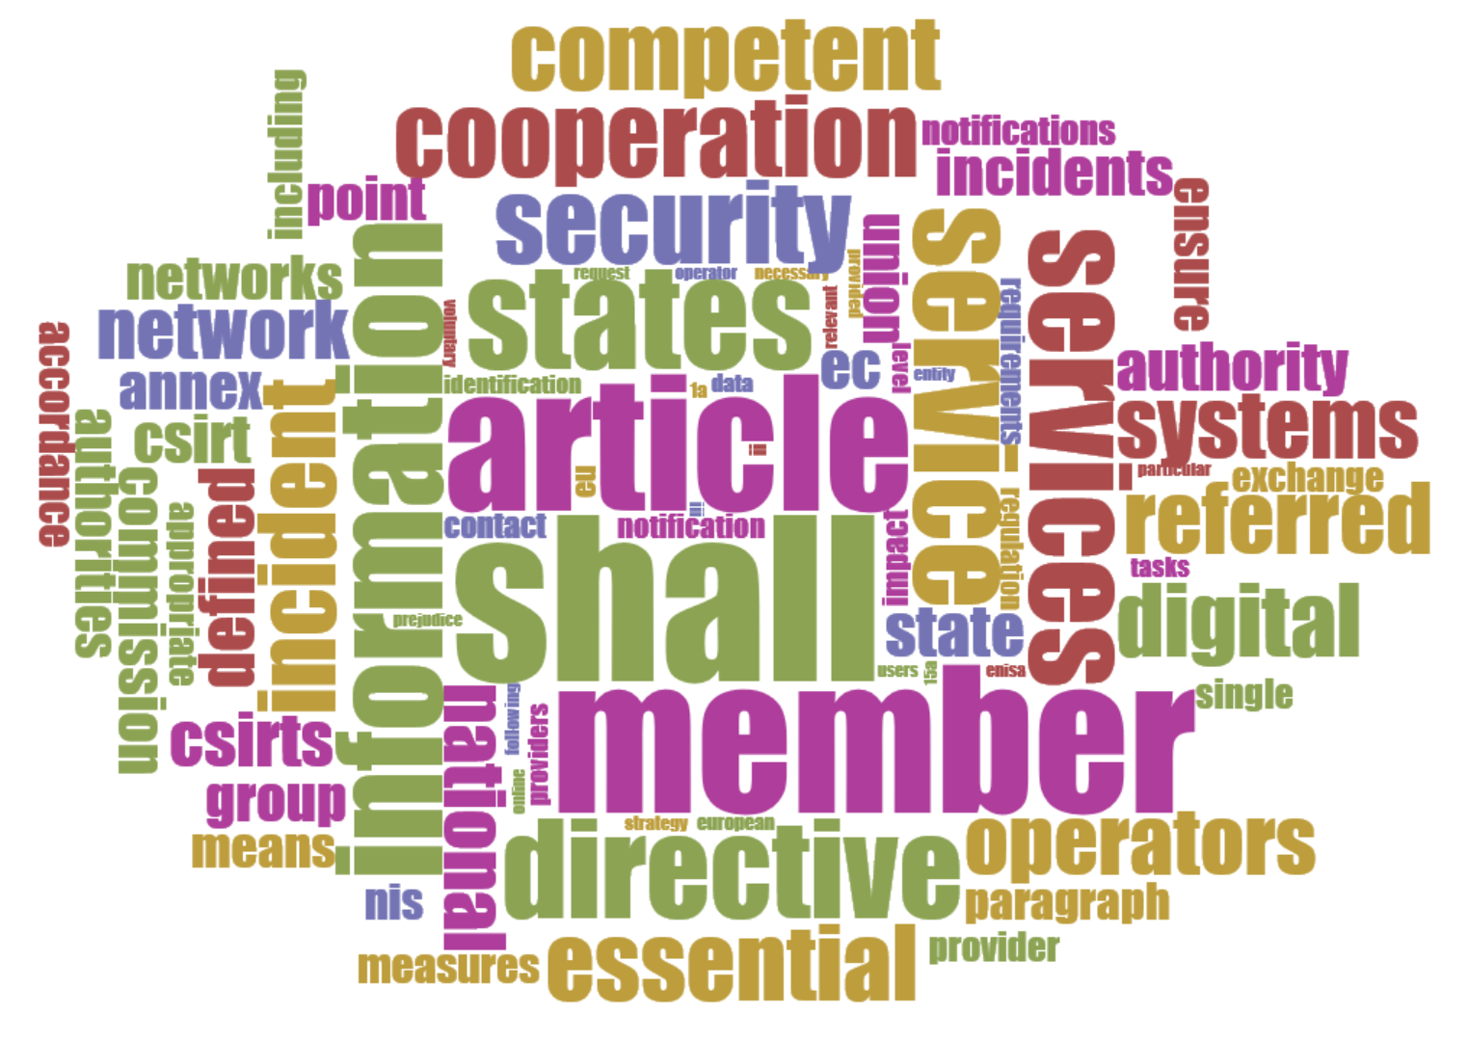
EU NIS Directive
Cirrus Word Cloud Display
3

Slide 4
EU NIS (Network and Information Security) Directive
Tentative agreement on same date as U.S. Cybersecurity Act of 2015 – 18 Dec 2015
Basics
lays down obligations for all 28 Member States to adopt a national NIS strategy
creates a cooperation group in order to support and facilitate strategic cooperation and the exchange of information among Member States and develop trust and confidence amongst them
creates a CSIRTs ("Computer Security Incident Response Team") network in order to contribute to developing confidence and trust between Member States and to promote swift and effective operational cooperation
establishes security and notification requirements for operators of essential services
establishes security and notification requirements for digital service providers
lays down obligations for Member States to designate national competent authorities, single points of contact and CSIRTs with tasks related to the security of networks and information systems
Creates a trifurcation
Applies to
operators of essential services in energy, transport, banking, financial services, healthcare and other critical industry segments
Providers of digital services
Does not apply to providers of public communication networks or publicly available electronic communication services or Trust Services
Includes sharing information on risks and incidents,” especially including notification of personal data breaches
Member States should be adequately equipped, both in terms of technical and organisational capabilities, to prevent, detect, respond to and mitigate network and information systems' incidents and risks
Member States can “take the necessary measures to ensure the protection of its essential security interests, to safeguard public policy and public security, and to permit the investigation, detection and prosecution of criminal offences”
Encourages closer international cooperation to improve security standards and information exchange, and promote a common global approach to NIS issues; might be helpful to draft harmonised standards
4

Slide 5
EU NIS Directive Entity Ontology
European Union
Public or Private Entity
Operators of Essential Services pursuant to Art. 14 2 and 2ac + Annex II
Digital Service Providers Pursuant to Art. 15a 2 + Annex III
public Electronic communication networks or publicly available electronic communication service providers under EU DIRECTIVE 2002/21/EC
European Commission
European Network and Information Security Agency
Cooperation Group
Network and Information Security Committee
Member State
1. Energy
2. Transport
3. Banking
4. Financial market infrastructures
5. Health sector
6. Drinking water supply and distribution
7. Digital Infrastructure
Online marketplace
Online search engine
Cloud computing service
Competent Authority
Computer Security Incident Response Team
Trust service providers under
Representative for a Digital Service Provider
Third Party
Qualified Auditor
Public
Others not identified
Micro and Small Enterprises
= excluded from the Directive
5

Slide 6
EU NIS Directive architecture & interfaces
*Processing of personal data pursuant to this Directive shall be carried out in accordance with Directive 95/46/EC; processing of personal data by Union institutions and bodies pursuant to this Directive shall be carried out in accordance with Regulation (EC) No 45/2001 [Article 1a]
Essential Services Providers
ESP-CA/CSIRT
CA/CSIRT-CA/CSIRT
^{Other Members}
Competent Authority or Computer Security Incident Response Team
CA/ CSIRT
Monitor & defend information system
Privacy processing*
defensive measures
cyber security risks
incidents
CA/ CSIRT
Required
Digital Service Providers [or Representative]
DSP-CA/CSIRT
Monitor & defend information system
Privacy processing*
CA/CSIRT-CA/CSIRT
^{Other Members}
CA/ CSIRT
public Electronic communication networks or publicly available electronic communication service or Trust providers
interfaces
PECN-CA/CSIRT
CA/ CSIRT
Monitor & defend information system
Privacy processing*
Voluntary
Other entities voluntary notification
CA/CSIRT-PUBLIC
Other-CA/CSIRT
Public
Monitor & defend information system
Privacy processing*
6

Slide 7
EU NIS Directive information exchange expressions
Defensive measures information | Related to risks (static) to resist, at a given level of confidence, any action that compromise the availability, authenticity, integrity or confidentiality of stored or transmitted or processed data or the related services offered by or accessible via that network and information systems (Art. 3) to manage the risks posed to the security of networks and information systems …to ensure a level of security of networks and information systems appropriate to the risk presented to prevent and minimise the impact of incidents affecting the security of the networks and information systems (Arts. 14, 15) Related to incident handling (dynamic) All procedures supporting the detection, analysis, containment and response to an incident (Art. 3)
Cyber security risk Information | Any reasonably identifiable circumstance or event having a potential adverse effect on the security of networks and information systems (Arts. 3, 8)
Incident information | Any event having an actual adverse effect on the security of networks and information systems Nature of the notified incidents, such as the types of security breaches (Art. 8a 3c – recital) Information that could support the effective handling of the incident (Art. 14 2a) Enable the competent authority or the CSIRT to determine the cross-border effect impact of the incident (Art. 14 2.), including (a) the number of users affected by the disruption of the essential service; (b) the duration of the incident; (c) the geographical spread with regard to the area affected by the incident Other parameters for operators of essential service (Arts. 1, 2, 14)
7

Slide 8
EU NIS Directive Timeline – first year actions
Relative
1 day: Article 21 2. They shall apply those measures [Member States shall adopt and publish, by 21 months after the date of entry into force of this Directive at the latest, the laws, regulations and administrative provisions necessary to comply with this Directive] from one day after the date referred to in paragraph 1.
2 months: Article 5 3. The national NIS strategy shall be communicated to the Commission within three months from its adoption.
6 months: Article 3a 1. By (6 months after the date referred to in article 21(1)), for each subsector referred to in Annex II, Member States shall identify the operators of essential services with an establishment on their territory.
3 years: Art. 20 2. Commission shall periodically review the functioning of this Directive and report to the European Parliament and to the Council… The first report shall be submitted no later than three years after the date referred to in Article 21(1)
Art. 15a 4, [4a]. Commission shall be empowered to adopt implementing acts in accordance with Article 19(3) further specifying the elements referred to in paragraph 1 [2]
Art. 20 1. Commission shall submit a report to the European Parliament and to Council …assessing the consistency of the approach taken by Member States in the identification of the operators of essential services
Article 6 4ab. The single point of contact shall submit a summary report to the cooperation group on the notifications received…
Art. 8a 5. the first draft implementing act to the Committee
Art. 20a 1. Cooperation Group and the CSIRTs Network shall begin to perform their tasks set out respectively in Articles 8a(3) and 8b(3)
Art. 20a 2. Member States shall ensure appropriate representation in the Cooperation Group and the CSIRTs Network.
Art. 22. 20 days after publication
Entry into force
6 months
One Year
8

Slide 9
EU NIS Directive timeline – actions after the first year
Recurring
Art. 6 4ab: Once a year, the single point of contact shall submit a summary report to the cooperation group on the notifications received, including the number of notifications and the nature of notified incidents, and the action taken in accordance with article 14(2), 14(2ac) and 15a(2).
Art. 8a 4. As input to the Commission's periodic review of the functioning of this Directive, the cooperation group shall every one and a half years produce a report assessing the experience gained with the strategic cooperation pursued under this Article.
Art. 8b 4. As input to the Commission's periodic review of the functioning of this Directive, the CSIRTs network shall every one and a half years produce a report assessing the experience gained with the operational cooperation, including conclusions and recommendations, pursued under this article. That report shall also be submitted to the cooperation group.
Art. 8a 3. The cooperation group shall have the following tasks: a. by 18 months after entry into force and every two years thereafter, establish a work programme on actions to be undertaken to implement the objectives and tasks, which shall be consistent with the objectives of this Directive.
Art. 8a 3. The cooperation group shall…establish a work programme on actions to be undertaken to implement the objectives and tasks.
Art. 21 1. Member States shall adopt and publish, …at the latest, the laws, regulations and administrative provisions necessary to comply with this Directive.
18 months
21 months
2 years
3 years
4 years
5 years
6 years
7 years
9

Slide 10
EU NIS Directive significant challenges
What standardized information exchange models, architectures, interfaces, and information expressions will be adopted among Members and interoperate with major partners?
How do the various identified member entities co-exist at national, regional, and global levels and fit into the NIS Directive model and architecture?
Competent Authorities
Computer Security Incident Response Teams
How do the various identified private sector entities co-exist at national, regional, and global levels and fit into the NIS Directive model and architecture?
How do Public Electronic Communication Networks or Publicly Available Electronic Communication Service Providers under EU DIRECTIVE 2002/21/EC and Trust Providers?
How do Information Sharing and Analysis Centers (ISACs) and Information Sharing and Analysis Organizations (ISAOs) fit into the NIS Directive model and architecture?
How do consistent technical specifications get developed and applied?
Cyber security information exchange expressions
Privacy filtering
How are virtualised infrastructures and services such as NFV, SDN, MEC to be treated?
10

