Slide 1
Cyber Observable Patterning
October 20th, 2016

Slide 2
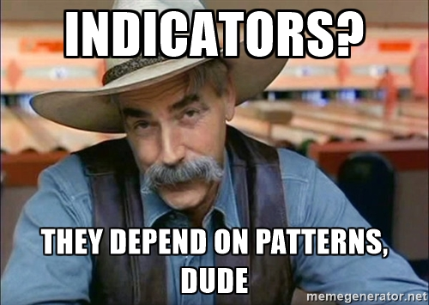
Why are we discussing patterning?

Slide 3
Patterning Background
Complete refactoring of CybOX 2.x patterning syntax
Spun up as a separate specification
https://docs.google.com/document/d/1suvd7z7YjNKWOwgko-vJ84jfGuxSYZjOQlw5leCswPY/edit#heading=h.t32x0azc539r
Syntax inspired by SQL-92
Integrated with Cyber Observable Object data models
Allows patterns to be written against any Object, e.g., File, IPv4 Address, Network Traffic, etc.
One string = one pattern
Primarily authored by John-Mark Gurney and Jason Keirstead
Many thanks!

Slide 4
Pattern Building Blocks

Slide 5
Comparison Expressions
The most basic components of Observation Expressions
Consist of an Object Path and a constant joined by a Comparison Operator
Comparison Expression
Object Path
Comparison Operator
Constant
file:hashes.md5 = 'y'
A Comparison Expression states which Object property to look for and the constant that its value should be compared against

Slide 6
Observation Expressions I
One or more Comparison Expressions, joined via Boolean Operators
The most basic valid Cyber Observable pattern is an Observation Expression with a single Comparison Expression:
Observation Expressions may be Qualified in order to further constrain the matching set:
[file:mime_type = 'image\bmp' AND file:magic_number = 'ffd8']
[file:size = 25536]
[file:file_name = 'foo.dll'] START '2016-06-01T00:00:00Z' STOP '2016-07-01T00:00:00Z'

Slide 7
Observation Expressions II
Multiple Observation Expressions may be joined using an Observation Operator to enable pattern-matching across multiple Observations:
Observation Expression Qualifiers and Operators are non-greedy, so parentheses may be used to achieve the desired logic:
[ipv4-addr:value = '192.0.2.5'] ALONGWITH [ipv4-addr:value = '192.0.2.10']
([ a ] ALONGWITH [ b ] REPEAT 5 TIMES) WITHIN 5 MINUTES

Slide 8
Operators and Qualifiers
Comparison Operators
=
!=
>
<
<=
>=
IN
LIKE
MATCHES
CONTAINS
Observation Expression Qualifiers
REPEATED
WITHIN
START/STOP
Observation Expression Operators
ALONGWITH
FOLLOWEDBY

Slide 9
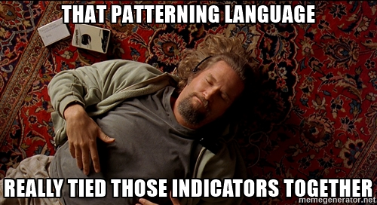

Slide 10
Key Questions
Specification
MVP operators
Stateful operators – REPEATED, FOLLOWEDBY, etc.
Context-specific operators such as CONTAINS
Implementation
As an implementer, must you support the full patterning spec?
Observable Object classes? E.g., as a HIDS vendor, must you support ALL of the network Objects?
Obviously not – but how do we communicate that in terms of conformance?
Stateful Operators? E.g., as a firewall vendor, must you support FOLLOWEDBY?
This question is not constrained to patterning
It highlights critical, cross-cutting questions of how to handle conformance in STIX
Level of specification – are things properly specified so that they can implemented correctly?
Are they overspecified? Underspecified?
What do we need in an implementer’s guide?
Do we need more examples?
ANTLR grammar – where should it be stored? STIX 2.0 Schemas GitHub repo? Elsewhere?

Slide 11
Conformance (notional)
Level 1N
Purely Network Devices/Sensors
E.g., Firewalls, IDS, etc.
Level 1H
Purely Host-based Devices/Sensors
E.g., AV, HIDS, etc.
Level 2
Host-based + Network Aggregator Devices/Sensors
E.g., SIEM, TIP, etc.
Individual patterns could be “tagged” with their level of applicability (host-based, network-based, or both):
{H}[(file:file_name = 'pdf.exe' OR file:size = '371712') AND file:created = '2014-01-13T07:03:17Z']
{N}[network-traffic:dst_ref.type = 'ipv4-address' AND network-traffic:dst_ref.value = '192.168.1.1']
{HN}[file:hashes.SHA-256 = 'aec070645fe53ee3b3763059376134f058cc337247c978add178b6ccdfb0019f']

Slide 12
Path forward
Finish remaining work items
Conformance
Update ANTLR grammar
Specification review
We need YOUR feedback
Remember, patterning is fundamental to STIX 2.0 Indicators
https://docs.google.com/document/d/1suvd7z7YjNKWOwgko-vJ84jfGuxSYZjOQlw5leCswPY/edit#

