Slide 1
Cyber Threat Intelligence: Technical Committee (CTI TC)
www.oasis-open.org
Monthly Meetings – April 20, 2017
Session #1 & Session #2
&

Slide 2
Agenda
www.oasis-open.org
Richard Struse – Chairman, CTI TC
Next F2F – When & Where
Release Schedule and Roadmap
STIX
Review Public Comments Matrix
Discuss Ballot for CSD
Ballot for Opinion & Intel Note
Cyber Observables
Malware & Infrastructure Status
TAXII
Interop

Slide 3
Spring 2017 Face to Face
www.oasis-open.org
Richard Struse – Chairman, CTI TC
We have a location reserved for May 23-24
Can you make it?
https://goo.gl/forms/lvjlSJte0kBqHwxQ2
Please respond by tomorrow (Friday) so we can make a decision

Slide 4
Release Schedule
Co-Chairs
We have reduced the number of topics that are being discussed
This means either:
Smaller releases (scope items out of 2.1)
Longer timelines (extend the cycle for release)
We need to speed up

Slide 5
Release Schedule (2)
Co-Chairs
When should STIX 2.1 be ready for CSD ballot?
End of July? (original target)
End of Sept.?
Or?
Editors need a month prior to the ship date for review periods and final editing

Slide 6
Road Map
Co-Chairs
The roadmap process will be discussed on a future working call
How to add items
How items should be prioritized
When items are deferred to a future release

Slide 7
STIX 2.0 Public Review
www.oasis-open.org
John Wunder and Sarah Kelly – Co-Chairs
Editors have completed all changes based on working call and Slack consensus
Need community to validate
Will summarize here and send to TC mailing list for more complete review
Changes fell into three buckets:
Substantive changes
Editorial fixes (wording, etc.)
Fixes to examples

Slide 8
Substantive Changes
www.oasis-open.org
John Wunder and Sarah Kelly – Co-Chairs
Accepted
Use single-quote rather than double-quote for property names in patterning
Add optional hash property to capture the hash of a URL in External Reference
Remove description property from cyber observable objects
Rejected
Add relationship for indicator “indicates” vulnerability
Rename x.509 extension
Change home_dir property in Unix account object to reference to directory object

Slide 9
Editorial Changes (Highlights)
www.oasis-open.org
John Wunder and Sarah Kelly – Co-Chairs
Accepted
Update data-marking relationships section to indicate that it’s not a STIX object and can’t have relationships
More clearly delineated normative from non-normative text
Moved glossary to appendix and added a few items
Added entries in conformance section for custom objects/properties
Clarified text around versioning
Added numerous cross-references
Added text to hashes definition to limit keys, as exists for dictionary
Rejected
Rewrite much of versioning and IDs section
Remove usage of graph nodes/edges
Define error conditions

Slide 10
2.0 Next Steps
www.oasis-open.org
John Wunder and Sarah Kelly – Co-Chairs
TC agrees that these changes are what we want and posts comment log (unanimous consent on mailing list)
Motion to approve CSD02 and open new 15 day public comment period
Will align with ballots for TAXII CSD01 and opinion/intel note
Rinse + repeat for 2nd comment period
If no material changes, open ballot to approve as CS

Slide 11
2.1 Status
www.oasis-open.org
John Wunder and Sarah Kelly – Co-Chairs
See roadmap: https://docs.google.com/document/d/1yvqWaPPnPW-2NiVCLqzRszcx91ffMowfT5MmE9Nsy_w/edit#heading=h.9av3pqeizci
Ballot to open on intel note and opinion, to approve adding new “comment” object and move it to 2.1 drafts
Malware and infrastructure in development now, co-led by STIX SC and Cyber Observable SC

Slide 12
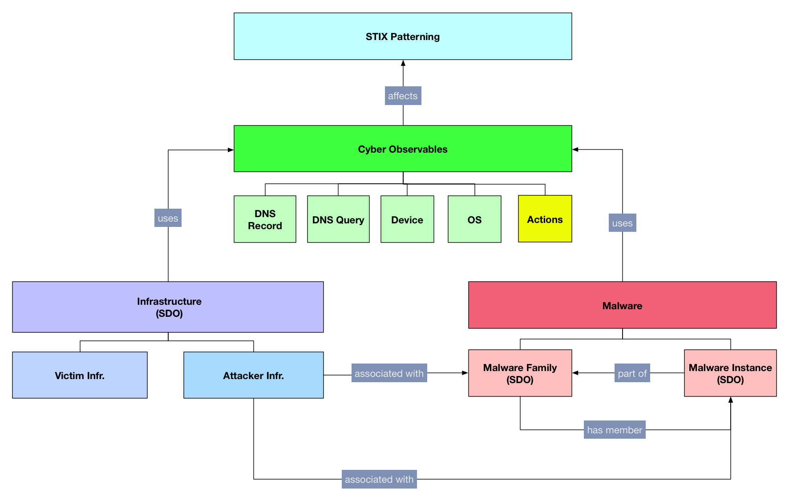
Cyber Observables Subcommittee Update I
Trey Darley & Ivan Kirillov – Co-Chairs
Interrelated: Malware, Infrastructure, Cyber Observables, and Patterning

Slide 13
Cyber Observables Subcommittee Update II
Trey Darley & Ivan Kirillov – Co-Chairs
We’ve defined some initial versions of Cyber Observable Objects and Extensions related to Infrastructure
DNS Query Extensions (Network Traffic)
DNS Record
Passive DNS Extension
Device
Firmware Extension (Software)
Operating System Extension (Software)
Current open questions revolve around modeling Passive DNS
Should we reference other Cyber Observable objects?
We need more feedback!
[1] https://docs.google.com/document/d/1PHRpmizbMGOwAu_TwRj5ofwnUEOIoM__vIDCDZGf4Sk/edit#

Slide 14
Cyber Observables Subcommittee Update III
Trey Darley & Ivan Kirillov – Co-Chairs
Infrastructure
We’ve had some initial discussions, particularly in regards to scoping
The current thinking is that for STIX 2.1, we’ll focus on adversary infrastructure: C2, botnets, malicious hosting providers, etc.
Malware
We’ve continued our discussions around modeling malware for STIX 2.1
The biggest open question is currently around whether we need discrete objects for Malware Instances and Malware Families
As a next step, we’re going to take a look at a combined SDO and determine whether that is a feasible modelling approach
Patterning
There has been some discussion around the expressivity of STIX patterns (for producers) versus the safety of their consumption (for consumers)
This work is continuing on the next working calls

Slide 15
TAXII Subcommittee Update
Bret Jordan & Mark Davidson – Co-Chairs
TAXII is ready for CSD01 ballot and Public Review

Slide 16
Interoperability Subcommittee Specification Update
Allan Thomson & Jason Keirstead – Co-Chairs
Use Case/Test Specification Development Part 1 specification Draft 2 out for review 20th April
Tests for Indicator, Sightings, Versioning, Data Markings, Custom Object & Property tests; COA defined
Personas Defined
MVP Personas defined for Data Feed Provider, TIP, SIEMs, TMS and TDS

Slide 17
Interoperability Subcommittee Team Questions
Allan Thomson & Jason Keirstead – Co-Chairs
Our Role on Interop Committee is…
Define interop test specification & guidelines including test cases
What else?
Q: Should self-certification Phase 1 require vendors/orgs send their results for review or confirmation by OASIS review sub-group?
Q: Who staffs the review group?
Interop committee?
TC review committee?

Slide 18
Interop – Call to Action
If you want to get involved
Sign up for Interop committee list on OASIS wiki
https://www.oasis-open.org/apps/org/workgroup/cti-interoperability/
Meetings every Weds at 9am PST
https://www.oasis-open.org/apps/org/workgroup/cti-interoperability/event.php?event_id=44770
2nd draft document
https://docs.google.com/document/d/1l54RhjxwuXrZUQ19zIHUiZ7_c6otbLbVVfluKJogU7s/edit?ts=5890ba79#heading=h.6i4nacmj4j5h
Next Milestone: Final Draft Targeting 15th May

Slide 19
Q & A
Richard Struse – Chairman, CTI TC
Cyber Threat Intelligence
Technical Committee

