Slide 1
STIX Enhancement Proposal
Version 5
July 2020

Slide 2
Introduction
Background
Focused Requirements
Proposal
Summary

Slide 3
Background
The following entities worked together to re-establish
A) Requirements for products and technology currently using or would like to use a mechanism to build upon STIX v2.1 data model
B) Focus efforts on MVP around the core requirements
C) Include/Use Full Knowledge of existing STIXv2.1 specifications
Group representatives from: Broadcom, Celerium, Cert.be, DHS, IBM LookingGlass Cyber, MITRE, New Context

Slide 4
Background
Group focused requirements and proposal on data model enhancements only
Initial focus on STIX NOT TAXII enhancements
Deliberately chose to exclude any process requirements or solutions associated with
OASIS
Sharing-community (AIS)
Industry forums (X-ISAC)
Industry consortiums
etc.

Slide 5
STIX Data Model Requirements #1 of 2
Avoid having to change STIXv2.1 version number if at all possible
Support globally unique identification of what entity or entities defined the extension (i.e. use STIX2 identity object)
Support display/description fields of extension that are useful for UI/debug...etc.
Support globally unique identification of extension to avoid conflicts
Support versioning of the extension
Allow support of intelligence that uses different versions of the same extension in the same intelligence feed(s) but across different object features that may share an extension capability

Slide 6
STIX Data Model Requirements #2 of 2
Support schema reference such that it *may* be possible to download a programmatic schema
Support extension for inclusion with SDO, SCO, SRO (i.e. enhanced standard STIX objects)
Support extension for new SDO, new SCO, new SRO (i.e. new objects)
Support ability to integrate extensions into STIX TC future standards with minimal changes provided those minimal changes are accepted by the TC as a whole
Avoid duplication or replication of existing common STIX standard features such as common properties, use in relationships, use in SDO/SCO/SRO
NO requirements stating where or how extension schemas are shared with interested parties other than inclusion of a reference.

Slide 7
Changes to Proposal
7/28/20 - Since introduced to TC meeting in July, mini-group has met with IBM to discuss and incorporate additional changes to include in extension proposal that allows both top-level and sub-component properties defined for extensions. See details in subsequent slides.

Slide 8
Proposal
Summary

Slide 9
Enhancement Summary
Introduce 3 (three) modifications on STIX 2.1
A new SDO, stix-extension, for declaring an extension
including whether it includes top-level or sub-component properties
Methods for adding custom information either as top-level properties or sub-component properties to
STIX Domain Object
STIX Cyber Observable
STIX Relationship Object
STIX Meta Objects (e.g. Marking, Language-Content)
A method for defining a custom STIX Object

Slide 10
STIX Enhancement 1
Declaration SDO

Slide 11
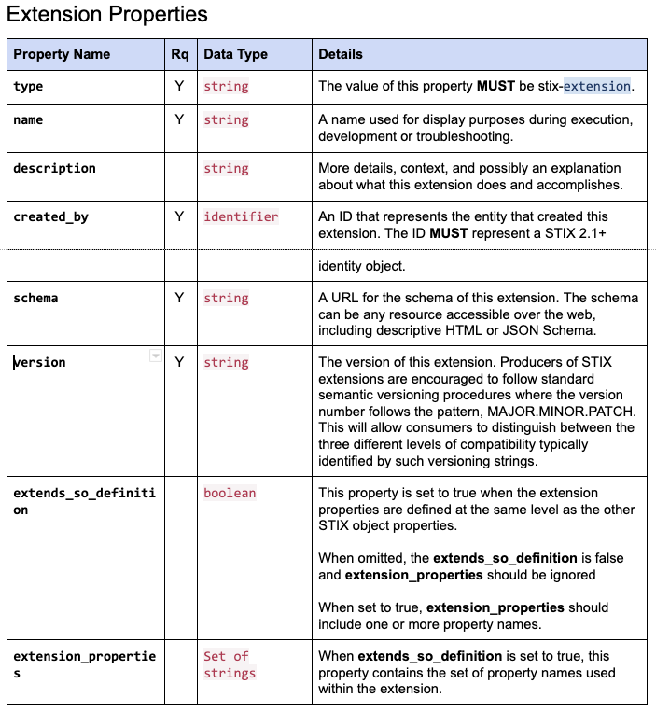
STIX Extension SDO
The proposal defines a STIX Extension SDO
Declaration of an extension
Communicates information about an extension schema
Defines requirements for the "extensions" property in SDOs, SCOs, SROs and Meta Objects

Slide 12
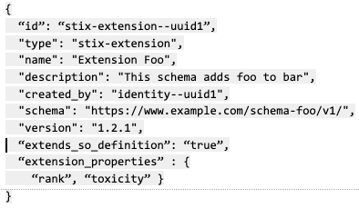
STIX Extension – Extended Top-Level Properties
An extension may incorporate top-level properties on SDO, SCO, SRO where those properties are at the same level as existing standard based objects
2 properties declare this extension uses top-level properties & includes them

Slide 13
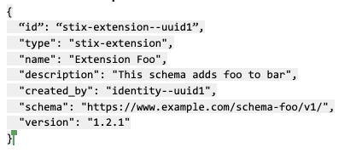
STIX Extension – Extended Sub-Component Properties
An extension may incorporate sub-component properties on SDO, SCO, SRO where those properties are included within the module of the extension itself
No explicit listing required

Slide 14
STIX Extension – Top-Level and Sub-component Usage
Top-level extension usage recommended where organization wishes to have additional properties at same-level as existing SO properties
Indicates the properties are integral to the primary SO properties
Sub-component extension usage recommended where organization wishes to have additional component on SO
Indicates the component/properties are a module of the primary SO

Slide 15
STIX Enhancement 2
Sub-Component Extension Use

Slide 16
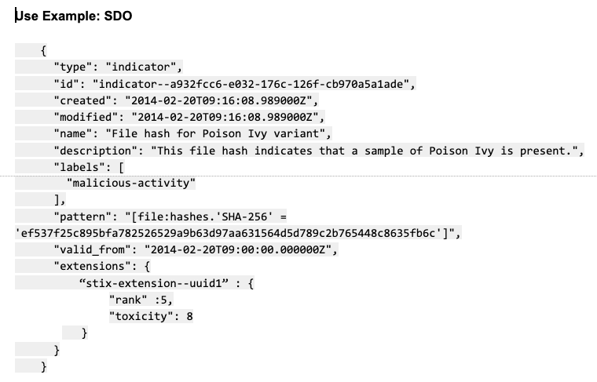
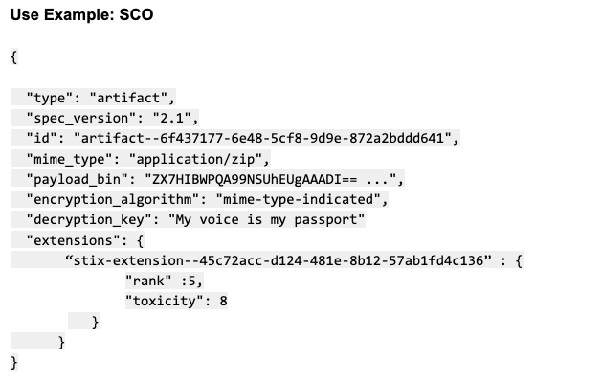
STIX Extension Use – Sub-Component Extensions
SDO
SCO

Slide 17
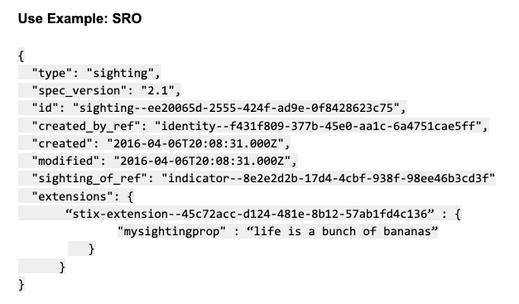
STIX Extension Use
SRO

Slide 18
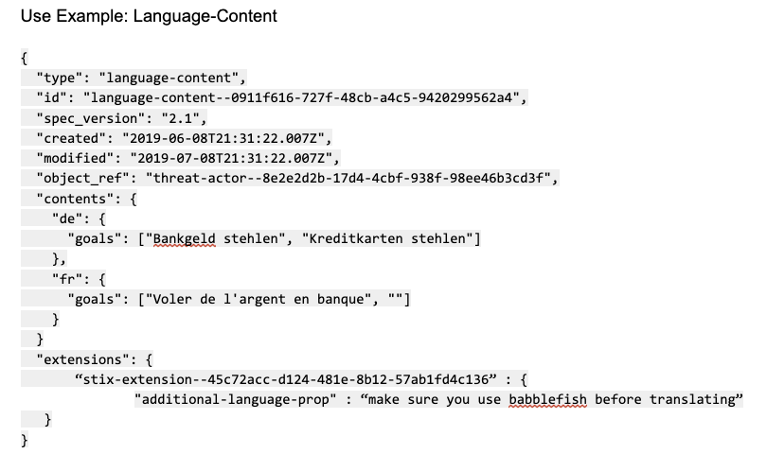
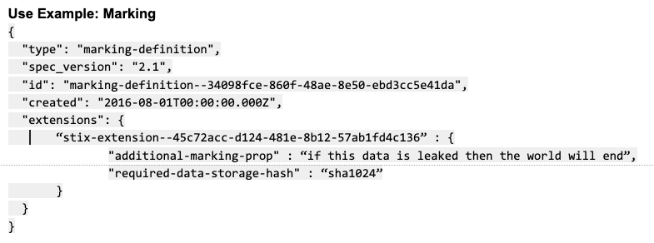
STIX Extension Use – Meta Objects
Marking Definition
Language Content

Slide 19
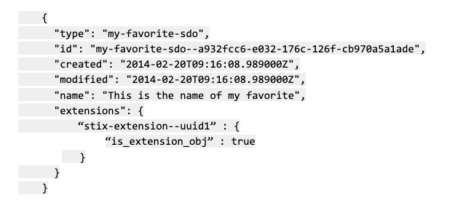
STIX Extension Use – New SDO/SCO/SRO
Entire SDO/SCO/SRO is an extension
Extensions property defines this SO’s schema is defined by the extension identified by stix-extension-uuid1
No additional properties defined in the extension property beyond that
If STIX TC decided to embrace this SO (STIX Object) for standards track
Object could stay as-is for the most part
Optionally remove the extension id once a standard version of the object is in use
Allows compatibility between pre-standards versions and standards versions
New SDO Example

Slide 20
STIX Enhancement 2
Top-Level Extension Use

Slide 21
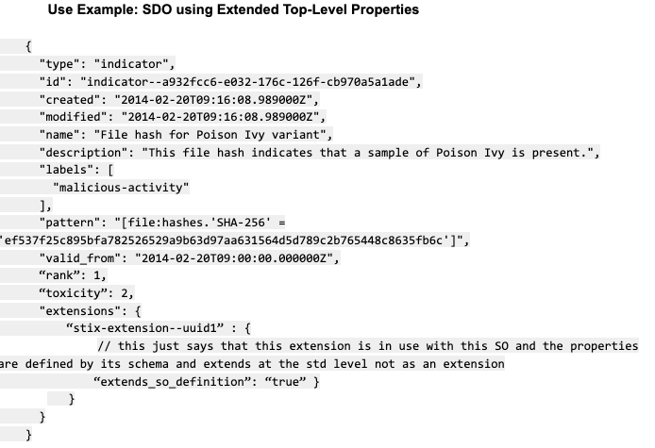
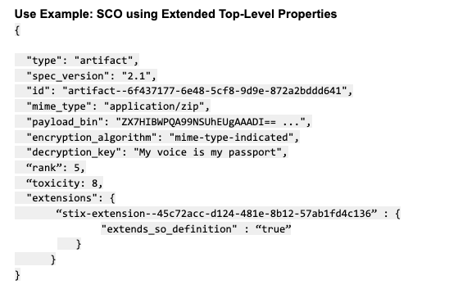
STIX Extension Use – Top-Level Extensions
SDO
SCO

Slide 22
STIX Extension Use – Top-Level Extensions
Only SDO and SCO examples shown but scheme can apply to other SO types such as SRO

Slide 23
STIX Enhancement 3
Update to STIX2.1 Specification

Slide 24
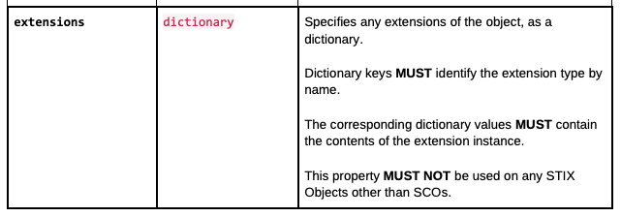
Specification Work
Current specification explicitly stops extension re-use
Proposal
Remove the statement "This property MUST NOT be used on any STIX Objects other than SCOs”
Enhance sentence “Dictionary keys MUST identify the extension….” to be more explicit around ID of extension for globally unique ID (as best practice)

Slide 25
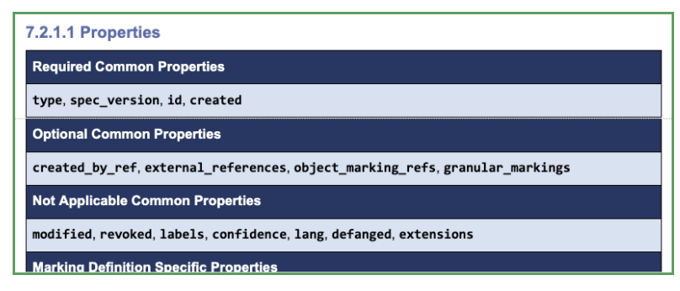
Specification Work – Meta Objects
Current specification lists extensions as common property that is not applicable to both Marking* (shown) and Language Content meta-objects
Proposal
Move extensions property from “Not applicable” to “Optional” common properties for both Marking and Language Content object definitions

Slide 26
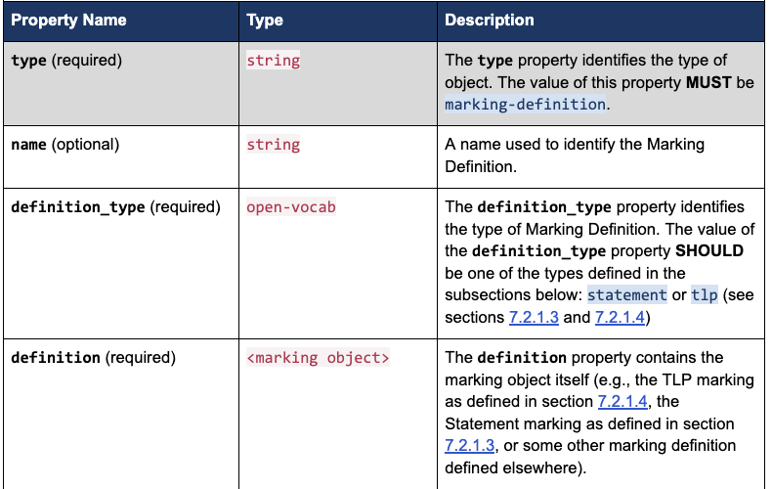
Specification Work – Meta Objects
Current specification requires definition_type and definition. This is redundant if using the new extension mechanism
Proposal
Change those properties to optional not required

Slide 27
STIX Enhancement
Summary

Slide 28
Summary
Minimal changes to STIXv2.1
Suggest STIXv2.1.1 as version number
Allows extensions for both top-level and sub-component design pattern choices
Allows extensions across all existing STIX Objects (SDO, SCO, SRO), STIX Meta Objects and new SDO/SCO/SRO in consistent manner
Leverages existing extensions property already defined in STIXv2.1
Could be used as mechanism to introduce new changes to STIX going forward in easy adopted manner

