Slide 1
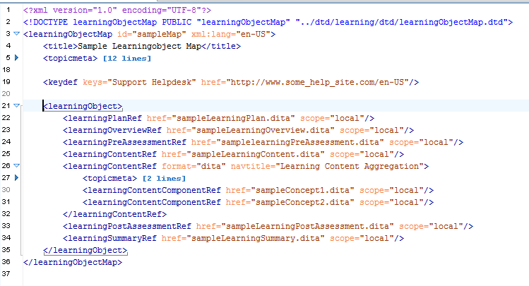
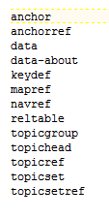
Additional Elements for learningObject and learningGroupMaps
?

Slide 2
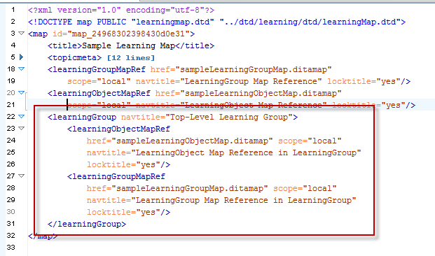
Recursion in learningGroupMaps
Recursion is permissible in the learningGroup within the learningMap. Do we need recursion implemented in the learningGroupMap as well?

