Slide 1
DITA for educational content
Birgit Strackenbrock
Jan Benediktus

Slide 2
Speakers
Birgit Strackenbrock – freelance information analyst and XML Schema developer, experienced in DITA Specializations
Jan Benedictus – founder Liones (web-agency) and Fonto XML (web-based XML editor for non-XML experts)
Both work for and together with educational publishers.
Jan is member of the DITA Lightweight TC, Birgit of the DITA T&L TC

Slide 3
Why this presentation?
Show that DITA T&L is suitable for educational content as well.
Make DITA Training & Learning more known and popular
Encourage users to use DITA T&L

Slide 4
DITA T&L
Elements in the learning and training section include specialized topics, maps, content, and metadata elements specially designed to support instructional content.
Simply using the content models described in this specification, of course, does not ensure quality learning content. Quality learning content only results from good instructional design and in-depth learning needs analysis.

Slide 5
Some definitions
Training - Organized activity aimed at imparting information and/or instructions to improve the recipient's performance or to help him or her attain a required level of knowledge or skill.
Education - The wealth of knowledge acquired by an individual after studying particular subject matters that provide an understanding of something. Education requires instruction of some sort from an individual or composed literature. The most common forms of education result from years of schooling that incorporates studies of a variety of subjects.
Learning - Measurable and relatively permanent change in behavior through experience, instruction, or study
(http://www.businessdictionary.com)

Slide 6
Kind of content
Training and learning ≠ education
Education is more complex
Education is the field of study that deals mainly with methods of teaching and learning in schools (www.merriam-webster.com)
Education mostly is committed to a curriculum
But nevertheless there are coincidences between training and educational material.

Slide 7
Educational content
Interactive questions
Assessments
Theory
Learning objectives
Metadata (LOM)

Slide 8
DITA T&L topics
<learningContent>
<learningAssessment>
<learningPlan>
<learningOverview>
<learningSummary>

Slide 9
<learningContent>
Provides the learning content itself
Comprises a set of self-contained content about a single terminal learning objective supported by zero or more enabling learning objectives

Slide 10
<learningAssessment>
Presents questions or interactions that measure progress, encourage recollection, and stimulate reinforcement of the learning content,
The interactions use a sub-set of the Question-Test Interoperability (QTI) specification, implemented as a DITA domain specialization.

Slide 11
QTI
The common standard for question and test material
The specification consists of a data model that defines the structure of questions, assessments and their results
For QTI a wide range of authoring and publications tools are on the market
Provides a wide range of question types
Is somehow difficult to extend with customer question types

Slide 12
Comparison
QTI | DITA T&L
textEntryInteraction
inlineChoiceInteraction
drawingInteraction
gapMatchInteraction
matchInteraction
graphicGapMatchInteraction
hotspotInteraction | Hotspot
graphicOrderInteraction
selectPointInteraction
graphicAssociateInteraction
sliderInteraction
choiceInteraction | SingleSelect, MultipleSelect
mediaInteraction
hottextInteraction
orderInteraction | Sequencing
extendedTextInteraction | OpenQuestion
uploadInteraction
associateInteraction | Matching
 | TrueFalse

Slide 13
Conclusion
DITA T&L only offers a small set of questions
Nearly all DITA T&L question types are more or less the same in QTI
But educational publishers want a big range of question types because different disciplines have different didactic needs.
DITA T&L should offer more question types (QTI and not QTI types)

Slide 14
DITA specialization “dita13.lc.extra-interactions”
Open source DITA-OT plug-in
Based/requires DITA 1.3
Defines more question types
Includes MathML

Slide 15
“dita13.lc.extra-interactions” question types
textEntry – fill in a blank
gapMatch – drag and drop a word into a blank
hottext – highlight a word in a text
inlineChoice – choose a word for a blank
gaphicGapMatch – drag and drop a word or image onto an image
multipleMatch – match items, relation can be n-to-n
drawing – draw on a given image, open question
acrosticWord – one-dimensional crossword
(most of them have an equative in QTI)

Slide 16
textEntry

Slide 17
lceTextEntry XML

Slide 18
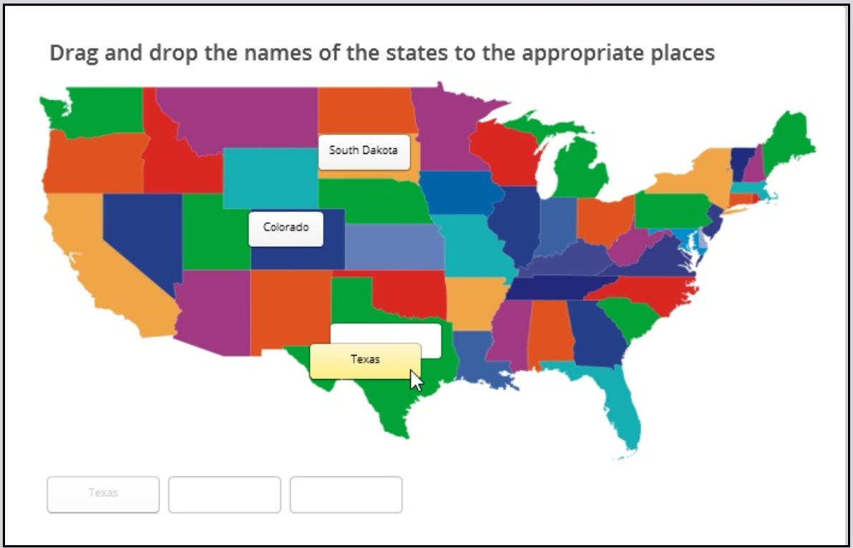
graphicGapMatch

Slide 19
lceGraphicGapMath XML

Slide 20
acrosticWord

Slide 21
lceAcrosticPuzzle

Slide 22
Point of interest during specializing
lcInteractionBase2 and lcQuestionBase2 are based on div that’s much more flexible than on fig
A correct answer is only recognizable through the empty element lcCorrectResponse2, no different semantic elements for incorrect and correct answers
Specializing as close as possible to the patterns used in DITA 1.3 T&L

Slide 23
DITA 1.3 T&L – Disadvantages for users
Double question elements e.g. lcOpenQuestion and lcOpenQuestion2
No semantic elements for correct and incorrect answers
No MathML integrated
Not enough question types
No concept for questions with sub-questions and overall assignment

Slide 24
DITA T&L assessment – next generation
Per question type one question element
More question types
Integration of MathML
Concept for questions with sub-questions
Semantic elements for correct and incorrect answers
Feedback per question, sub-question and answer

