Slide 1
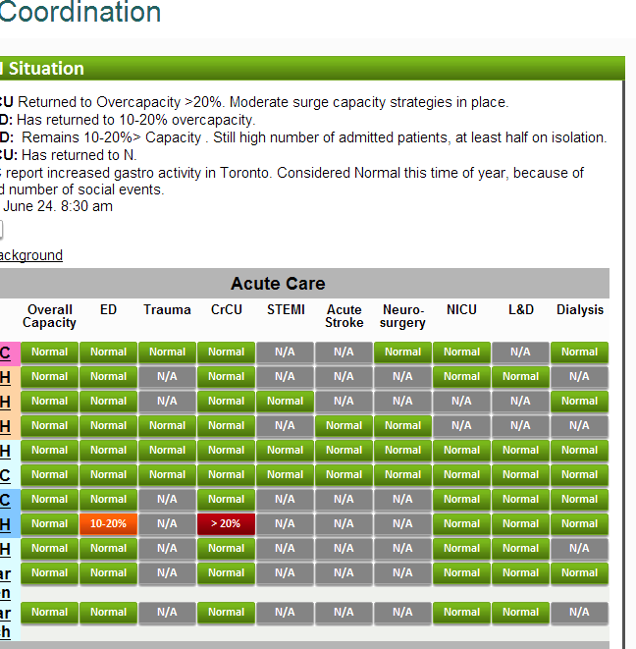
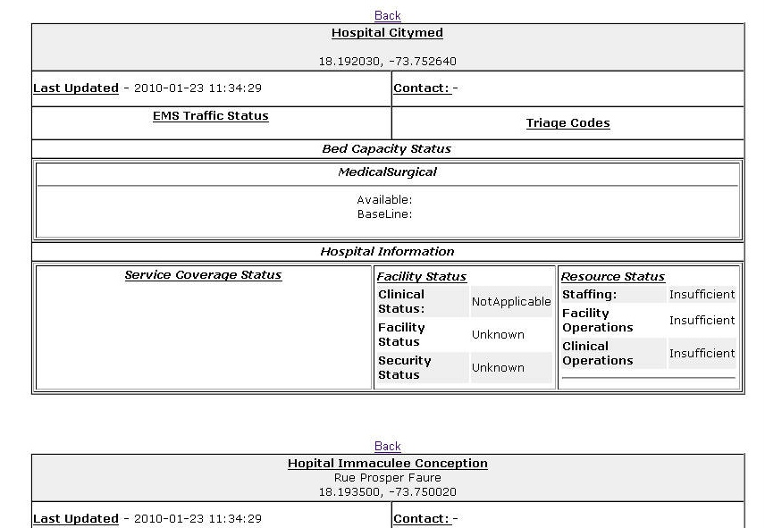
Hospital AVailability Exchange EDXL-HAVE
Hospital Status – day-to-day and in crisis:
Capacities (bed counts, utilization)
Services Offered
Ambulance status (offload times – air and land)
Deployed widely in Haiti, being adapted for non-Hospital Use (e.g. urgent care, temporary facilities, doctor offices, walk-in clinics)

