Slide 1
Akoma Ntoso and functionally equivalent naming conventions (FENC)
27 August 2016

Slide 2
Akoma Ntoso Naming Convention Version 1.0
We need to define what could be considered a “functionally equivalent naming convention” (FENC) according to the Conformance Clauses of OASIS
We need to define it in 4.1.2 URI/IRI of Akoma Ntoso Naming Convention Version 1.0
Rough idea:
AKN naming convention OR
FENC and FRBRAlias using AKN naming convention OR
FENC and full FRBR metadata

Slide 3
Example: ELI metadata vs. FRBR metadata
AKN | ELI
FRBRcountry | [Individual countries]
FRBRsubtype | type_document based on dcterms:type
FRBRauthor | passed_by based on dcterms:creator
FRBRdate | date_document based on dcterms:date
FRBRnumber or FRBRname | id_local??? or title
FRBRlanguage | language based on dcterms:language
FRBRversionNumber | version or version_date
FRBRportion | ???
FRBRformat | format based on dcterms:format
http://publications.europa.eu/documents/2050822/2138819/ELI+-+A+Technical+Implementation+Guide.pdf/

Slide 4
A functionally equivalent naming convention (FENC) must be:
recognizable: a syntactical means exists to recognize the specific syntax used for the URI (e.g., a specific prefix);
published: a sufficiently detailed description of the syntax is publicly available and backed by a recognizable institution;
FRBR compliant: A full distinction between "distinct intellectual creations", "specific intellectual forms", "physical embodiments" and "exemplars" of relevant documents must be explicitly supported and aligned with the FRBR conceptualizations. Support for items is not necessary nor requested.

Slide 5
A functionally equivalent naming convention is defined as follows:
CEN Metalex compliant: the seven rules in CEN Metalex requirements (section 6.1 of *) must be fully implemented: "To allow for the discovery of IRI identifiers, names must be:
Persistent: names at all levels must maintain the same form over time regardless of the political, archival and technical events happened since their first generation;
Global: all relevant documents by all relevant bodies must be represented;
Memorizable: names should be easy to write down, easy to remember, easy to correct if they were written down wrongly;
Meaningful: names should mean something; It should be possible to make assumption about the kind, freshness and relevance of a citation by looking only at the document’s name;
Guessable across levels: references to different levels of the same document must be similar; e.g., given a reference to an expression a user should be able to deduce the name of the work;
Guessable across document classes: references to different instances of the same document type must be similar;
Guessable across document components: references to different components of the same document at the same level must be similar."
* ftp://ftp.cen.eu/CEN/Sectors/List/ICT/CWAs/CWA15710-2010-Metalex2.pdf

Slide 6
A functionally equivalent naming convention is defined as follows:
active: at least one working, accessible, available, robust resolver must exist that provides dereferencing of URIs/IRIs according to the specific syntax;
equivalent: at least one working, accessible, available, robust converter must exist that converts URIs/IRIs according to the specific syntax into equivalent URIs/IRIs according to the Akoma Ntoso Naming convention;
evident: Akoma Ntoso XML documents identifying themselves (in <FRBRUri> and <FRBRThis> elements) using a FENC URI, must also
EITHER provide equivalent <FRBRalias> elements with the URI ref corresponding to <FRBRThis> according to the Akoma Ntoso Naming Convention, one for each of the first three FRBR levels,
OR consider as REQUIRED instead of optional the following elements (in their respective FRBRWork, FRBRExpression and FRBRManifestation containers): FRBRdate, FRBRauthor, FRBRcountry, FRBRsubtype, FRBRnumber (or FRBRname), FRBRversionNumber, FRBRlanguage, FRBRportion and FRBRformat.
Any Naming Convention that complies with these requirements (items 1. through 7.) is termed a functionally-equivalent Naming Convention (FENC) and its URIs/IRIs can be used in any context where Akoma Ntoso URIs/IRIs are appropriate.

Slide 7
Current Conformance Rules
Akoma Ntoso Version 1.0. Part 1: XML Vocabulary
Part I
Conformance clauses for Akoma Ntoso Version 1.0 can be found in Akoma Ntoso Version 1.0. Part 2: Specifications, Section 3 Conformance.
http://docs.oasis-open.org/legaldocml/akn-core/v1.0/csprd02/part1-vocabulary/akn-core-v1.0-csprd02-part1-vocabulary.html#_Toc451851347

Slide 8
Current Conformance Rules
Akoma Ntoso Version 1.0. Part 2: Specifications
Part II
This chapter defines Akoma Ntoso conformance clauses. Akoma Ntoso specifications MUST be compliance with the Annex B xsds included in the zip file in attachment that are:
akomantoso30.xsd
modular.xsd
xml.xsd
http://docs.oasis-open.org/legaldocml/akn-core/v1.0/csprd02/part2-specs/materials/akn-core-v1.0-csd02-part2-specs-3.html

Slide 9
New Conformance Rules
Akoma Ntoso Version 1.0. Part 2: Specifications
Part II
This chapter defines Akoma Ntoso conformance clauses. Akoma Ntoso specifications MUST be valid against the XSD schemas included in the zip file under the Annex B. The zip file includes:
akomantoso30.xsd
modular.xsd
xml.xsd
http://docs.oasis-open.org/legaldocml/akn-core/v1.0/csprd02/part2-specs/materials/akn-core-v1.0-csd02-part2-specs-3.html

Slide 10
Current Conformance Rules
Akoma Ntoso Naming Convention Version 1.0
This chapter defines Akoma Ntoso conformance clauses.
#1 an XML document is compliant with Akoma Ntoso specs in level 1 if
The XML file MUST be valid according to the XML schema: http://docs.oasis-open.org/legaldocml/ns/akn/3.0/WD17;
#2 an XML document is compliant with Akoma Ntoso specs in level 2 if it is compliant at level 1 and
2.1 The values of the eId and wId attributes MUST follow the Akoma Ntoso naming convention as formulated in chapters 4 and 5;
2.2 The values of the FRBRuri and FBRRthis elements MUST follow the specification detailed in chapter 4;
2.3 The values of the href and src attributes in ALL elements (except <a>) MUST follow the specifications detailed in chapter 4 and 5 .
http://docs.oasis-open.org/legaldocml/akn-nc/v1.0/csprd02/akn-nc-v1.0-csprd02.html#_Toc447637073

Slide 11
New Conformance Rules
Akoma Ntoso Naming Convention Version 1.0
This chapter defines Akoma Ntoso conformance clauses.
an XML document is compliant with Akoma Ntoso specs in level 1 if
The XML file IS valid against the XML schema: http://docs.oasis-open.org/legaldocml/ns/akn/3.0/WD17;
an XML document is compliant with Akoma Ntoso specs in level 2 if it is compliant at level 1 and if
The values of the eId and wId attributes follows the Akoma Ntoso naming convention as formulated in chapters 4 and 5 of this document;
The values of the FRBRuri and FBRRthis elements follows the specification detailed in chapter 4 of this document or any functionally equivalent naming convention as detailed in chapter xxx;
The values of the href and src attributes in ALL elements (except <a>) follows the specifications detailed in chapter 4 and 5 of this document or any functionally equivalent naming convention as detailed in chapter xxx.
http://docs.oasis-open.org/legaldocml/akn-nc/v1.0/csprd02/akn-nc-v1.0-csprd02.html#_Toc447637073

Slide 12
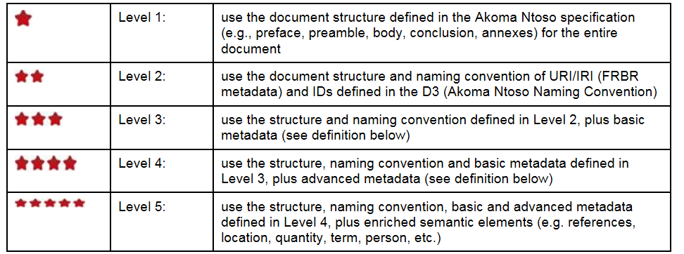
Current Compliance levels (Non-Normative)
http://docs.oasis-open.org/legaldocml/akn-core/v1.0/csprd02/part1-vocabulary/akn-core-v1.0-csprd02-part1-vocabulary.html#_Toc451851346

Slide 13
New Compliance levels as a bidimensional matrix
Structure and URIs/IRIs | sublevel A | Sublevel B | Sublevel C | Sublevel D
Level 1 uses the document structure defined in the Akoma Ntoso specification (e.g., preface, preamble, body, conclusion, annexes) for the entire document as defined in the chapter 8 of this document (conformance). | basic metadata is added | normative references are used | advanced metadata are added | semantic elements are added
Level 2 use the document structure and naming convention of URI/IRI (FRBR metadata) “functionally-equivalent Naming Convention” and the IDs of AKN naming convention as defined in Akoma Ntoso Naming Convention Version 1.0, chapter 4 and 5. | basic metadata is added | normative references are used | advanced metadata are added | semantic elements are added

Slide 14
Examples
AKN without AKN Ids, with normative references and advanced metadata is qualified as Level 1.BC
AKN with AKN naming convention with normative reference is Level 2.B
AKN with complete AKN naming convention is Level 2.ABCD

