Slide 1
OASIS Overview Managing TC Work Using JIRA
TOSCA TC December 19, 2011

Slide 2
Goal
Demonstrate OASIS JIRA installation
Show best practices for managing development projects
Give TC a place to start

Slide 3
What is JIRA?
Issue-tracking system used for bug & issue tracking, project management, etc.
Components:
Projects – the overall collection of issues. At OASIS, we assign a project at the TC level (e.g. AMQP TC, Energy Interop TC)
Issues – the individual atomic entries that the TC enters, tracks, resolves & eventually closes (e.g. ENERGYINTEROP-504, Add Reading Type as optional element in ei:Market)
Versions – Identifiers for specific stages of your spec’s lifecycle (e.g. working draft (wd) 07, Committee Specification Draft 02)
Components – Sub-sections of a project typically tied to its discrete parts (e.g. Schema, Specs, Models)
Status / stages – Indicators of the progress in resolving the issue

Slide 4
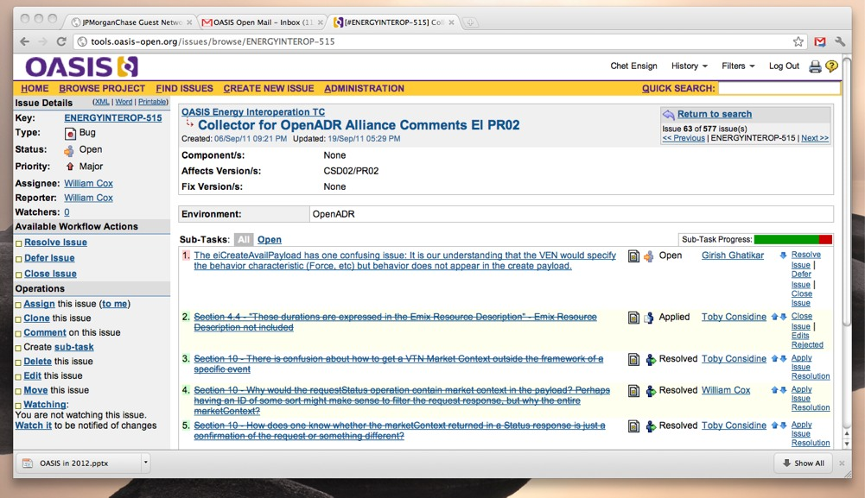
What is JIRA?

Slide 5
Organizing Your Project
OASIS creates your project at TC level
E.g. OASIS Energy Interoperation TC, OASIS AMQP TC
Within your project:
Use Versions to organize issues by OASIS specification stage
Use Components to organize issues the way you organize your specification

Slide 6
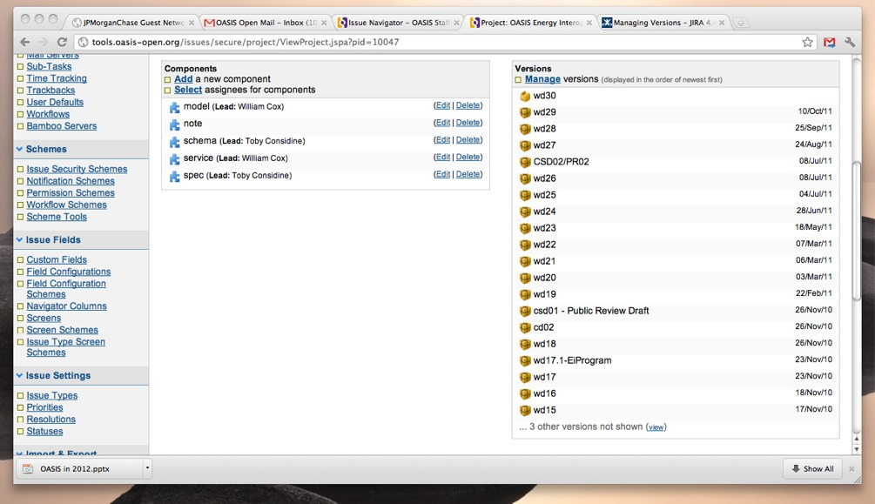
Organizing Your Project

Slide 7
How to Get Started
Decide what you want to track
Public review comments only? Issues raised in committee meetings?
Define your terms
JIRA status codes are: New, Open, Resolved, Applied, Closed, Deferred
Decide what those will mean in your project
Decide how you will assign / approve / close
E.g. issues aren’t real until they are in JIRA
E.g. issues are closed until approved in TC meetings

Slide 8
How to Get Started
TC Admin sets up your project & users
TC sets up versions and components
Versions and components are defined by clicking the “Administer Project” link on the project main page
TC members add issues and sub-tasks
Issues are entered by clicking the “Create a new issue” link on the project main page
Sub-tasks can be created during entry or by converting an issue that was initially entered

Slide 9
Questions?

