Slide 1
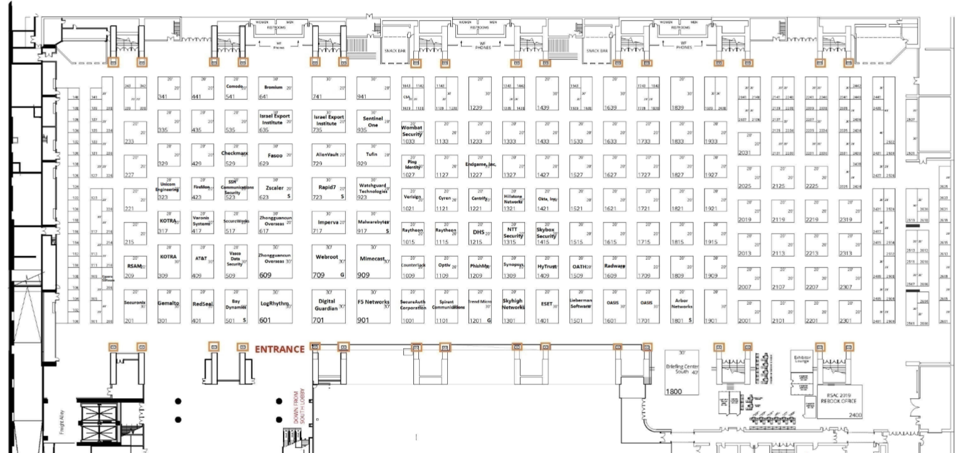
RSA 2018 – Cyber Showcase
~ Dates: 16-20 April
~ Two side-by-side booth spaces; front row marked in green
~ 24 members will participate; only 4 spots left

