Slide 1
OCA to OpenC2 Mapping
Version 3

Slide 2
OCA to OpenC2 – C4 Diagram
OCA Action | OpenC2 Mapping (Action/Target)
Quarantine | Contain File, Contain device
Block File | Deny Process, Deny File
Block URL | Deny URL
Query Device | Query Device
Open Incident Response Case | SIEM or Threat Intelligence to SOAR

Slide 3
OCA to OpenC2 – Use Case Mappings Endpoint
OCA Action | OpenC2 Mapping
Endpoint Protection Software (EPSW) – update signatures | Update File
EPSW checks for new network blocks | (Trigger via EPSW) Set (Configure parms of retrieval, schedule for retrievals, where to pull from)
EPSW scans file | Scan Files
EPSW sends alert to logging tools
EPSW receives Quarantine file request | Contain File
EPSW polls TIP for updated malicious hash list | Update File

Slide 4
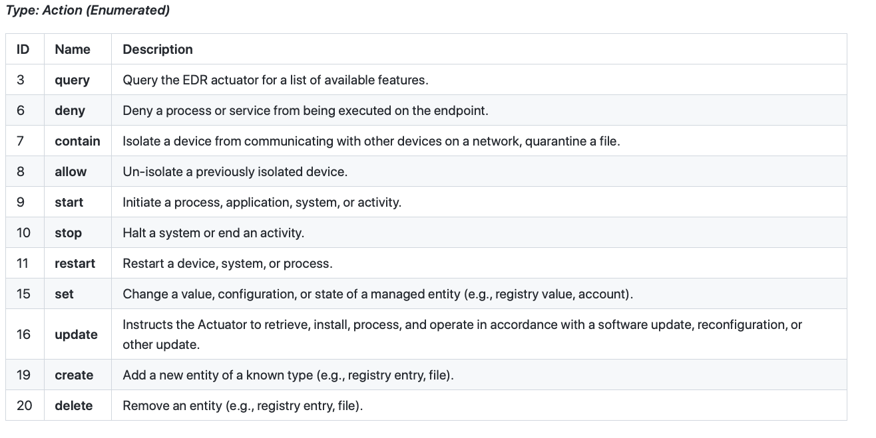
OpenC2 EDR Actuator Profile

Slide 5
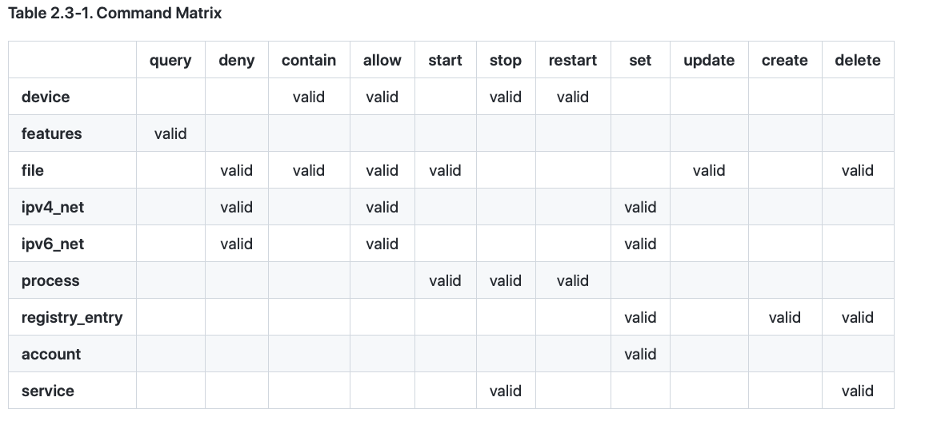
EDR Command/Target Matrix
OCA Use
OCA
Request
Scan
URL
Domain

Slide 6
OCA to OpenC2 – Use Case Mappings Malware Protection (File, Endpoint)
OCA Action | OpenC2 Mapping
Quarantine Device (from SIEM/SOAR) | Contain Device
Block File (from SIEM/SOAR) | Contain File

Slide 7
OCA to OpenC2 – Use Case Mappings SIEM/SOAR
OCA Action | OpenC2 Mapping
Quarantine Device (to Malware protection, endpoint) | Contain Device
Block File (to Malware protection, endpoint) | Contain File
 | Scan Files
Assess Endpoint Posture (PACE)
Collect Posture Attributes (PACE)
Query (to Threat Detection)
Open Incident Response (to SOAR from SIEM)
Orchestrate Posture Collection (SOAR to PACE)
Orchestrate Posture Assessment (SOAR to PACE)

Slide 8
OCA to OpenC2 – Use Case Mappings Threat Intelligence
OCA Action | OpenC2 Mapping
Quarantine Device (to Malware protection, endpoint, SIEM, SOAR) | Contain Device
Block File (to Malware protection, endpoint, SIEM, SOAR) | Contain File
Block URL (to SIEM,SOAR)
Collect Posture Attributes (PACE)
Query (from SIEM or SOAR to Threat Detection)
Open Incident Response (to SOAR)

Slide 9
OCA to OpenC2 – Use Case Mappings
OCA Action | OpenC2 Mapping
TIP gathers updates (threats) | QUERY or REST API
Email filtering deny list update (threats) | DENY
New blocking policy pushed out by operations | Update
Security operations invokes new server scan | SCAN
Vulnerability service scans new server VM | SCAN

Slide 10
OCA to OpenC2 – Use Case Mappings
OCA Action | OpenC2 Mapping
TIP gathers updates (threats) | QUERY or REST API
Email filtering deny list update (threats) | DENY
New blocking policy pushed out by operations | Update
Security operations invokes new server scan | SCAN
Vulnerability service scans new server VM | SCAN

Slide 11
OCA to OpenC2 – C4 Diagram - PACE
OCA Action | OpenC2 Mapping (Action/Target)
Publish Collection Results | (Endpoint, Malware protect for Email, Malware protect for Endpoint to Posture Collection)
Perform Posture Attribute Collection | Query (Posture Collection System to Endpoint, Malware protect for Email, Malware protect for Endpoint)
Orchestrate Posture Assessment | SOAR to Posture Collection System
Orchestrate Posture Collection | Query (posture attributes) SOAR to Posture Assessment System
Assess Endpoint Posture | Query (SIEM or SOAR to Posture Collection System)
Collect Posture Attributes Action | Query (SIEM or SOAR to Posture Collection System)

Slide 12
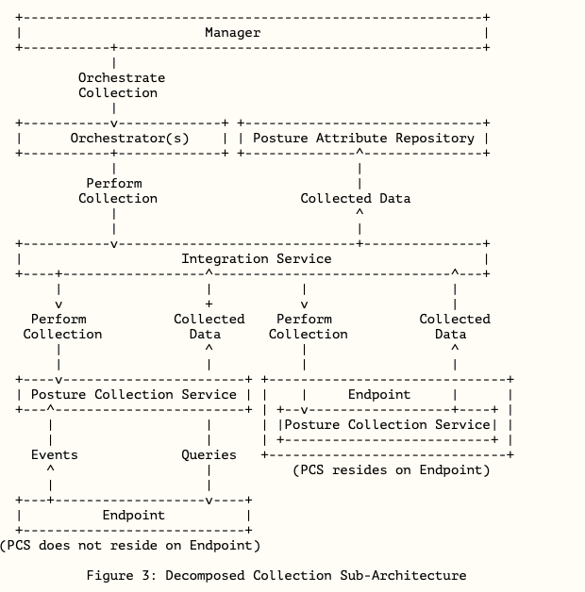
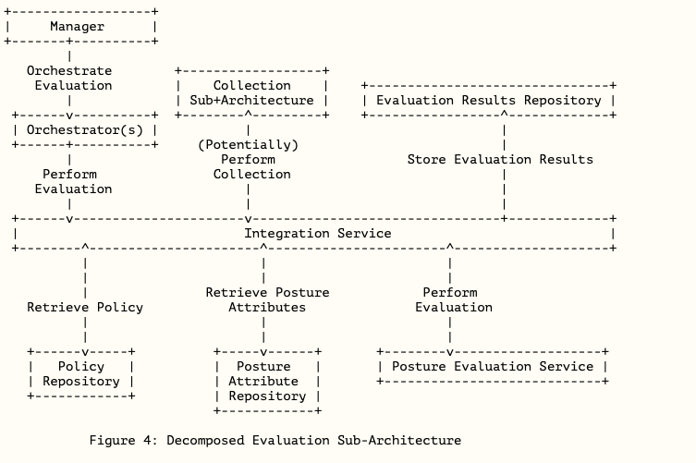
SACM Architecture

