Slide 1
OASIS OSLC PROMCODE TC Domain Model Revisited and Use Cases Development Plan of Specifications (Memorandum)
Specification Development and Review Team
Mikio Aoyama, Kazuhiro Funakoshi, Yoshio Horiuchi, Tsutomu Kamimura, Shigeaki Matsumoto, Arthur Ryman, Kazuo Yabuta, Hiroyuki Yoshida
2014/07/21, 08/05, 08/19, 9/02, 9/16

Slide 2
Upcoming TC Meeting Schedule Proposed
Meeting Schedule |  | Date/Time [EST] | Date/Time [JST]
11 | TC Meeting | 8:00 p.m., Sep. 16 | 9:00 a.m., Sep. 17
12 | TC Meeting | 8:00 p.m., Sep. 30 | 9:00 a.m., Oct. 1
13 | TC Meeting | 8:00 p.m., Oct. 14 | 9:00 a.m., Oct. 15
14 | TC Meeting | 8:00 p.m., Oct. 28 | 9:00 a.m., Oct. 29
Note: End US DST: Sunday, 2 November 2014

Slide 3
Issues
Domain Model Revisited
Measure
Eliminate Type and Unit
Vocabulary
Resource Shape

Slide 4
Issues Related to EMS in Domain Model
Commonality and Difference between EMS and PROMCODE
Policy: If PROMCODE use a concept which is defined in EMS, PROMCODE should not define it, but refer it.
Use of “Estimation in PROMCODE”:
Estimation in EMS is out of scope of PROMCODE. The “planned” value in PROMCODE is a value agreed between an acquirer and an supplier after estimation
Measurement/Measure&Mertics/Measurement
Use consistent model
Measure of ScopeItem is not defined
Associate MeasureType and UnitType to Project
Unification of Vocabulary
Use the same vocabulary to those of the same meaning
metric, unitOfMeasure

Slide 5
Comparison of EMS and PROMCODE
 | EMS | PROMCODE
Estimation and Measurement | Use Estimation and Measurement i | Estimation is out of scope. Planned is a value for agreement between Acquirer and Supplier. Value might be based on estimation, but estimation id not in the included in the activities of project control.
Metric | metric metric:Sloc (URI) | Measure value:Decimal -> MeasureType [refer to]
 |  | MeasurementCriteria
Unit of Measure | unitOfMeasure unit:Loc (URI) | UnitType <-[referred by] Measure unit ->unitOfMeasure
Measurement | Measurement numericValue xsd:double | Measurement ->
ScopeItem |  | Unit of PlannedSize is undefined ->Associate MeasureType and UnitType to Project (A unique measure across the project)

Slide 6
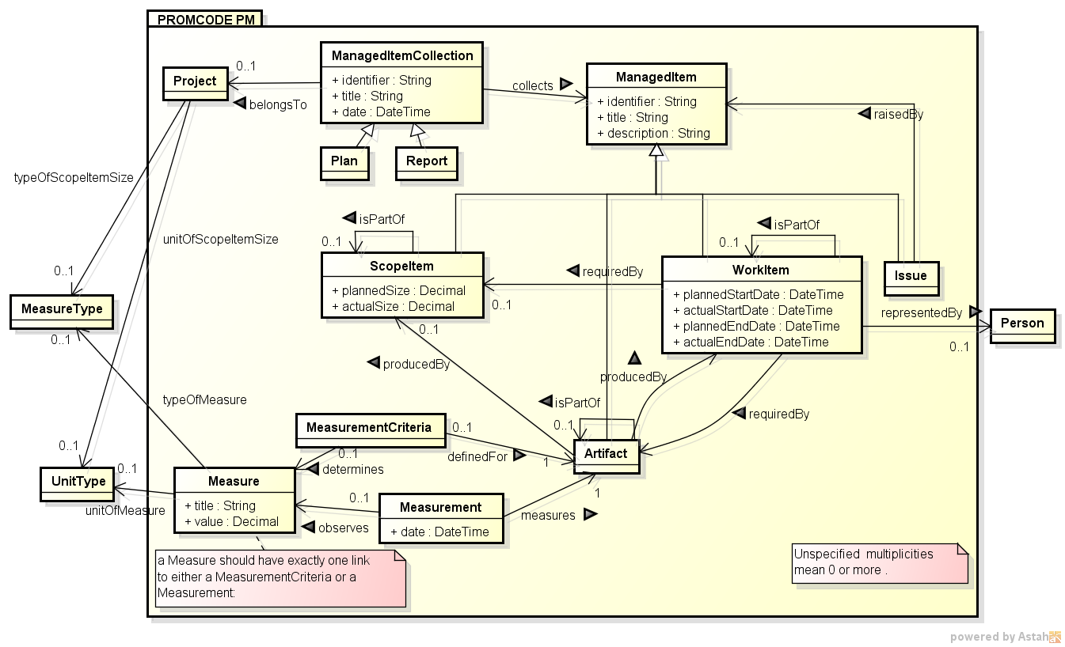
Domain Model v. 2.4(Revised Sep. 16)

Slide 7
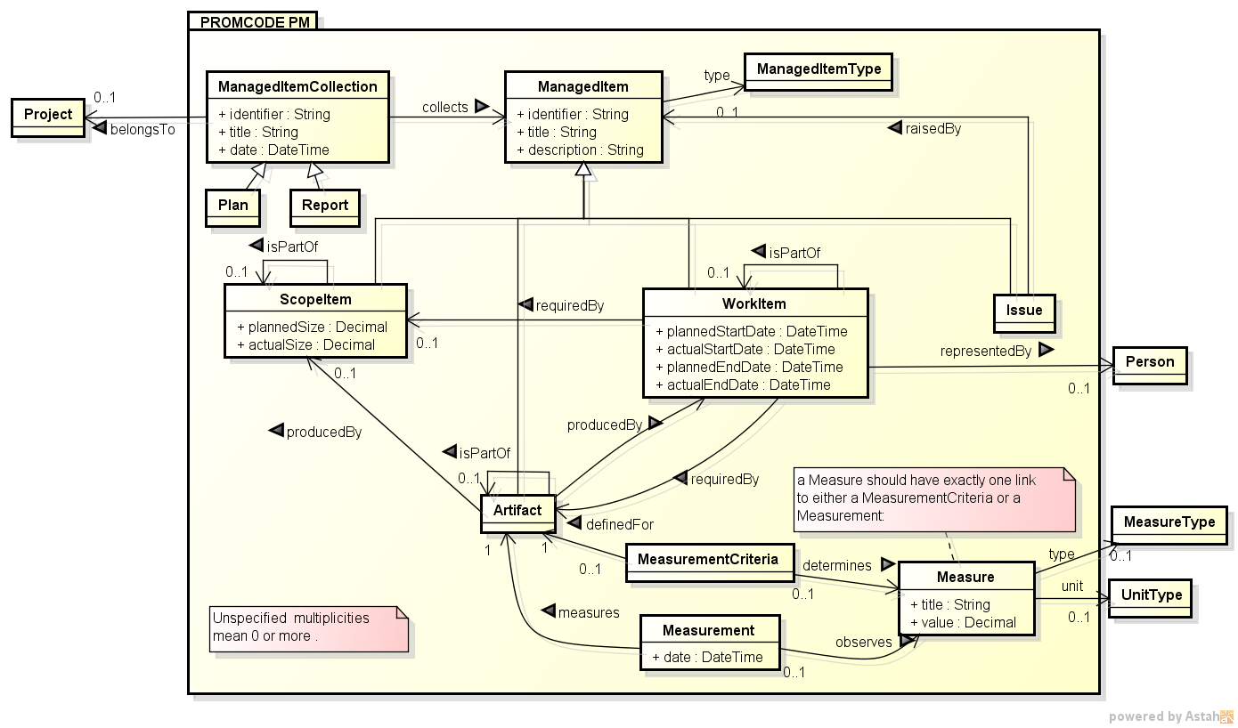
Domain Model v. 2.2(Revised Sep. 2)

Slide 8
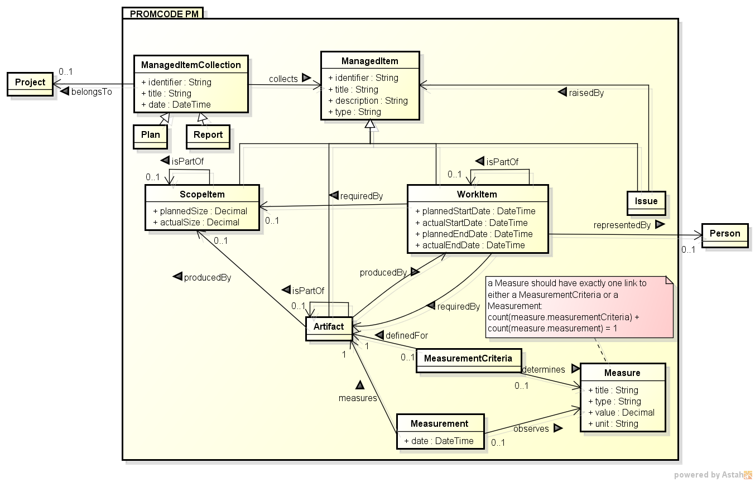
Domain Model (Aug. 6)

Slide 9
Assumptions
Project Context
Context: Data Interface between Acquirer and Supplier
Supply chain is formed by chaining the Acquirer and Supplier through the PROMCODE interface
Scope of time: Assume the plan is completed and the project scope is defined, which implies that scope definition including planning is out of scope of PROMCODE
Acquirer
Supplier
Acquirer
Supplier
Organization
A
Organization
Bn
Organization
Cnm
*
*

Slide 10
Domain Model Revisited (1/2)
Structure around ManagedItem
Attributes of ManagedItem: Add type for classification
Add “ManagedItemCollection” as a collection of ManagedItem, which represents a collection of status, or snapshot, of the project
Attributes: Add identifier and title
Add “Plan” and “Report” as subclasses of ManagedItemCollection:
Plan reflects an order from the acquirer to Supplier when the project is started
Report reflects a report compiled from the snapshot in ManagedItemCollection
Add “Project” as a reference to the project under management
The entity Project is only for reference, and is considered as out of scope of the PROMCODE domain model

Slide 11
Domain Model Revisited (2/2)
Structure Measure/Measurement
Add “MeasurementCriteria” as a criteria of Measure
Add attributes of type and title to Measure
Title: Bug density, Type: NoOfBugsPerKLOC, Unit: 1, Value: 3
Attributes
 | Measurement | MeasurementCriteria | Measure
Title | + | + | +
Identifier | + | + | NA
Type | + | NA | +

Slide 12
Use Cases
Use vocabulary practically common in project management in contracted delivery
Consistent with global standards: PMBOK, ISO 21500:2012
Project Initiation and Planning
Project Execution
Acquirer
Supplier
Project Closing

Slide 13
Simple Use Case
User roles
Project manager of acquirer (PM-A)
Project manger of supplier (PM-S)
Pre-condition
A legal contract to bind an acquirer and a supplier is handled separately.
There is no cascading of acquirer-supplier relationships.
Project environment of an acquirer and a supplier are not shared; i.e., project environment of a supplier is not accessible to PM-A and therefore, project information needs to be sent to PM-A for project management by an acquirer.
Steps
PM-A and PM-S work together to define ScopeItems, WorkItems and artifacts as a plan and establish agreement between them.
Details of steps in establishing agreement may vary and we will not specify them further. .
PM-S updates on regular basis actual values of properties of WorkItems and of measurements and measures attached to artifacts.
This can be done by PM-A requesting a report to PM-S or by PM-S posting a report to an agreed location.
PM-S sends an update as a Report to PM-A.
PM-A reviews updates and takes actions such as such as creating and managing Issues. In particular,
Review the possibility of schedule delay
Review Quality
Details of these will be elaborated in the next pages.
Repeat Steps 2-4 as necessary
Conduct acceptance review and close a project

Slide 14
Review and Actions at Step 4-1 (Schedule Delay)
Schedule Delay
PM-A compares previous report and current report and highlights the difference.
Reviews the difference and raises a concern if the following is observed.
No progress from the previous report
Risk of not meeting a schedule emerges with the current pace of progress.
May use past data on productivity to project risk.
PM-A interacts with PM-S on further update.
Reasons for delay
Outlook of meeting a schedule.
Based on the interaction, PM-A takes one of the following actions.
No formal action, but with notice on the situation to monitor.
Create an issue on the situation and create actions
Escalate to stakeholders for possible plan change.
If it results in a plan change, it will trigger the process of plan change and information on schedule delay will be reset with new plan.

Slide 15
Review and Actions at Step 4-2 (Quality)
Quality Concern
PM-A compares previous report and current report and highlights the difference.
Reviews the difference and raises a concern if the progress is not sufficient and there is a risk of not meeting quality goal.
PM-A interacts with PM-S on further update.
Reasons of the current problem
Outlook of meeting a goal
Assess the impact to the overall project.
Based on the interaction, PM-A takes one of the following actions.
Create an issue on the situation and create actions
Escalate to stakeholders for possible plan change.
If it results in a plan change, it will trigger the process of plan change and information on quality situation will be reset with new plan.

Slide 16
TOC of Draft Specification (1/2)
TOC Based on OASIS TOSCA | PIC | PROMCODE Spec 1.0
1. Introduction | Mikio | 1. Introduction
2. Interface Specification Design
2.1 Dependencies on Other Specs |  | 4.2 Compliance ?: Core, FOAF,
2.2 Notational Conventions
2.3 Normative References |  | 5. References
2.4 Non-Normative References |  | 5. References
2.5 Typographical Conventions
2.6 Namespaces |  | 4.2.2 Namespaces
2.7 Extensibility |  |  | ?
3. Core Concepts and Usage Patterns
3.1 Core Concepts | Mikio, Matsumoto | Supply Chain Concept 2. PROMCODE Modeling Framework
3.2 Use Cases |  | New

Slide 17
TOC of Draft Specification
TOC Based on OASIS TOSCA | PIC | PROMCODE Spec 1.0
4. PROMCODE Domain Model | Yoshida | 3. PROMCODE Domain Model
4.1 Domain Model |  | 3.1 Domain Model
4.2 Examples of Project Models |  | 3.2 Examples of Project Models
5. PROMCODE Resource Definitions | Wakao, Horiuchi | 4. PROMCODE Service Specification
5.1 PROMCODE Resource Definitions |  | 4.3 PROMCODE Resource Definitions
6. PROMCODE Service Specification | Wakao, Horiuchi
 |  | 4.4 Service Provider Capabilities
7. Common Practices for Adoption |  | 4.5 Common Practices for Adoption
Appendix: Example
Appendix: Vocabulary, Resource Shape | Funakoshi, Arthur

Slide 18
Time Line Revised
Milestone | Initial Plan | Revised
TC Launched | Mar. 25, 2014
Start Writing Initial Working Draft |  | Aug. 5, 2014
Initial Working Draft | May 26, 2014 | Sep. 16, 2014
Committee Working Draft | Jun. 30, 2014 | Oct. 2014
Committee Spec. Public Review | Jul. 31, 2014 | Nov. 2014
Committee Specification | Sep. 15, 2014 | Dec. 2014
Candidate of OASIS Standard | Dec. 2014 | Feb. 2015
OASIS Standard | Mar. 2015 | Mar. 2015
Specification Development Team:
Aoyama, Funakoshi, Horiuchi, Matsumoto, Wakao, Yoshida
Specification Review Team: Development Team and
Kamimura, Ryman, Yabuta

Slide 19
References
[ 1] R. Cyganiak, et al. (eds.), RDF 1.1 Concepts and Abstract Syntax, W3C
Recommendation, 25 February 2014, http://www.w3.org/TR/2014/REC-rdf11-concepts-20140225/#dfn-iri
[ 2] R. Cyganiak, An RDF Design Pattern: Inverse Property Labels, Jun. 2006,
http://richard.cyganiak.de/blog/2006/06/an-rdf-design-pattern-inverse-property-labels/.
[ 3] A. G. Ryman, OSLC Resource Shape: A Language for Defining Constraints on
Linked Data, .
[ 4] A. Rynam, Vocabulary Annotation Vocabulary, Sep. 2013,
http://open-services.net/wiki/core/Vocabulary-Annotation-Vocabulary/.
[ 5] A. Ryman, Resource Shape 2.0, W3C Member Submission, Feb. 2014,
http://www.w3.org/Submission/2014/SUBM-shapes-20140211/.

