Slide 1
PMRM Overview and Privacy Management Analysis Tools Development
John Sabo
John.annapolis@verizon.net
Gershon Janssen
gershon.janssen@gmail.com @gershonjanssen

Slide 2
“Smart” and Privacy
Smart Grid: “A smart grid is a modernized electrical grid that uses analog or digital information and communications technology to gather and act on information, such as information about the behavior of suppliers and consumers , in an automated fashion, to improve the efficiency, reliability, economics and sustainability of the production and distribution of electricity.”
Smart City: “A city can be defined as ‘smart’ when investments in human and social capital and traditional (transport) and modern (ICT) communication infrastructure fuel sustainable economic development and a high quality of life…through participatory action and engagement….. Online collaborative sensor data management platforms are on-line database services that allow sensor owners to register and connect their devices to feed data into an online database for storage and also allow developers to connect to the database and build their own applications based on that data.
Smart Phone: “A smart phone … is a mobile phone with more advanced computing capability and connectivity than basic feature phones.”
Internet of Things: “The Internet of Things (IoT) refers to uniquely identifiable objects and their virtual representations in an Internet-like structure. Today …IoT… is used to denote advanced connectivity of devices, systems and services and covers a variety of protocols, domains and applications.”
(Definitions: Wikipedia)

Slide 3
Smart: Connectivity, Information and Context
“Your phone is constantly gathering what app developers call signals. These could be your commuting habits, which the phone can glean from its internal GPS, often within a few feet. Your phone could also gather your meetings, your future trips, your friends and family, your favorite sports team, the type of news you usually read and even things like your heart rate. Things really get interesting when the apps that gather these signals start to be predictive. When that happens, your phone can start anticipating your needs, interests and habits ….” Examples: Google Now, Cortana, EverythingMe, Mynd, EasilyDo….”
“Contextual is a whole world,” said Ami Ben David, co-founder of the company EverythingMe. “We’re going to start looking at computers as being smart, as having infinite computing power and infinite access to databases, and therefore able to talk to us and give us what we want.”
(Molly Wood, New York Times, May 7, 2014: http://www.nytimes.com/ 2014/05/08/technology/personaltech/the-app-that-knows-you.html?emc=eta1
Smart: How do We Design in Privacy?

Slide 4
Understanding “Smart” Applications and Designing in Privacy
Gaps
Discontinuity between policies and technology
Speed to market – innovation
Complexity and scale
Lack of standards
Privacy Focus: macro or micro?
Work Underway in OASIS
OASIS PBD-SE Technical Specification (under development)
OASIS PMRM Committee Specification v1.0 and use case work
XACML Profiles
Emerging Tools
“Privacy by Design Use Case Template”
Derived from PMRM and PbD technical committee collaboration

Slide 5
Privacy Use Case Template as Tool Supporting Privacy by Design
Provides all stakeholders associated with the specified software development project within an organization a common picture and a clearer understanding of all relevant privacy components of the project
Can expose gaps where PbD analysis has not been carried out where implementation has not been initiated or completed
A tool to map privacy policies, requirements and control objectives to technical functionality
Facilitates the re-use of knowledge for new applications and the extension of Privacy by Design principles more broadly throughout an organization
Where code must bridge to external systems and applications, a standardized template will help ensure that Privacy by Design principles extend to the transfer of personal information across system and organizational boundaries.
A standards-based use case template can reduce the time and cost of operationalizing PbD and improve the quality and reusability of documentation

Slide 6
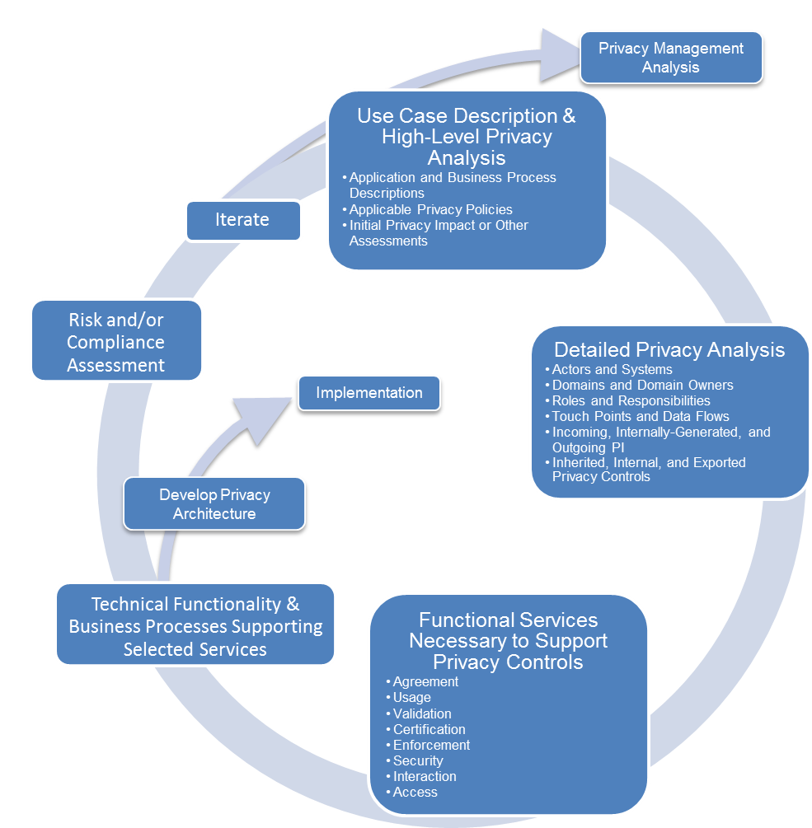
PMRM v1.0 Methodology Designed to Make Possible Analysis of Complex Use Cases

Slide 7
PMRM-Based Template Benefits
Provides an inventory of Privacy Use Case components and the responsible parties that directly affect software development for the Use Case
Segments Privacy Use Case components in a manner generally consistent with the OASIS PMRM v1.0 Committee Specification
Enables understanding of the relationship of the privacy responsibilities of software developers vis-à-vis other relevant Privacy Use Case stakeholders
Bring insights to the privacy aspect when moving through the different stages of the privacy lifecycle and across interconnected applications
May be extended to address predicates for software developers (training, privacy management maturity, etc.)
Does not specify an implementer’s SDLC methodology, development practices or in-house data collection, data analysis or modeling tools
Valuable as a tool to increase opportunities to achieve Privacy by Design in applications by extracting and making visible required privacy properties
Enables Capability Maturity Model analysis for an organization

Slide 8
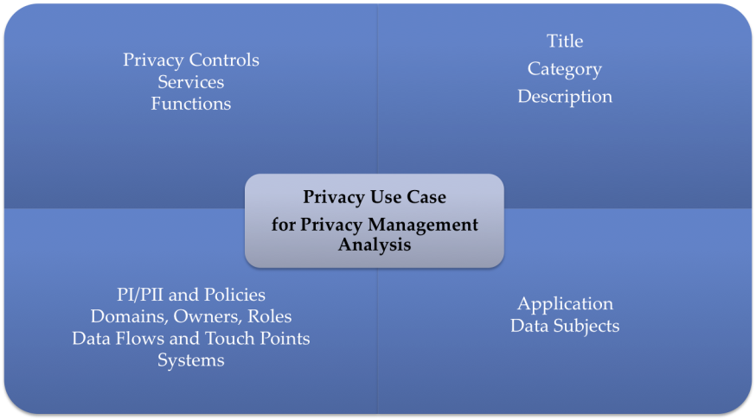
Privacy Use Case Template

Slide 9
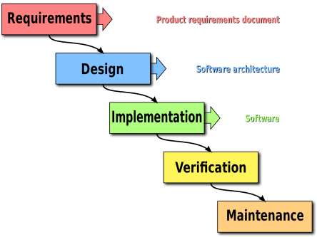
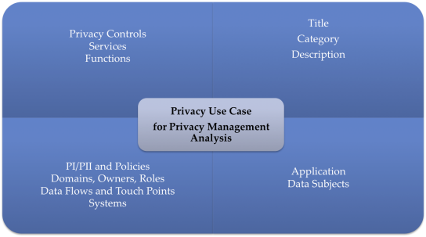
Template Helps Address Challenge of Mapping Privacy Analysis to Software Development Lifecycle Processes
SDLC Graphic Source: Wikipedia Commons

Slide 10
PMRM Template Privacy Management Analysis (PMA)
Baseline Information
Use Case Title
Use Case Categorization
Use case Description
Applications associated with Use Case
Data Subjects
PI/PII
Legal/Reg
Domains and Owners
Data Flows and Touch Points
Systems
Controls
Services
Functions
Policies, Controls and Supporting Services/Functions
Applications and Data Subjects
Technical, Managerial and Boundary Data

Slide 11
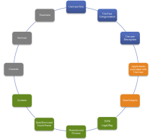
Baseline Information
Use Case Title
A short descriptive title for the use case
ACME Insurance Company Vehical Data Tracking for Reduced Premiums

Slide 12
Baseline Information
Category of Use Case
e.g. Application categories such as “Online Banking” or Model categories such as “Two Domain”.
Mobile-Vehicular

Slide 13
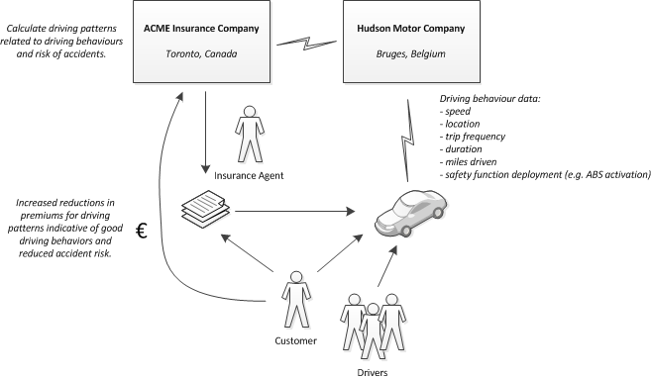
Baseline Information
Use Case Description
High-level synopsis of the use case.

Slide 14
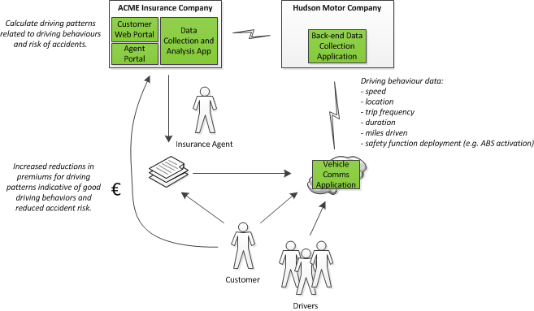
Applications and Data Subjects
Applications associated with Use Case
Relevant applications and products where personal information is communicated, created, processed, stored or deleted and requiring software development

Slide 15
Applications and Data Subjects
Data subject(s) associated with Use Case
Include any data subjects associated with any of the applications in the use case.
The registered Insured person associated with the vehicle VIN
Other drivers designated by the vehicle owner

Slide 16
Technical, Managerial and Boundary Data
PI and PII covered by the Use Case
The PI and PII collected, created, communicated, processed, stored or deleted within privacy domains or systems, applications or products.
per domain, system, application or product depending on level of use case development
including incoming, internally generated and outgoing PI
Registered driver name, Account Number, VIN
Registered driver contact information
Linked vehicle operational data
Linked vehicle time and location data
Linked evaluation assessment and summary information

Slide 17
Technical, Managerial and Boundary Data
Legal, regulatory and/or business policies governing PI and PII in the Use Case
The policies and regulatory requirements governing privacy conformance within use case domains or systems and links to their sources.
Government(s) regulations
Vehicle Manufacturer privacy policies
Telecom Carrier privacy policies
Insurance Company privacy policies
Data Subject Consent preferences
Specific policies governing apps (e.g., “Data Communications to Manufacturer”
Links to policies ….
http://acmeinsurancegroupinc.biz/vehicle privacy/
http://HudsonCarCompany.biz/privacy_vehicle….

Slide 18
Technical, Managerial and Boundary Data
Domains, Domain Owners, and Roles associated with Use Case
Domains - both physical areas (such as a customer site or home) and logical areas (such as a wide-area network or cloud computing environment) that are subject to the control of a particular domain owner
Domain Owners - the stakeholders responsible for ensuring that privacy controls and functional services are defined or managed in business processes and technical systems within a given domain
Note: Identifying stakeholders is essential for clarifying the intersection of privacy requirements and software development.
Roles - the roles and responsibilities assigned to specific stakeholders and their relationship to systems within a specific privacy domain

Slide 19
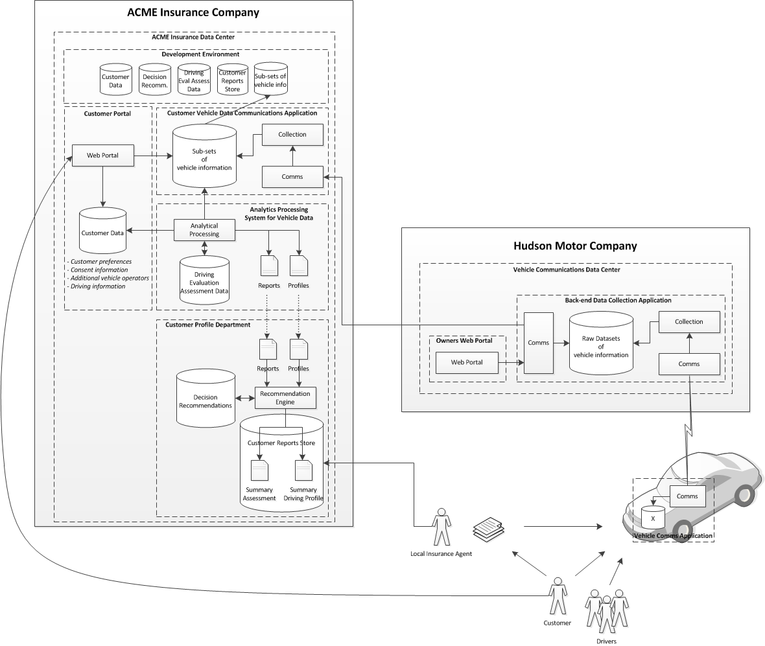
Domain 1: Hudson Motor Company’s Vehicle Communications Data Center, Vehicle Owner’s Web Portal and Backend Data Collection Application
Domain 1 Owner: VP, Vehicle Manufacturer’s Vehicle Communication and Data Division
Role: Application design, development, content, testing, integration testing with external systems, and adherence to corporate security and privacy policies, management of raw datasets of vehicle information.
Technical, Managerial and Boundary Data
Domains, Domain Owners, and Roles associated with Use Case

Slide 20
Technical, Managerial and Boundary Data
Data Flows and Touch Points Linking Domains or Systems
Touch points - the points of intersection of data flows with privacy domains or systems within privacy domains
Data flows – data exchanges carrying PI and privacy policies among domains in the use case
Hudson Motors
Communications Division
Vehicle Backend Data Operations
Vehicle Web Portal
Vehicle Communications System
Acme Insurance Customer Vehicle Programs
Customer Profile Dept.
Analytics Domain
Customer Portal
Software Development Group
Data Communications
Local Agent portal

Slide 21
Technical, Managerial and Boundary Data
Systems supporting the Use Case applications

Slide 22
Policies, Controls and Supporting Services/Functions
Privacy controls required for developer implementation
Control - a process designed to provide reasonable assurance regarding the achievement of stated objectives
per specific domain, system, or applications as required by internal governance policies and regulations
including inherited, internal and exported privacy controls
Acme Insurance Customer Vehicle Programs
Customer Profile Dept.
Analytics Domain
Customer Portal
Software Development Group
Data Communications
Local Agent portal
Outgoing PI
(Name, account number, driving pattern and assessment summaries)
Incoming PI
(Driving patterns and assessed risk linked to VIN)
Exported Control AR-3: Requirements for Contractors
Inherited Control DM-1: Minimization of PII

Slide 23
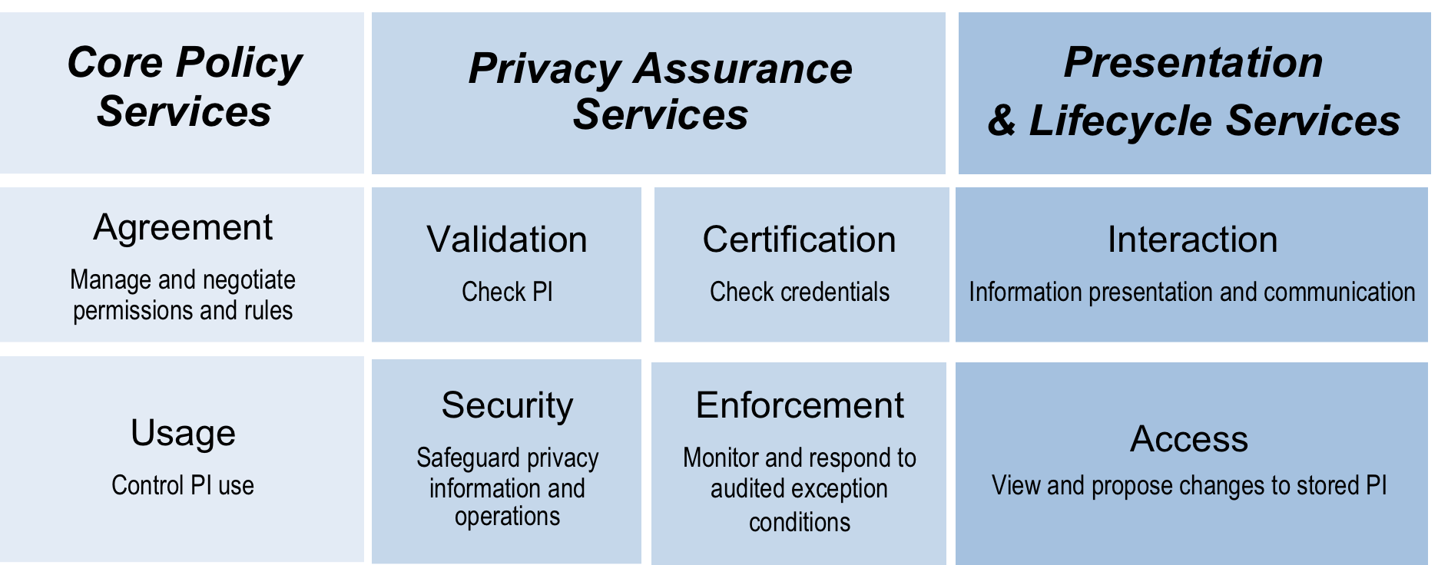
Policies, Controls and Supporting Services/Functions
Services
Service - a collection of related functions and mechanisms that operate for a specified purpose
Identify Services satisfying privacy controls
Exported Control AR-3: Requirements for Contractors
Inherited Control DM-1: Minimization of PII

Slide 24
Policies, Controls and Supporting Services/Functions
Functions
Define technical functionality and business processes supporting selected services
Inherited Control DM-1: Minimization of PII
Usage service
Automated interfaces to maintain separation of data using identifier with relatively inaccessible auxiliary info
Security service
Role-based access control
Exported Control AR-3: Requirements for Contractors
Agreement service
Chain-of-trust contract clause

Slide 25
“Responsibilities” Table
Stake-holders/Lead | Use Case Descrip-tion | Applications | Data Subjects | PI/PII | Domains | Legal/Regs/Policies | Data Flows/Touch points | Systems | Privacy Controls | Services - Technical Functions
CPO | x |  | x | x | x | x |  |  | x
IT Architect |  |  |  |  | x |  | x |  | x | x
Business Analyst | x | x | x |  | x |  | x
Team Privacy Champion |  |  | x | x |  | x | x |  | x
Senior Developer |  | x |  |  |  |  |  | x | x | x
Line of Business Owner | x | x |  |  | x |  |  |  | x
Legal Department |  |  |  |  | x | x |  |  |  | x
CIO |  |  |  |  |  | x |  | x |  | x
Data Center Director |  |  |  |  | x |  |  | x |  | x

Slide 26
A Work in Process
PbD-SE TC and PMRM TC working in parallel to develop practical standards and standards-derived tools
Open to broader participation from business, policy and technical experts
Contact today’s workshop speakers or email: join@oasis-open.org

