Slide 1
OaSIS CTI Interop Showcase @ RSA 2017
13-17 February San Francisco, CA

Slide 2
Presentation (speakers/schedule)
Companies interested in speaking during RSA:
Threat Connect
EclecticIQ
IBM Security
LookingGlass
NC4
TruSTAR
Fujitsu
DFLabs
Any missing?
Schedule:
Tuesday and Wednesday have been identified as the best days to hold presentations. Attached is a sample schedule. Presentation time slots will be allocated using the same selection process that is being used to select seats.

Slide 3
Presentation (content)
Presentations should include consistent general information & company specific slides
Five or six general information slides are being pulled together to help keep the messaging consistent. Those slides to include: info on OASIS, the RSA showcase and CTI work (will be available on Mon, 6 Feb).
Company specific slides should focus on your participation, implementation and expression of the STIX/TAXII specs. As always they should remain in the spirit of cooperation and avoid product hyperbole.
Length: Typical show floor presentation lengths are between 8-15 mins; Recommending roughly 10-12 minutes

Slide 4
Booth raffle
Attracting attendees to presentations
To help draw attendees to the presentations, we do plan to hold a raffle. Each individual attending a presentation will receive a raffle ticket.
The raffle item may include:
Apple Watch,
Drone
Go-Pro
If you have other suggestions, please circulate your suggestion by Fri, 3 Feb. The raffle would take place after our final presentation on Wednesday (during the pub crawl).

Slide 5
Reminders and deadlines
CTI Interop Showcase Flyer
Draft to be circulated to the group on Mon, 6 Feb
Comments due from the group by Thurs, 9 Feb
Press Release – Call for Quotes
Q
uote deadline is Tues, 7 Feb
Press release will be distributed on Tues, 14 Feb
Booth Staff Registration
List of booth staff representatives has been circulated
Deadline to submit changes or request additional passes is Mon, 6 Feb
Call for video monitor cord requirement (SVG or HDMI)
Request going out today

Slide 6
schedule
Our space will be available for set-up and testing on Monday, 13 February from 8:00-4:00 PM. The show will open for a special reception Monday evening. Below is a complete list of show hours, including setup and dismantle times. Monday, 13 February Setup & testing beginning at 8:00 AM (runs till 4:00 PM) Welcome reception: 5:00 - 7:00 PM Tuesday, 14 February 10:00 AM – 6:00 PM Wednesday, 15 February 10:00 AM - 6:00 PM Thursday, 16 February 10:00 AM – 3:00 PM Booth dismantle: 3:00 – 5:00 PM

Slide 7
Code of conduct
All participants must have at least one representative present onsite at all times during the event. (In special cases, this requirement may be waived by advance consent of OASIS staff and the Interop Team.)
Due to space constraints, each participating company will need to limit the amount of staff in the booth to no more than two per company -- at any given time.
Onsite, all representatives are expected to behave in a professional, collegial manner, and should:
First, represent OASIS as a vibrant, critical industry body that values participation;
Represent your TC, the work being done and the importance of participation for ensuring satisfaction of industry requirements; and finally,
Represent your company without negativity towards others.
Professional business attire is required. Company logo shirts may be worn, but must reflect only the branding of the participating company.
Literature displayed in the booth must directly relate to the product and/or services on display from participating member companies.
To remain consistent and fair, any lead retrieval within our space must be done using only those OASIS designated lead generation devices. No other devices or actions may be used. All leads generated will be provided to all participants.

Slide 8
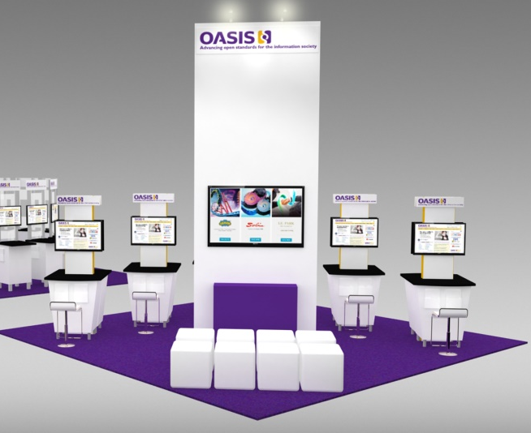
Booth design
SHOW FLOOR ENTRANCE THIS WAY...
Back of booth
Front of booth
FINAL SEAT SELECTION GRID TO BE DISTRIBUTED TO THE GROUP UPON COMPLETION.

Slide 9
Reminder of pod info
Reminder of what’s included in your workstation?
Small counter (size: 35” x 24”) and chair
Monitor (32”)
Electricity outlet
Wired Internet connectivity (one cable)
Logo signage (above the monitor)
Equipment: Each participating company is responsible for bringing its own company equipment (including a computer) to the event. Please be mindful that all equipment MUST fit within your workstation. Monitors (32”) will be provided -- VGA and HDMI cords will available if the request has been received in advance.

