Slide 1
OASIS Booth Layout Options RSA 2017

Slide 2
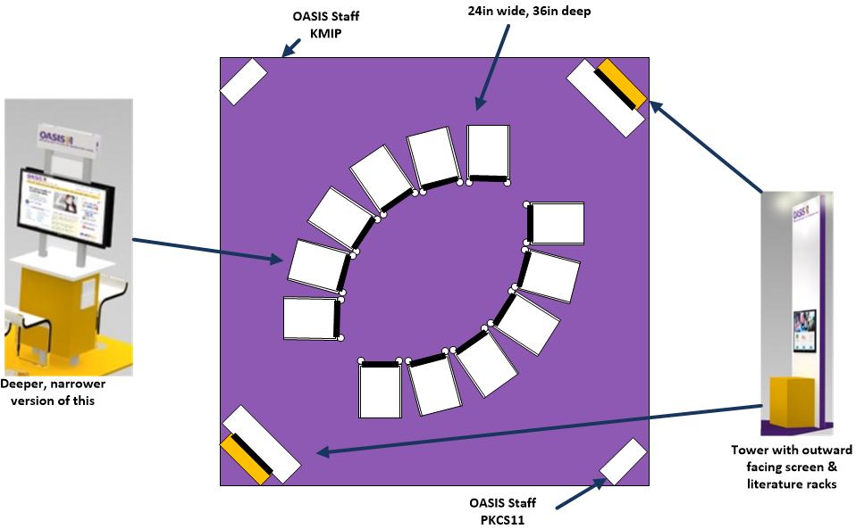
Option 1

Slide 3
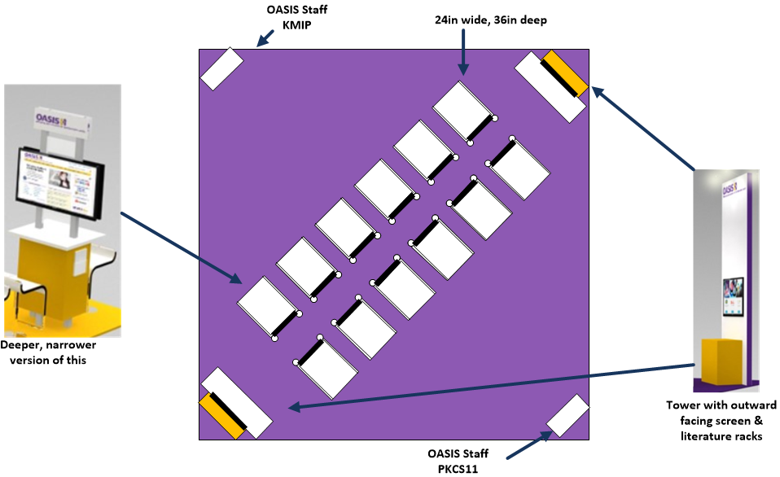
Option 2

Slide 4
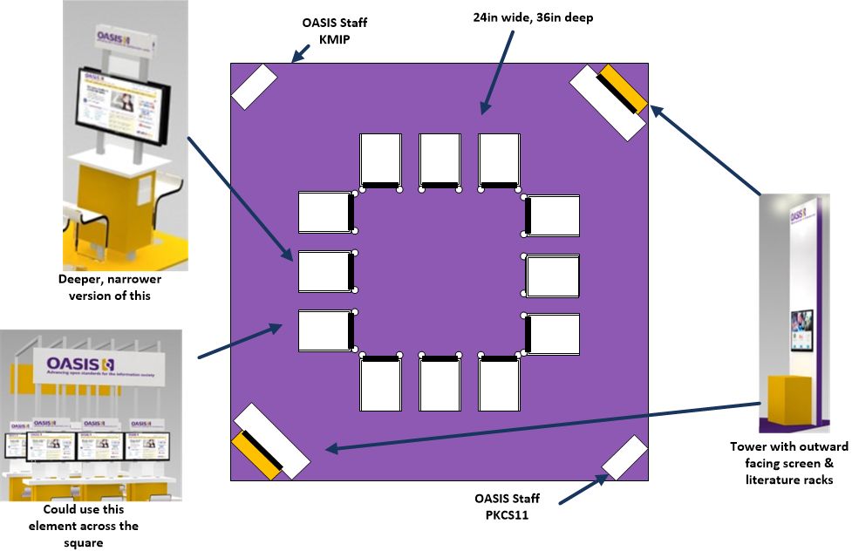
Option 3

Slide 5
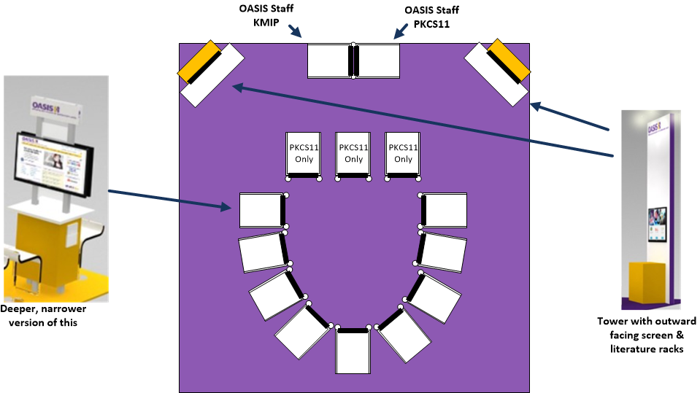
Option 4

