Slide 1
Service Interface Description
Actions relevant to the service interface

Slide 2
Section 4.1.1.3
The major elements for the Service Description subclass follow directly from the areas discussed in the Reference Model. Here, we discuss the detail shown in Figure 17 and the purpose served by each element of service description. For example, Service Policies as included in Figure 13 indicate those policies that affect conditions of use of the service; however, while the description may link to detailed policy documents, it is not the purpose of description to justify or elaborate on the rationale for the policies. Similarly, Service Interface Description as included in Figure 13 captures information about what interactions are supported by the service via its Behavior Model and the information exchange needed to carry out those interactions in accordance to the service's Information Model; it is not the coded interface.
Note, the intent in the subsections that follow is to describe how a particular element, such as the service interface description, is reflected in the service description, not to elaborate on the details of that element.

Slide 3
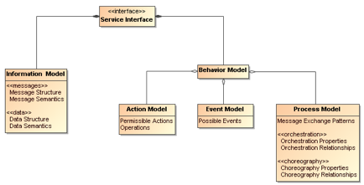
Service Interface Description
The Service Interface Description element as shown in Figure 14 includes the information needed to carry out this message exchange in order to realize the described service behavior.

Slide 4
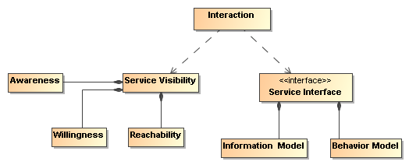
Service Interface Description

