Slide 1
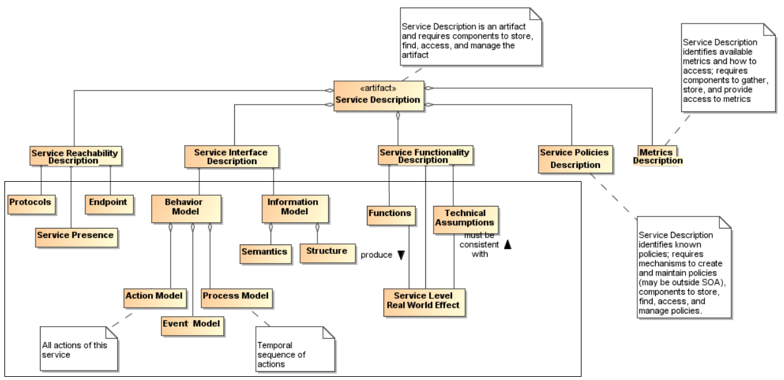
Service Description Model
Figure 16, v. A
(my preference)
contributors into description

Slide 2
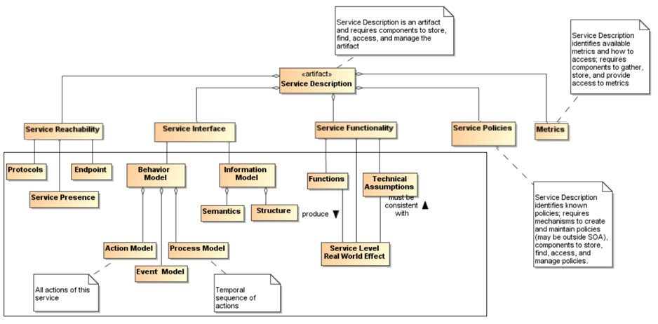
Service Description Model
Figure 16, v. B
contributors into description

Slide 3
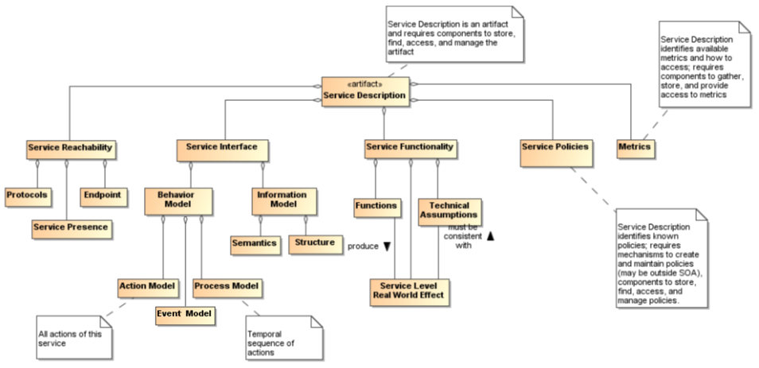
Service Description Model
Figure 16, v. C

Slide 4
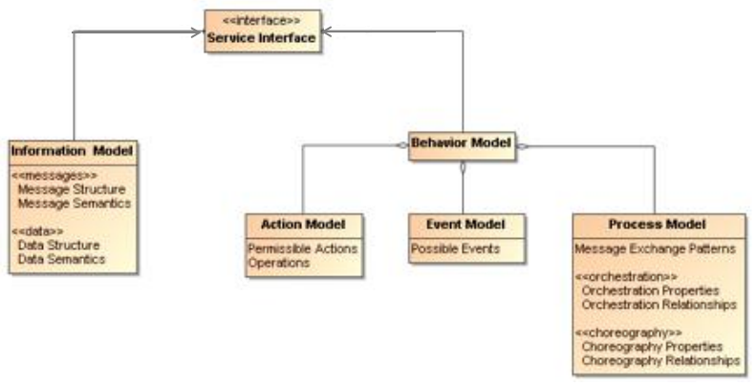
Service Interface Model
Figure 17
Existing text in the Section is enough; no additional explanations are needed.

Slide 5
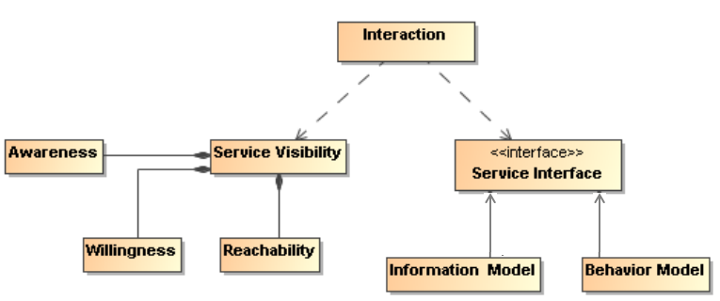
Figure 29
Interaction dependencies
Existing text in the Section is enough; no additional explanations are needed.

