Slide 1
Interesting IaC projects and initiatives
Matija Cankar, Anže Luzar
XLAB d.o.o.
Presentation for TOSCA TC group
This project has received funding from the European Union’s Horizon 2020 and Horizon Europe research and innovation programme under Grant Agreements No. 952644 (FISHY), 952633(MEDINA), 101000162 (PIACERE), 101070052 (TANGO), 101095542 (CYLCOMED), 101073821 (SUNRISE), 101070177 (ICOS)

Slide 2
Agenda
About us
Orchestration and IaC modelling
TOSCA Orchestrator
Gaia-X orchestrator
DOML – DevOps modelling language
IaC Security and Trustworthiness
Steampunk spotter
IaC Scan Runner
Secure runtime monitoring tools and LOMOS

Slide 3
About us
XLAB research
Established in 2003 (XLAB in 2001)
Among largest Slovenian private CS research groups (80+ EU and national res. projects)
https://www.xlab.si/research/ (please follow us).
DevOps automation team https://steampunk.si/

Slide 4
Orchestration and IaC modelling

Slide 5
xOpera orchestrator

Slide 6
Opera - xOpera orchestrator
xOpera is a project. Opera is an orchestrator.
Core is light-weight and open-source
State-aware, based on Ansible executor
TOSCA v1.3, TOSCA v2.0 (new).
Initially CLI based, with extensions for integration (API, SaaS, etc.)

Slide 7
Where you can get (x)Opera?
Main page: https://github.com/xlab-si/xopera-opera
Documentation: https://xlab-si.github.io/xopera-docs/
In action:
pip install opera
opera deploy <filename>.yaml

Slide 9
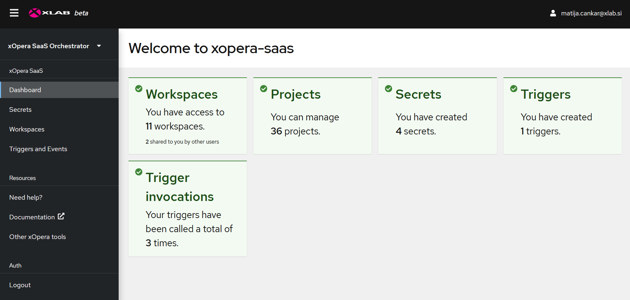
xOpera SaaS dashboard

Slide 10
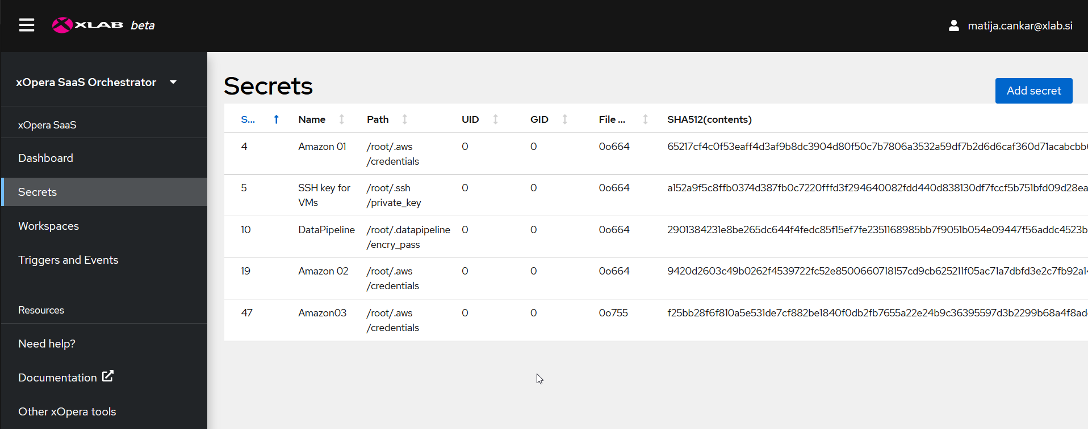
Secrets (Credentials) managemet

Slide 11
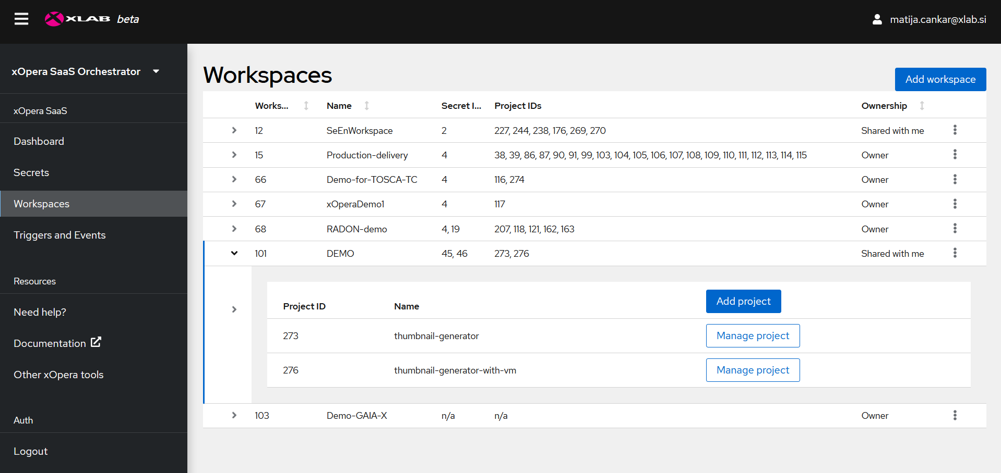
Workspace management

Slide 12
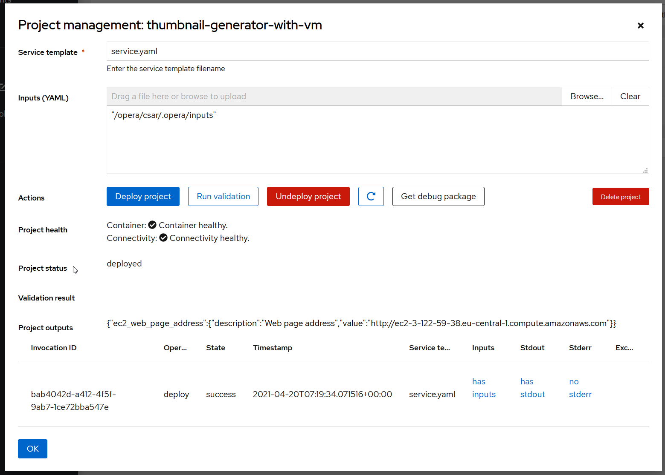
Project management

Slide 13
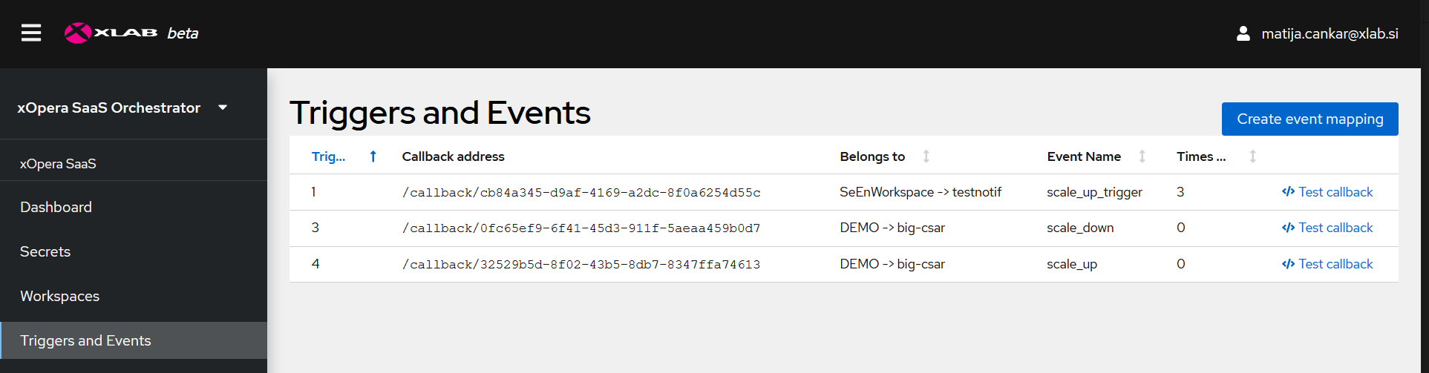
Triggers and events
Managing the notifications.

Slide 14
What is Gaia-X

Slide 15
What is Gaia-X
Federated Data Infrastructure Ecosystems
Focus on creating open, transparent and secure ecosystem.
Orchestrator is a key component of GXFS (Gaia-X federation Services) – more on that later.
https://gaia-x.eu/

Slide 16
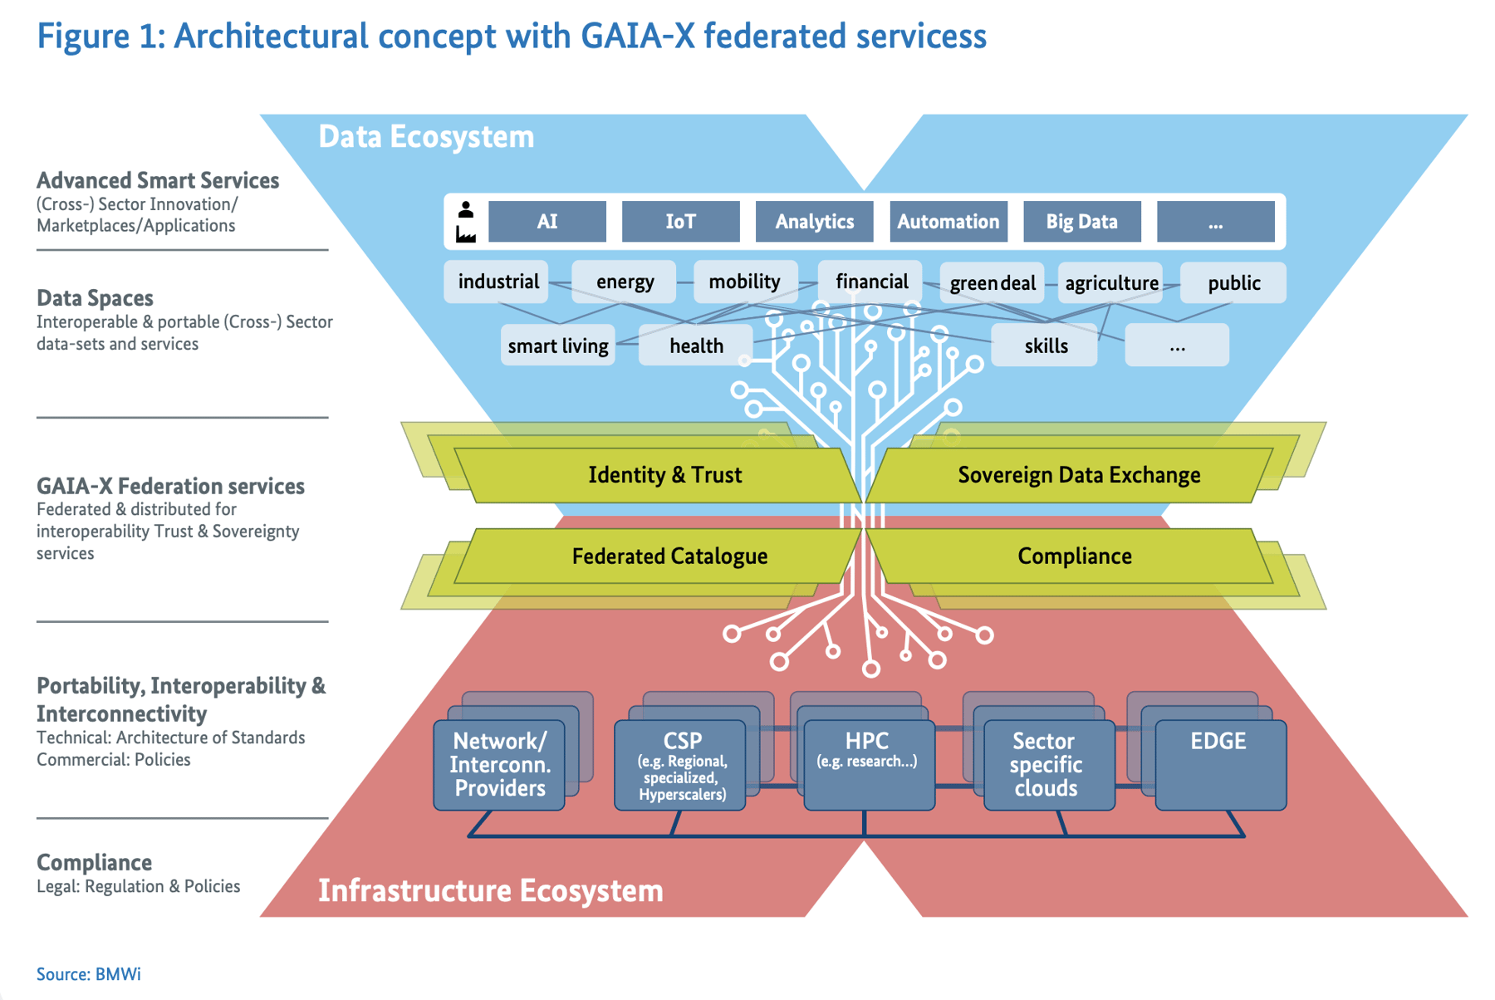

Slide 17
Gaia-X current state?
Second iteration of architecture ideas
First PoC implementations from Germany hub
#5 hackathons already passed
We are looking forward to participate in hackathons also with TOSCA orchestrator

Slide 18
GXFS Orchestrator

Slide 19
GXFS (Meta) Orchestrator
Similar architectural approach as xOpera SaaS
Supports TOSCA and other IaC language options (currently also Terraform).
XLAB developed PoC
Available on GitLab:
Docs: https://gaia-x.gitlab.io/data-infrastructure-federation-services/orc/documentation/0100-overview.html
Repo: https://gitlab.com/gaia-x/data-infrastructure-federation-services/orc

Slide 20
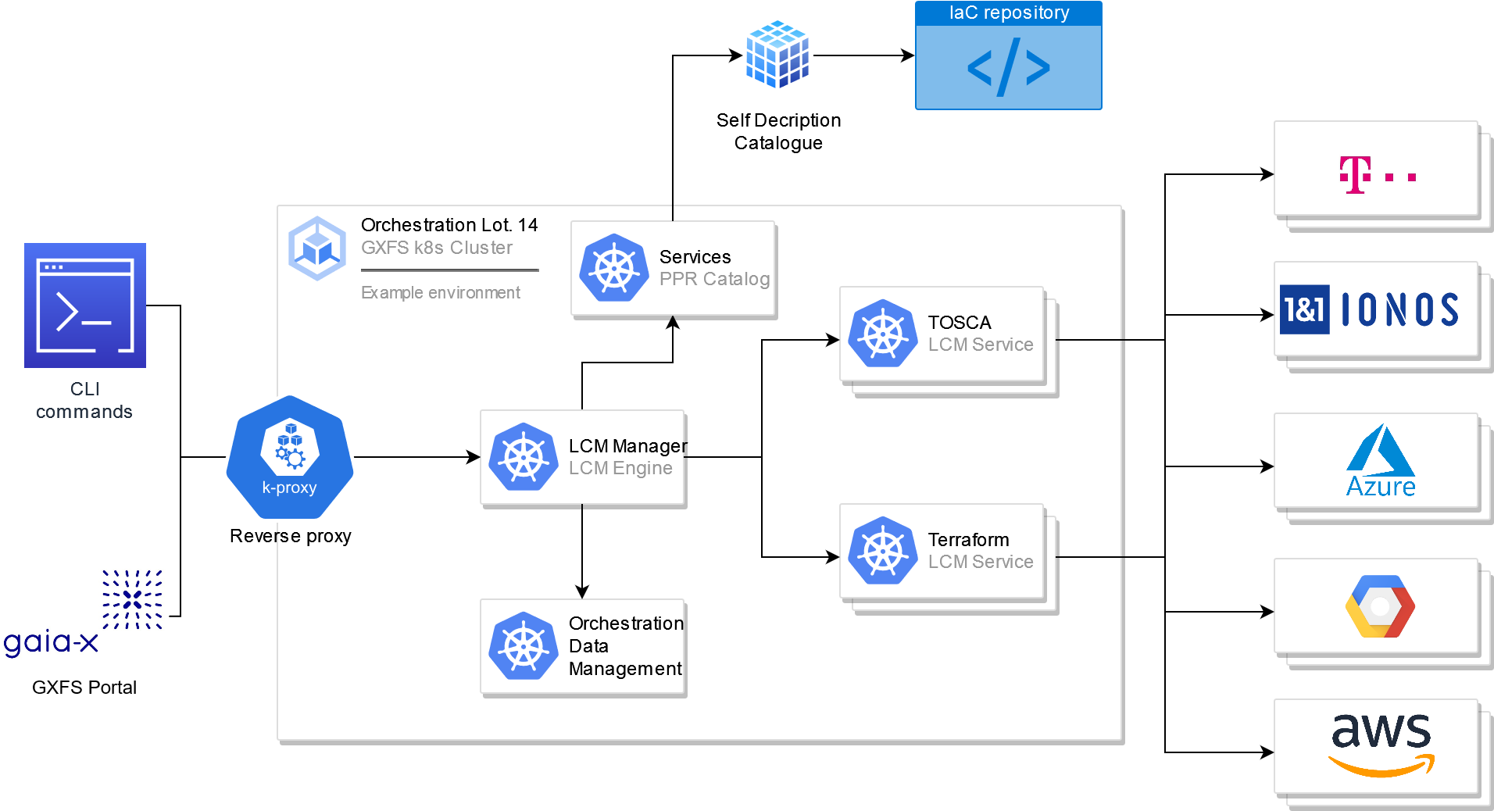
GXFS Orchestrator architecture

Slide 21
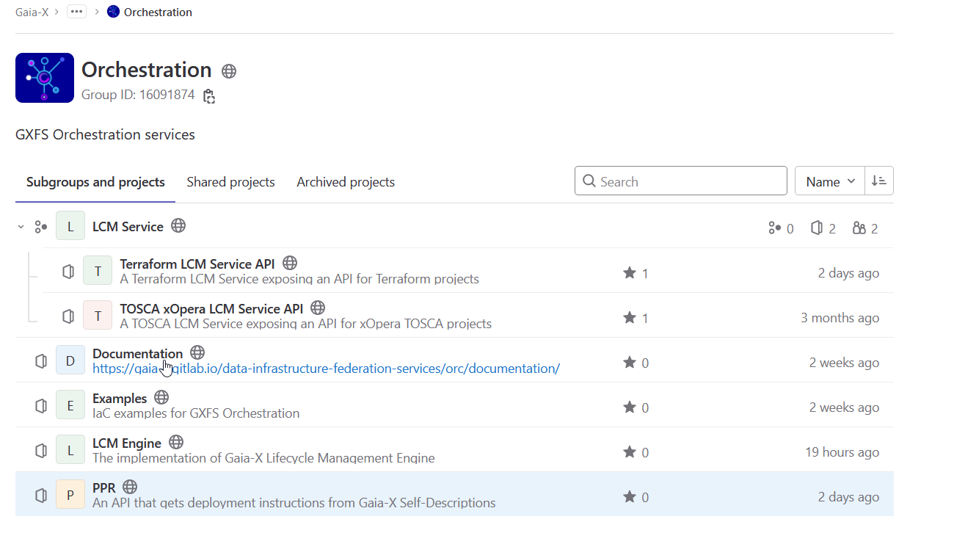
https://gitlab.com/gaia-x/data-infrastructure-federation-services/orc

Slide 22
GXFS Orch. VS xOpera SaaS
GXFS Orchestrator:
Pluggable orchestrators
TOSCA and Terraform
No GUI, no straightforward application auth system
xOpera SaaS
GUI
TOSCA only
Template Library publishing system integration

Slide 23
Use cases (GXFS Orchestrator)
Already in progress:
PIACERE – Resource catalogue and self-descriptions
InHPC-DE – Gauss Centre of Supercomputing

Slide 24
DevSecOps DOML

Slide 25
DevSecOps specific language
H2020 PIACERE - https://www.piacere-project.eu/
Trustworthy IaC in DevOps integrated framework
DOML – DevSecOps domain specific language
Application layer,
abstract/concrete layer
Optimization layer
Ability to describe cloud applications (high level)
Translates to orchestrator specific IaC code
https://www.piacere-doml.deib.polimi.it/

Slide 26
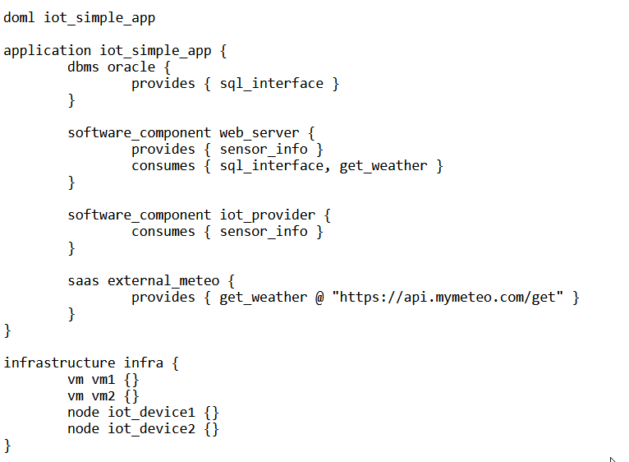
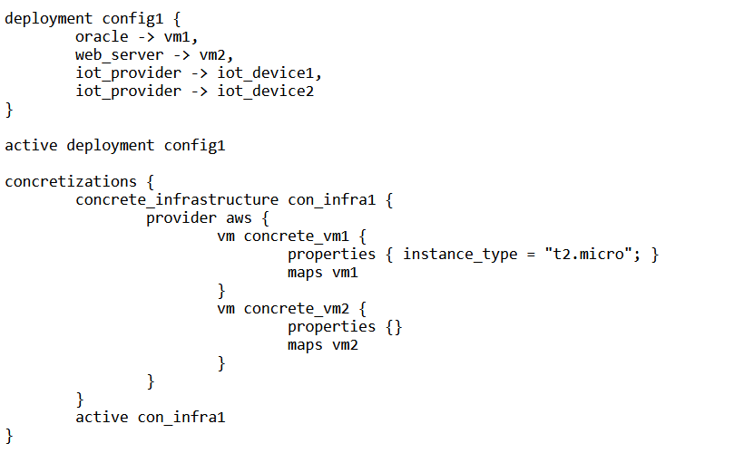
DOML Example

Slide 27
IaC Trustworthines Security and IaC

Slide 28
Trust in IaC
An important pain point of the business users
Vulnerabilities
Upgrades
Misconfigurations
Monitoring of application life-cycle

Slide 29
Steampunk Spotter & IaC Scan Runner

Slide 30
Steampunk Spotter (Ansible)
Verify playbook templates – similar as SAST
Assisted Automation Writing tool
Analyzes and offers recommendations for Ansible content
Ansible upgrade support (2.4 -> 2.14)
Check compatibility with collections and versions
Launched at AnsibleFest – October 2022
Brings GUI, API, CLI and integrations
*SAST: Static application security testing

Slide 31
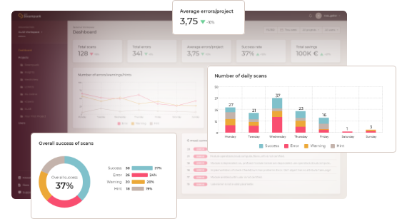
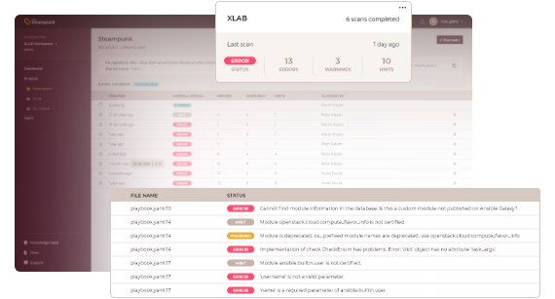
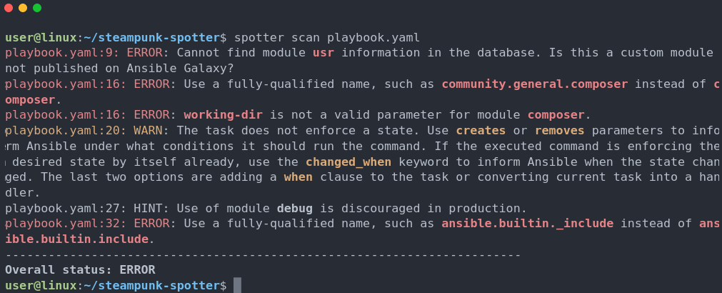
Steampunk Spotter (Ansible)
https://steampunk.si/spotter/

Slide 32
Steampunk Spotter (Ansible)
Allows "trustable automation"
Reduces risks and speeds up automation
Beyond simple syntax checks (deep dive into Ansible content)
Working on extending support to other IaC tools (Terraform, Pulumi, TOSCA?) and using AI
https://steampunk.si/spotter/
*SAST: Static application security testing

Slide 33
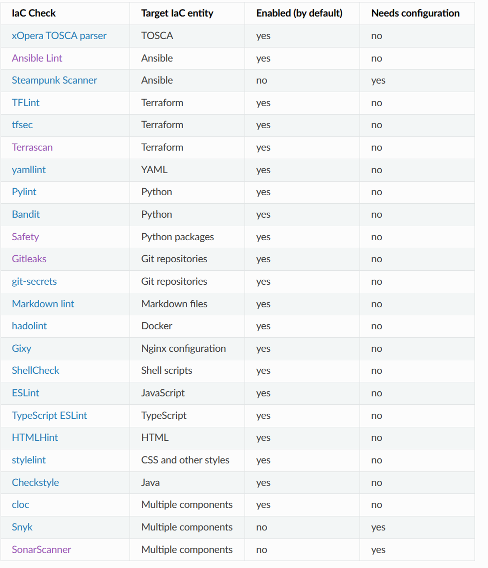
IaC Scan Runner
The open source service for IaC check
Inspect files, determine and run specific tests.
https://xlab-si.github.io/iac-scanner-docs/02-runner.html

Slide 34
Spotter and IaC Scan Runner
Use cases and research:
PIACERE H2020 to scan IaC after it has been generated from a DOML
CYLCOMED – Ansible playbook Scanners
TANGO – Scan of IaC for energy aware computing

Slide 35
DAST and LOMOS

Slide 36
DAST* Security platform
Wazuh – an opensource security platform (not by XLAB)
Endpoint security
Threat intelligence
Security operation and cloud security
Exploit functionality to gather cloud/application lifecycle data.
*DAST: Dynamic application security testing

Slide 37
Standard compliancy check (MEDINA project)
EUCS (European Cybersecurity Certification Scheme for Cloud Services)
Standard developed by ENISA
Wazuh used to gather evidence about compliance:
Evidence of malware detection,
Detection of vulnerabilities
Collection and analysis of logs
Incident handling.

Slide 38
(Historical) log analyzer
Issues:
Services and monitoring systems gather logs,
Notification systems need to be set by experts
Log data is huge
Experts need to cover a large field of knowledge.an Cybersecurity Certification Scheme for Cloud Services),

Slide 39
LOMOS
XLAB’s proprietary tool for automatic log analysis.
Base on:
Deep learning
Semantic of log messages
Semantic and sequential information
Transforms from unstructured logs to structured datasets
Trained on “normal data”.

Slide 40
LOMOS features
Application-agnostic.
Highly adaptable and interoperable.
Uses state-of-the-art AI/ML techniques.
Deals with heterogeneous sources effortlessly.
Efficiently processes large data volumes at high rates.
Discovers unknown patterns and learns system behaviour.
Requires minimal configuration efforts.

Slide 41
DAST + LOMOS use cases
PIACERE - Runtime security monitoring and self-healing
FISHY - Detection and protection components providing basic honeypot functionalities; Vulnerability Assessment ->Wazuh + LOMOS
ICOS - AIOps-based strategy for modelling, capturing and optimizing log streams, with integrated alerting capabilities
TANGO - AI supported infrastructure management for TANGO project.

Slide 42
A recap
Orchestration and IaC modelling
TOSCA Orchestrator (xOpera)
Gaia-X orchestrator (GXFS Orchestrator)
DOML – DevOps modelling language (PIACERE)
IaC Security and Trustworthiness
Steampunk spotter (Ansible Scanner/Linter)
IaC Scan Runner
Secure runtime monitoring tools and LOMOS

Slide 43
Keep in touch
Want to know more?
Contact us:
xopera@xlab.si
matija.cankar@xlab.si
www.xlab.si
Or create an issue or PR on our GitHub! ☺

