Slide 1
TC Process Overview
Nonprofit, global consortium for standards and open source projects
Chet Ensign, Technical Community Steward, OASIS

Slide 2
TC Process Overview
TC Process rules created & maintained by OASIS BoD
Role of Community Steward
Support activities of OASIS members
Communicate procedures & best practices to members
Represent interests of members to staff and BoD
Improve tools & support for community
Recommend improvements to the process itself
TC Process is at https://www.oasis-open.org/policies-guidelines/tc-process
General Committee Process is at https://www.oasis-open.org/policies-guidelines/oasis-committee-operations-process-2018-05-22

Slide 3
Open Repository Overview
Optional program to support work of the TC
Marries strengths of open source development with stable governance of standards development
Runs on GitHub
Independent of TC standards work
Operates under open source license chosen by TC
Non-OASIS/non-TC members can contribute; Maintainers can be selected from broad community
Each contributor must sign a CLA
Open Repository Guidelines & Procedures is at https://www.oasis-open.org/policies-guidelines/open-repositories

Slide 4
Standards Lifecycle
Working draft
Committee Spec / Public Review draft
Committee Specification
Candidate OASIS Standard
OASIS Standard
Notes:
Standards Track work progress:
Working draft
Committee Specification Draft
Committee Specification Public Review Draft
Committee Specification
Candidate OASIS Standard
OASIS Standard
Approved Errata

Slide 5
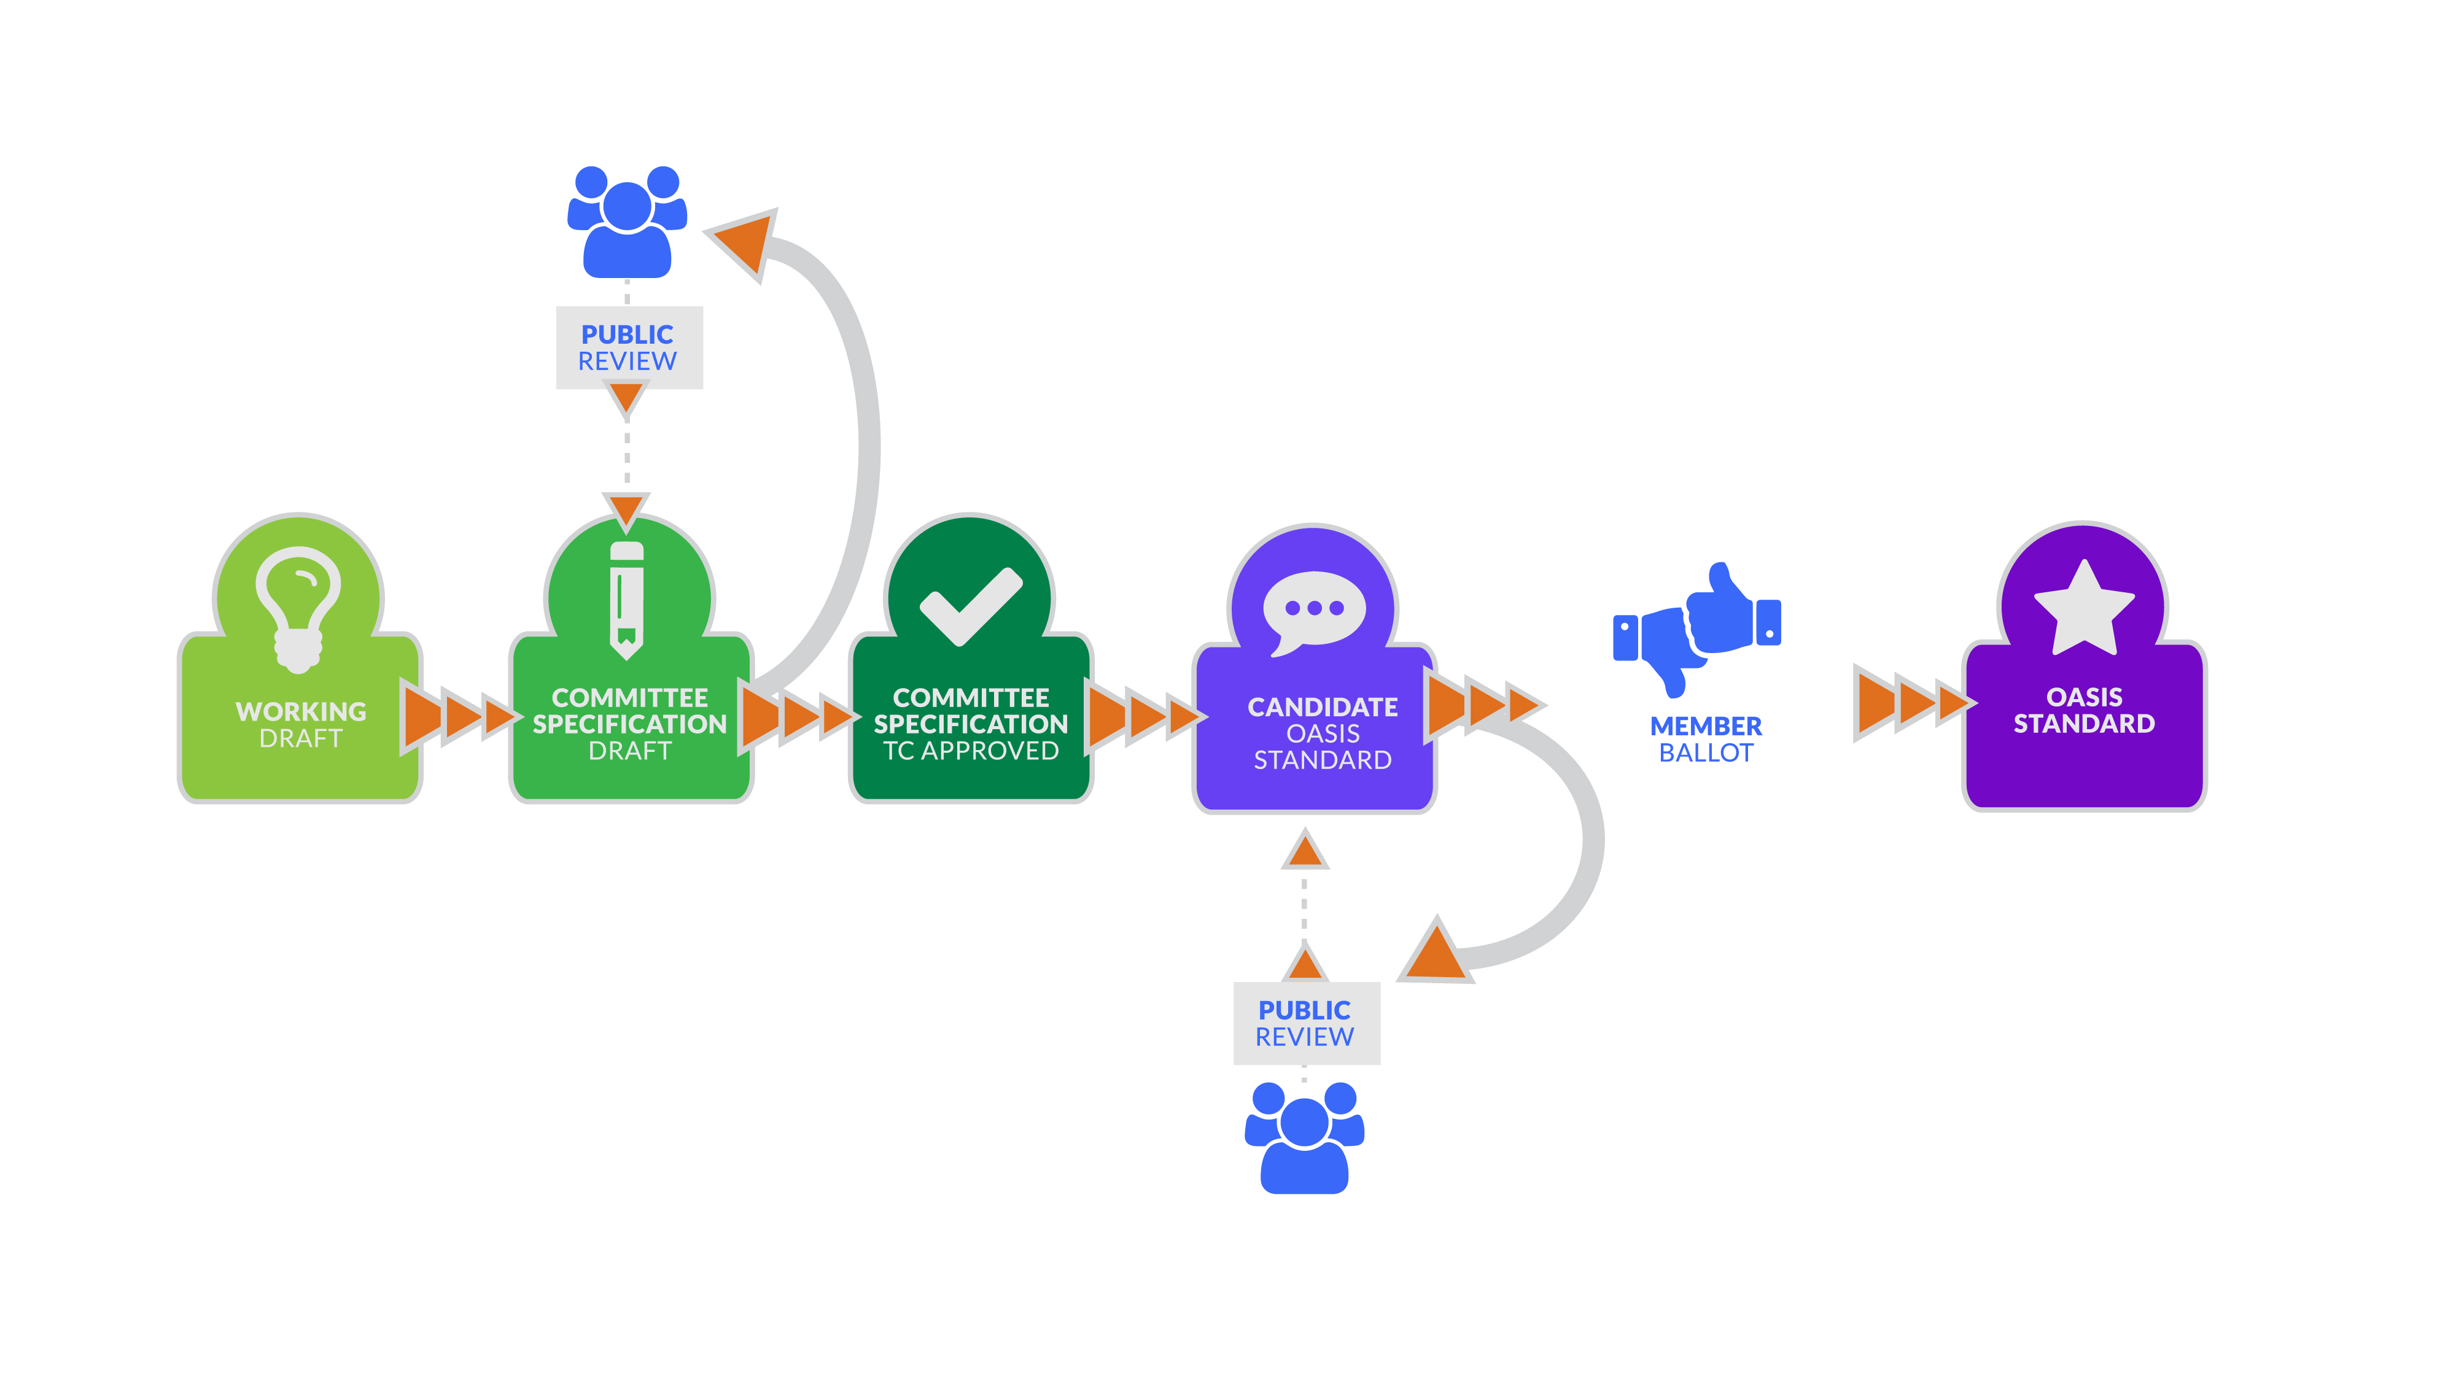
Standards Track workflow in a nutshell

Slide 6
Other Work
Committee Notes progress - For educational, informative work - Public reviews optional - Published as Committee Note
Administrative documents (meeting minutes, etc.) require no formalities
- Meeting minutes must be sent to TC mailing list & must track attendance and motions approved/rejected
All content must be maintained on OASIS-provided / approved systems
Notes:
Non-Standards Track work progress:
Working draft
Optional Committee Note / Public Review Draft
Committee Note
Non-Standards Track Work Products are non-normative – white papers, adoption collateral, etc.
Administrative documents (meeting minutes, etc.)
Meeting minutes must be sent to TC mailing list & must track attendance and motions approved/rejected
Content must be maintained on OASIS-provided systems

Slide 7
Resources
Internal/public websites
Email lists
Calendar
Ballot Facility
Roster
Document Repository
Notes:
Key goal of OASIS resources is to keep your work & decisions visible & transparent
Standard resources:
TC collaboration tools (“Kavi”)
Private web site & public page
Roster
Calendar
Ballot facility
Document repository
Publicly archived TC mailing list
Only TC Members may post
Members and Observers are subscribed automatically
TC comment list (non-member feedback to TC)
Chair automatically subscribed – others must join
Chat room
http://webconf.soaphub.org/conf/room/lp

Slide 8
At TC request
Wiki
Issues Tracker
Version Control
Open Repository
Notes:
TC wiki
Publicly visible but only TC members may edit
TC version control via Github or SVN
OASIS Open Repository via Github
Open source project(s) hosted by TC
Issues management via JIRA or Github
Where TC feels need for capability not provided by OASIS, contact TC Admin to discuss alternatives

Slide 9
A word about contributions
TC members may contribute existing or new material to the TC for consideration in its work
TC is under no obligation to do anything with it
Contribution only gives OASIS non-exclusive right to use and republish. Full rights remain with the contributor
Contributions covered by terms of TC’s chosen IPR mode
Process is simple: - Load contribution to document repository - Send email to TC mailing list
Notes:
TC members may contribute existing or new material to the TC for consideration in its work
TC is under no obligation to do anything with it
Contribution only gives OASIS non-exclusive right to use and republish. Full rights remain with the contributor
Contributions covered by terms of TC’s chosen IPR mode
Process is simple:
Load contribution to TC’s document repository
Can’t contribute via links
Send email to the TC mailing list announcing the contribution and including a link to the uploaded file
Generally done automatically when uploaded

Slide 10
A few other things to know
TC’s run on Roberts Rules of Order including requirements for quorum
Observers only ‘observe’
To gain voting rights, attend two consecutive TC meetings
If you don’t care about voting or affecting quorum, you can request to be made a Permanent Non-Voting Member
Members have full participation rights and can gain voting rights.

Slide 11
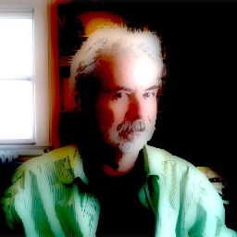
Questions, comments
Chet Ensign
Chief Technical Community Steward +1-973-996-2298 chet.ensign@oasis-open.org

