Slide 1
Securing Sensitive Data While Enhancing Privacy
Moderators: David Goodman and Joni Brennan
Panelists: John Tolbert, Gerry Gebel, Daniel Raskin, Michael Garcia, Karyn-Higa Smith, and Soren Peter Nielsen

Slide 2
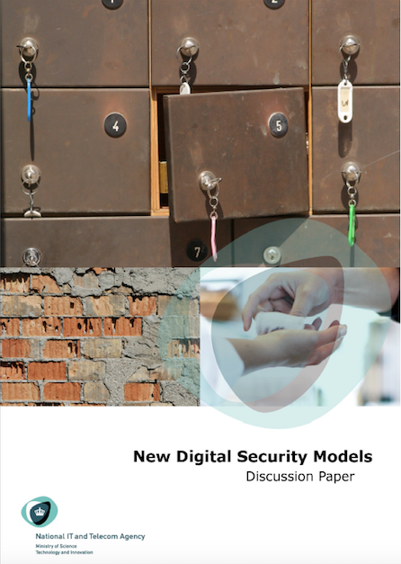
EU Data protection regulation
What’s on the table
Fines and enforcement
Territorial reach
Scope of personal data
Justifications for processing
Data protection officers
Security and breach notification
Processors and supply chain
Risk based
One stop shop mechanism
Profiling
Data portability
Right to be forgotten
International transfers
Privacy by design
Two avenues to security
Assurance-based security
Preventive security
from an identification paradigm to a validation paradigm
*) https://digitaliser.dk/resource/896495

Slide 3
Example: Loan application Pursuing the best interest rate
Tax Agency
Bank A
Bank B
Bank C
For Risk evaluation Banks want detailed information about the customer, including
SSN
Income
Assets
Debt
All or most of this data is held by the Tax Agency
Customer

Slide 4
Example: Loan application Traditional solution
Assurance-based security
Tax Agency
Bank A
Bank B
Bank C
2. SSN
3. Data
1.
Customer

Slide 5
Example: Loan application Alternate solution
Preventive security
Tax Agency
Bank A
Bank B
Bank C
2. Anonym. Tax Certificate
3. Anonym. Tax Certificate
1.
Only the necessary information about the user is disclosed.
Disclosure is done under the user s control.
User may perform transactions under a virtual identity
including not being identified unless strictly necessary.
Enabled through:
Attribute-based credentials
Transaction isolation and
Purpose-specific keys
Customer

Slide 6
”We need to know the users identity”
OK, as long as identity can be contextual
Entity
Person
Attribute 1
Attribute 2
Attribute 3
Identity A
Attribute 4
Identity B
Attribute 5
Attribute 6
.
.
.
Attribute n-1
Identity C
Attribute n
Requires context-based credentials

Slide 7
Attribute Based Credentials (ABC) and SAML credentials
Similarities
Collection of attributes with information about the holder (user) of the credential.
Cannot be forged or changed as it is protected by the issuers digital signature
May be revoked, and have an expiry date.
May only be used with a private (secret) key, which alone is known to the holder.
Additional ABC features
Do not directly reveals the holders identity
Not traceable back to the issuing process
Same ABC can be used a different service providers w/o SP ability to interconnect
Is technically not sent, but presented via a protocol, where the user proves it to contain certain attributes w certain values.
Selective disclosure - User has control over which attributes to reveal
Can have mechanism to ensure it only is used a certain number of times
Can sign w private key and attain integrity and non-repudiation
Verifiable encryption - Is possible for a user to send encrypted data to a service provider, and subsequently prove properties about them, without revealing the content

Slide 8
Using XACML for policies and access control – potential areas to consider
Specify which attributes Service Provider requires
Ability to handle access control w/o requiring ID and full set of attributes
Ability to bundle/link set of Attributes to a specific credential
Ability to prove condition instead of simply revealing attribute?
E.g. Do not send birth date when condition simply is > 18 years old

Slide 9
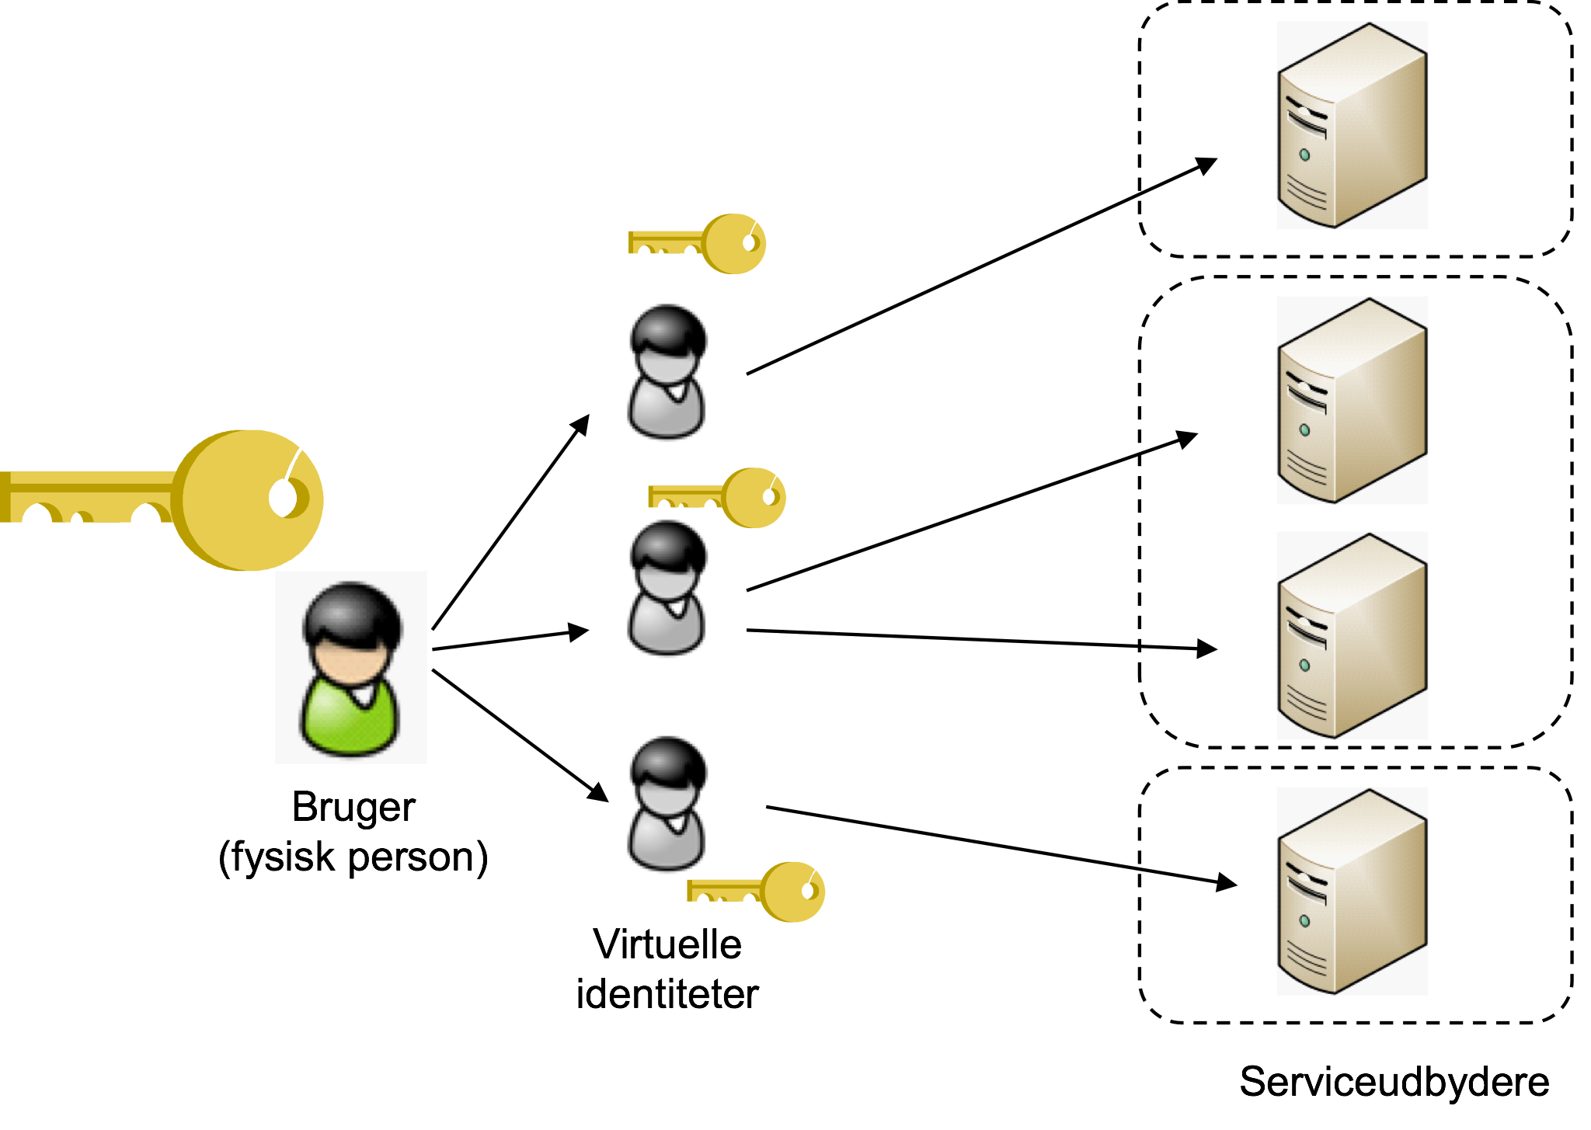
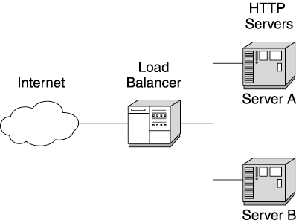
We need to have a more ”Architectural thinking” approach to identity

Slide 10
Securing Sensitive Data While Securing Consumer Privacy
Panel: Leveraging OASIS standards
6 May 2015
Karyn Higa-Smith
Program Manager Cyber Security Division
Homeland Security Advanced Research Projects Agency Science and Technology Directorate
https://www.youtube.com/watch?v=kydn6j31ATU
1
Notes:
I am a Program Manager at S&T under the Homeland Security Advance Research Projects Agency, Cyber Security Division, leading research in Identity and Access Management, and development of Data Privacy Technologies
http://www.dhs.gov/science-technology-directorate-mission-goals-and-objectives

Slide 11
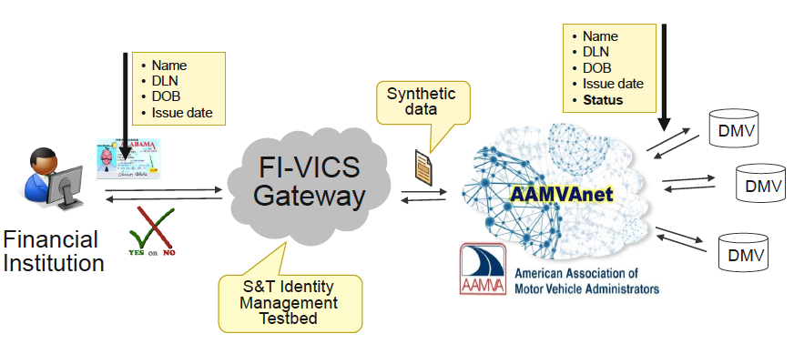
Verification of Identity Credentials Service

Slide 12
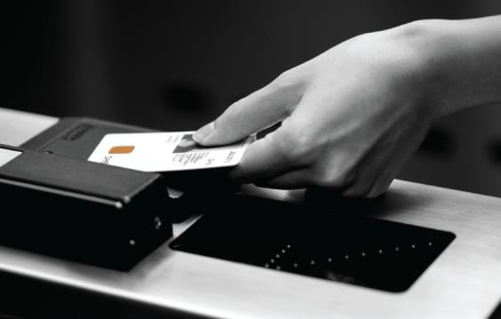
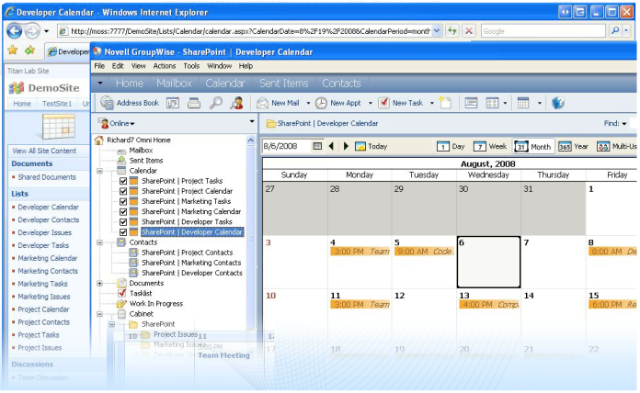
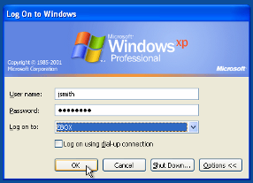
Converging Cyber and Physical Access Control Systems
Requirement for access control management using PIV and PIV-I
Interoperability testing at the S&T IdM Testbed
Test PACS against the “Logical” Policy Decision Point
PACS vendors to integrate software code based on the standard interfaces
XACML (Extensible Access Control Markup Language) - open standard access control policy language
1
Policy
Enforcement
Point
5
Requestor
2
4
Policy
Decision
Point
3
Notes:
Historically, PACS are not considered IT systems.
Working through the technical issues

Slide 13
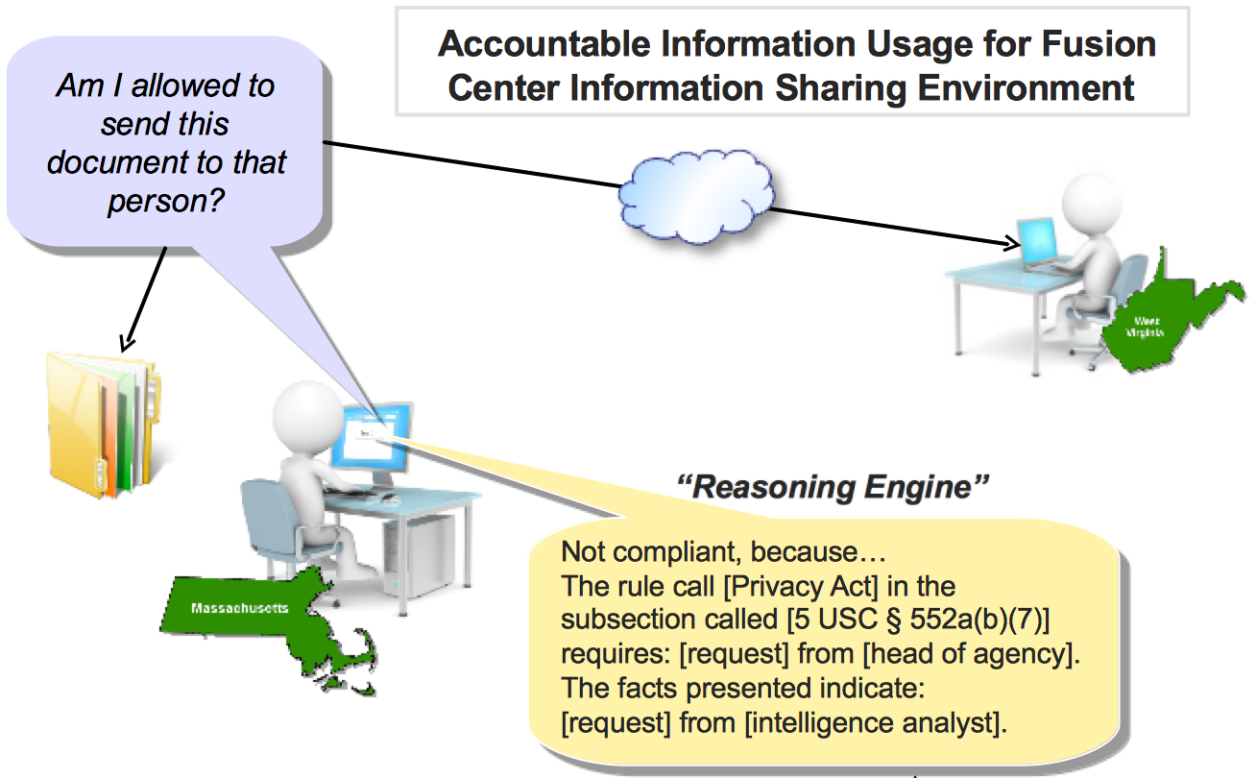
Privacy Laws and Regulations

Slide 14
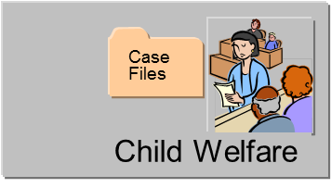
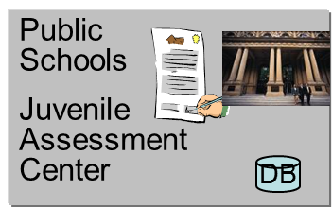
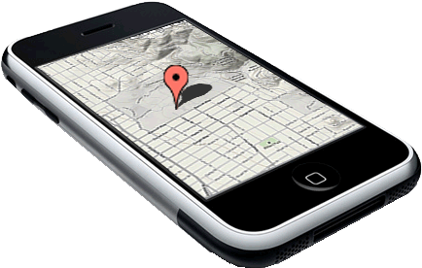
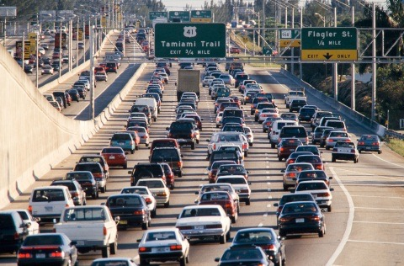
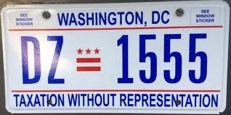
Privacy Laws and Policies
Identity, Privacy, Theft Protection
“Reasoning Engine”
Not compliant, because…
The rule call [Privacy Act] in the subsection called [5 USC § 552a(b)(7)] requires: [request] from [head of agency].
The facts presented indicate: [request] from [intelligence analyst].
First Responder
Doctor
Intel Analyst
Law Enforcement
Notes:
Robotic Aircraft for Public Safety (RAPS) may require face-blurring or anonymizing features.
As the technology continues to mature and develop, the privacy risks and concerns will increase.
Public perception of privacy rights:
Fourth Amendment
Warrant Requirement
Unreasonable Search & Seizure
The need to Identify and address privacy and civil liberties issues related to DHS uses of UAS by providing policies, procedures, and best practices.
Exchanging Protected Health Information (PHI)

Slide 15
Data Privacy Technical Topic Areas
Privacy Policy Compliance Tools
Automatic E-mail Encryption
OMB Data Extract Rule Compliance
Privacy-Preserving Federated Search
Privacy-preserving Information Sharing
Anonymous matching
Privacy-preserving Identity Matching methods
Enhancing Identity Matching Tools
Mobile Computing Privacy
Emerging privacy needs in the mobile space
Privacy data storage and usage
Homeland Security mission to preserve personally identifiable information: potential R&D efforts
Notes:
The topic areas with associated NIST 800-53 privacy controls
1. Technology examples: encryption, data tagging, tracking, and "mission impossible" data destruction
2. data tagging on pertinent information for a specific need and refrain from sharing unneeded data; tools may include access control, and policy administration tools
3. Seeking tools that assist organizations to do business with international partners and comply with the varying privacy policies. What are the privacy policies we can mutually agree on? An analogy of FAA/International Civil Aviation Org (ICAO) for air travel and having something similar for digital information moving across boarders.
3c. for purposes of identitifying individuals for entry/exit use-cases, matching while preserving identities. Seeking such tools that may also reduce identity theft and fraud
4. Privacy by Design, development mobile applications tools with privacy in mind (and not an after thought), point to the 7 principles developed by the privacy commissioner of ontario Canada
Workshop in February – Research Strategy
Jim Adler (use of data,
MS – Carrol
Katherine Tucker – MIT

Slide 16
An Economic Perspective
An Economic Perspective:
High search costs dominate the privacy landscape
Privacy isn’t dead, it’s just too expensive
Standards underlie the policy
Machine readability lowers costs, facilitates trust brokers; then the market can determine the goodness of any given policy
Convert uncertainty to risk
Risks are good; so let’s enable folks to determine which risks to take!

Slide 17
OAUTH
UMA
USER-CENTRIC
Sharing between the server and client-side apps on the same user's behalf
Consent occurs when an app asks if it's okay to have your data.
Enables revocation of consent between two connected apps.
Extends OAuth to authorize the sharing of my data with me and others
Proactively "push" sharing to someone else rather than simply consent when an app asks
Fine-grained controls through scopes
Applications receive entitlements, giving all the power back to the applications and making it easier to scale! (No such thing as a PEP/PDP.)
ORGANIZATION-CENTRIC
SAML
XACML
Use pseudonyms to link accounts from the IDP to the SP
SP doesn’t need to know exactly which user sits at the side of the IDP, the user can be represented by an pseudonym.
SAML and OAuth can be used together (e.g. – SAML login can be turned into an OAuth token)
Organization centric managed policies
Fine-grained policies
PEP/PDP Based Model -- All decisions at the shoulders of the PDP
UMA and XACML -- XACML's portable policy framework could be used w/ UMA so that people could take their policy from one system to another

Slide 18
Addressing Privacy Requirements with XACML
European Identity Conference May 2015
© 2014 Axiomatics AB

Slide 19
Privacy requirements vs. Business enablement
Business value is generated by sharing data
Privacy regulations introduce friction into the process
Multi national organizations also challenged with country specific privacy rules
Sectors such as financial services, insurance, healthcare, government, pharmaceuticals and others are heavily impacted
Legacy access control approaches often fail to meet requirements
Regulatory Compliance and Governance
© 2015 Axiomatics AB

Slide 20
What does XACML contain?
XACML
Reference
Architecture
Request / Response Protocol
Policy Language
© 2015 Axiomatics - @axiomatics

Slide 21
XACML policy language represents privacy rules
Its attribute-based model allows for very granular policy constructs
Attributes of the user, resource and environment can be incorporated
Conditions for allowing or denying access can be every simple or elaborate
Parents can see child’s bank info, but not vice versa
Bankers that are assigned to clients can see all data, bankers in the same office have a restricted view, bankers outside the country don’t see any data
Consent preferences can also be accommodated
Named doctors or bankers who can or cannot see my records
XACML policies determine access level and can also specify data masking
Obscure part or all of a particular data field when it is returned to the user/application
© 2015 Axiomatics - @axiomatics

Slide 22
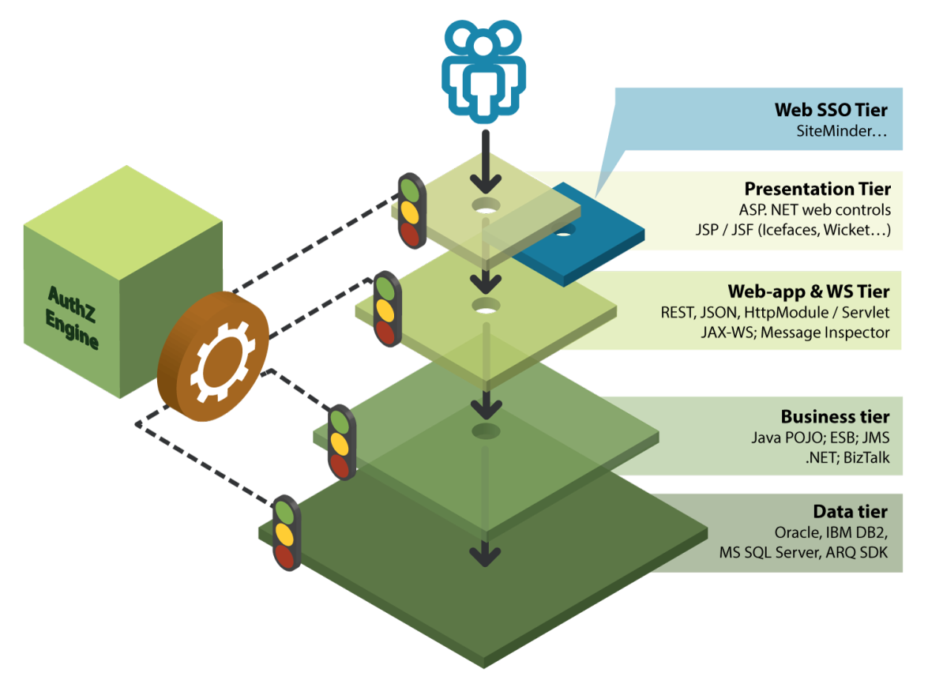
XACML enforces authorization rules at any layer
© 2014 Axiomatics AB

Slide 23
XACML Privacy Policy Profile
This is a very basic XACML profile
Cites OECD obligations for the custodian of private data
Defines two standard attributes
Purpose of use: determined/defined at time of data collection
Purpose of request: at run time, why is this data element being requested
© 2015 Axiomatics - @axiomatics

Slide 24
XACML & Privacy
Attribute Minimization
Don’t collect and store more personal information than is needed
Carefully write authorization policies
Would “age” work instead of “birthdate”?
Don’t transmit more attributes than required for policy evaluation
Encrypt all data at rest and in transit
XACML Admin/Delegation Profile
“PolicyIssuer” — can contain attributes and PKI certificates. Facilitates federated authorization.
“Situation” — attributes, targets, and rules to constrain when the policy or policies apply to a specific decision request
“Delegate” — authorized to write policies for specific situations
Just-in-time XACML policy delivery via SAML-XACML profile for policy evaluation in situ with subject attributes (to be used in conjunction with XACML A/D profile)
XACML decision as SAML assertion (can hide subject attributes)

Slide 25
Possible XACML innovations
Do not log PII XACML Obligation
XACML profile for Time-To-Live
Mimics SSO cookies
Promote interoperability with OAuth
Reduces AuthZ requests
OAuth (Issued) Scope as XACML policy
XACML Access-Permitted function as OAuth Grant / Access Token Response

